Slide 1

HEADACHE

Slide 2
Headaches are one of the most common neurological problems presented to GPs and neurologists. They are painful and debilitating for individuals, an important cause of absence from work or school and a substantial burden on society.
The World Health Organization estimates that 50% to 75% of all adults between the ages of 18 and 65 years have headaches
This high prevalence results in significant disability and lost productivity: headache disorders are the 3rd highest cause of years lost to disability worldwide

Slide 3
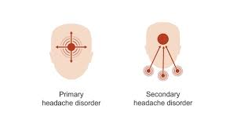
TWO MAJOR CATEGORIES
Primary headache disorders (those caused by the headache disorder itself, not due to other causes) and secondary headache disorders, those caused by ( or “symptomatic of”) another underlying medical problem

Slide 4
The pain can be due to the involvement of pain-sensitive structures in the head , including cranial nerves, cervical nerve roots, blood vessels, meninges, scalp, temporomandibular joint ( TMJ), teeth, pericranial and cervical muscles, and paranasal sinuses.

Slide 5

Patients may also have multifactorial headaches, so a detailed history and examination are necessary to identify the contributing factors

Slide 6
Key points from the history
When obtaining the history the following information must be elicited:
Onset
Precipitants and triggers
Duration
Location( unilateral or bilateral; frontal, lateral, vertex ,or occipital)
Quality and severity
Frequency
Alleviating and exacerbating factors
Positional influences ( better or worse when supine)
Waking the patient from sleep, or occurring upon awakening
Associated with menses
Associated symptoms
Additional aspects of the history important in evaluating a patient with headache are:
Analgesic use
Caffeine use
Medical history
Current or recent pregnancy
Medications( including asking specifically about contraceptive use, over-the –counter treatments, and supplements)
Social history, including detailed screening for illicit drugs
Family history
Sleep, including a history of insomnia and snoring, symptoms suggestive of obstructive sleep apnea

Slide 7

Evaluate people who present with headache and any of the following features, and consider the need for further investigations and/or referral:
Worsening headache with fever
Sudden‑onset headache reaching maximum intensity within 5 minutes
New‑onset neurological deficit
New‑onset cognitive dysfunction
Change in personality
Impaired level of consciousness
Recent (typically within the past 3 months) head trauma
Headache triggered by cough, valsalva
(trying to breathe out with nose and mouth blocked) or sneeze
Headache triggered by exercise
Orthostatic headache (headache that changes with posture)
Symptoms suggestive of giant cell arteritis
Symptoms and signs of acute narrow angle glaucoma
A substantial change in the characteristics of their headache.

Slide 8
Consider further investigations and/or referral for people who present with new‑onset headache and any of the following:
Compromised immunity, caused, for example, by HIV or immunosuppressive drugs
Age under 20 years and a history of malignancy
A history of malignancy known to metastasise to the brain
Vomiting without other obvious cause.

Slide 9
In the era of the smartphone, patients may bring pictures of themselves to a clinician for review if they have paroxysmal symptoms and signs( such as ptosis or lacrimation), which can aid in the diagnosis
Patients should have a general medical and neurological examination to assess for secondary causes of headache

Slide 10
Attention to vital signs is important: patients with significant hypertension may be susceptible to developing certain secondary headaches outlined below
Fever may suggest an underlying infection, including a CNS infection
A cardiovascular exam can evaluate for arrhythmia or carotid stenosis, which can cause secondary headache syndromes
A detailed head and neck exam includes evaluating for nuchal rigidity, cervical myofascial pain, occipital Tinel sign( evaluated by eliciting tenderness or tingling when palpating near the occipital protuberance along the occipital nerve), and palpation of the TMJ, assessment of dental wearing or chipping to suggest bruxism, and observing the oropharynx for narrowing that could suggest obstructive sleep apnea

Slide 11
A full neurological exam should also be performed, with emphasis on the funduscopic exam to assess for papilledema
The cortical sensory exam can suggest cortical dysfunction that may occur with venous sinus thrombosis
Focal neurological deficits, including field cuts, cranial nerve palsies, weakness, or sensory symptoms, often suggest a secondary headache

Slide 12
*some neurologists use the term trigeminal autonomic cephalgia to group a number of conditions including cluster headache, paroxysmal hemicrania and short-lived unilateral neuralgiform headache with conjunctival injection and tearing (SUNCT). It is recommended such patients are referred for specialist assessment as specific treatment may be required, for example it is known paroxysmal hemicrania responds very well to indomethacin
Condition | Notes
Migraine | Recurrent, severe headache which is usually unilateral and throbbing in nature May be be associated with aura, nausea and photosensitivity Aggravated by, or causes avoidance of, routine activities of daily living. Patients often describe 'going to bed'. In women may be associated with menstruation
Tension headache | Recurrent, non-disabling, bilateral headache, often described as a 'tight-band' Not aggravated by routine activities of daily living
Cluster headache* | Pain typical occurs once or twice a day, each episode lasting 15 mins - 2 hours with clusters typically lasting 4-12 weeks Intense pain around one eye (recurrent attacks 'always' affect same side) Patient is restless during an attack Accompanied by redness, lacrimation, lid swelling More common in men and smokers

Slide 13
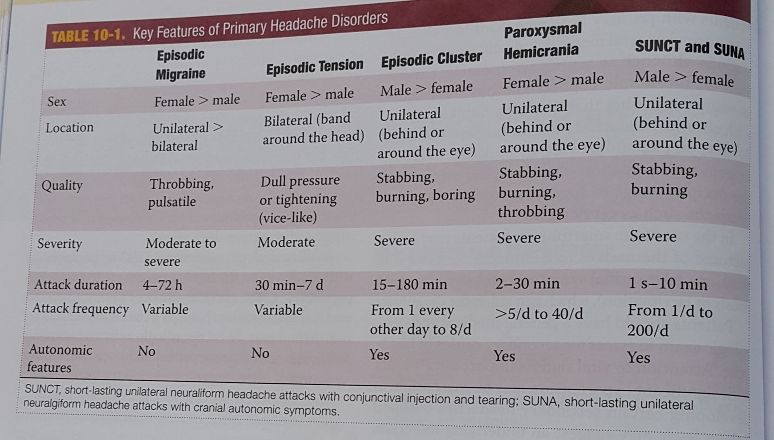

Slide 14
Temporal arteritis | Typically patient > 60 years old Usually rapid onset (e.g. < 1 month) of unilateral headache Jaw claudication (65%) Tender, palpable temporal artery Raised ESR
Medication overuse headache | Present for 15 days or more per month Developed or worsened whilst taking regular symptomatic medication Patients using opioids and triptans are at most risk May be psychiatric co-morbidity

Slide 15
Other causes of headache
Acute single episode
Meningitis
Encephalitis
Subarachnoid haemorrhage
Head injury
Sinusitis
Glaucoma (acute closed-angle)
Tropical illness e.g. Malaria
Chronic headache
Chronically raised ICP
Paget's disease
Psychological

Slide 16
TENSION-TYPE HEADACHE
Tension-type headache ( often referred to as tension headaches, stress headaches, or ordinary headaches) are the one of the most prevalent primary headache disorders, occurring in 30% to 70% of adults worldwide
Pain is usually bilateral and described as pressure or tightness
It is usually mild to moderate and lasts for under an hour to several days
Unlike migraine, it is not associated with photophobia, phonophobia, nausea, or vomiting
The examination is generally normal , but some patients have pericranial tenderness to palpation of the scalp, neck, or shoulder muscles

Slide 17
Interestingly, patients with infrequent tension-type headaches generally do not seek medical attention, because they do not have significant disability from their symptoms
Patients with frequent or chronic tension-type headaches benefit from treatment

Slide 18
Tension-type headache treatment
1. Abortive treatments
Many patients with tension headaches do not require abortive treatments because the pain is generally mild and does not interfere with the patient’s functioning
For those with moderate to severe pain, NSAIDs are the mainstay of treatment
Aspirin and acetaminophen may also be used, but the latter is often less effective than NSAIDs
Patients should be counseled about the development of MOH and advised to not use analgesics more than twice a week for long periods

Slide 19
2. Preventive treatments
Antidepressants are the first-line preventive therapy for chronic tension headache
The tricyclic amitryptiline is the most studied to date and has good evidence for efficacy
Other antidepressants , including mirtazapine and venlafaxine are second-line therapies
Muscle relaxants such as tizanidine are helpful sometimes, particularly in patients with a cervicogenic component

Slide 20
3. Adjuvant treatments
Tension headaches are often reported to be triggered by stress (physical or emotional); addressing these triggers, if chronic, is important
Biofeedback ( a mind-body technique used to teach patients greater body awareness and how to control some physical reactions to pain and stress) can be effective
Poor posture and neck muscle spasm are also frequent contributors to chronic tension-type headaches, and physical therapy can help

Slide 21
Migraine
The International Headache Society has produced the following diagnostic criteria for migraine without aura:
Point | Criteria
A | At least 5 attacks fulfilling criteria B-D
B | Headache attacks lasting 4-72 hours* (untreated or unsuccessfully treated)
C | Headache has at least two of the following characteristics: 1. unilateral location* 2. pulsating quality (i.e., varying with the heartbeat) 3. moderate or severe pain intensity 4. aggravation by or causing avoidance of routine physical activity (e.g., walking or climbing stairs)
D | During headache at least one of the following: 1. nausea and/or vomiting* 2. photophobia and phonophobia
E | Not attributed to another disorder (history and examination do not suggest a secondary headache disorder or, if they do, it is ruled out by appropriate investigations or headache attacks do not occur for the first time in close temporal relation to the other disorder)

Slide 22
Migraine
  It is estimated that 1 in 7 adults worldwide has migraine
  It impacts women more than men in a 2:1 ratio
  Migraine headaches are most likely to develop in adolescence and early adulthood
  They can be episodic or chronic
  Migraine has numerous identified triggers, including weather changes, menses and caffeine( both withdrawal and overuse)
  Many patients identify foods and drinks such as alcohol( most commonly red wine), soft cheeses, and nitrite-heavy foods, such as processed meats, as precipitants, but data are sparse in this area and many migraine attacks occur without identifiable triggers

Slide 23
Migraine
  Migraine with aura (seen in around 25% of migraine patients) tends to be easier to diagnose with a typical aura being progressive in nature and may occur hours prior to the headache. Typical aura include a transient hemianopic disturbance or a spreading scintillating scotoma ('jagged crescent'). Sensory symptoms may also occur
  Auras may occur with or without headache and:
  Are fully reversible
  Develop over at least 5 minutes
  Last 5-60 minutes

Slide 24
The following aura symptoms are atypical and may prompt further investigation/referral;
  motor weakness
  double vision
  visual symptoms affecting only one eye
  poor balance
  decreased level of consciousness.

Slide 25
Patients with migraine with aura have an increased cardiovascular risk when compared to healthy controls
The use of oestogen-based contraceptives is therefore contraindicated in patients with migraine with aura, as the combination results in a substantially increased stroke risk

Slide 26
Management
Acute treatment
First-line: offer combination therapy with
  an oral triptan (serotonin 1b/1d agonists) and an NSAID, or
  an oral triptan and paracetamol
For young people aged 12-17 years consider a nasal triptan in preference to an oral triptan
If the above measures are not effective or not tolerated offer a non-oral preparation of metoclopramide or prochlorperazine and consider adding a non-oral NSAID or triptan
Triptans are currently not known to be safe in pregnancy and have a cardiovascular risk
Caution should be exercised when prescribing metoclopramide to young patients as acute dystonic reactions may develop

Slide 27
Triptans also interact with selective serotonin reuptake inhibitors and serotonin-norepinephrine reuptake inhibitors , with a low risk of serotonin syndrome
Patients must be counseled on side effects of all treatments
Identifying the right abortive treatment requires careful consideration of the patient’s headache features , comorbidities, concurrent medication use, cost, and family planning goals
Using abortive treatments on a chronic basis more than twice a week can result in medication overuse headache (MOH), so patients should be counseled to not use any of these treatments chronically more than twice a week to prevent this complication

Slide 28
Prophylaxis
Prophylaxis should generally be given if 'Migraine attacks are having a significant impact on quality of life and daily function, for example they occur frequently (more than once a week on average) or are prolonged and severe despite optimal acute treatment'
Options:
  Propranolol
  Topiramate: should be avoided in women of childbearing age as it may be teratogenic and it can reduce the effectiveness of hormonal contraceptives
  Amitriptyline
For women with predictable menstrual migraine treatment NICE recommend either frovatriptan (2.5 mg twice a day) or zolmitriptan (2.5 mg twice or three times a day) as a type of 'mini-prophylaxis‘
Monoclonal antibodies directed against the calcitonin gene-related peptide (CGRP) receptor: examples include erenumab

Slide 29
In addition to oral therapies, onabotulinum toxin A ( often referred to simply as Botox) was also approved as migraine prophylaxis for chronic migraine in 2010

Slide 30
Lifestyle modifications
Lifestyle factors are important to identify
A comorbid sleep disorder ( insomnia, obstructive sleep apnea …) makes patients more susceptible to migraine
Skipping meals, insufficient fluid, excessive caffeine intake, and lack of exercise make susceptible patients more prone to migraine attacks
Patients should be counseled on these factors

Slide 31
Cluster headache
Cluster headaches are known to be one of the most painful conditions that patients can have the misfortune to suffer. The name relates to the pattern of the headaches - they typically occur in clusters lasting several weeks, with the clusters themselves typically once a year.
Cluster headaches are more common in men (3:1) and smokers. Alcohol may trigger an attack and there also appears to be a relation to nocturnal sleep. Histamines, and nitroglycerine are triggers in susceptible patients

Slide 32
Features
Intense sharp, stabbing pain around one eye. Pain typical occurs once or twice a day, each episode lasting 15 mins - 2 hours
The patient is restless and agitated during an attack due to the severity
Clusters typically last 4-12 weeks accompanied by redness, lacrimation, lid swelling nasal stuffiness miosis and ptosis in a minority
Investigations
Most patients will have neuroimaging - underlying brain lesions are sometimes found even if the clinical symptoms are typical for cluster headache
MRI with gadolinium contrast is the investigation of choice

Slide 33
Management
NICE recommend seeking specialist advice from a neurologist if a patient develops cluster headaches
Acute
100% oxygen (80% response rate within 15 minutes)
Subcutaneous triptan (75% response rate within 15 minutes)
Prophylaxis
  Verapamil is the drug of choice
  There is also some evidence to support a tapering dose of prednisolone

Slide 34
Some neurologists use the term trigeminal autonomic cephalgia to group a number of conditions including cluster headache, paroxysmal hemicrania and short-lived unilateral neuralgiform headache with conjunctival injection and tearing (SUNCT). It is recommended such patients are referred for specialist assessment as specific treatment may be required, for example it is known paroxysmal hemicrania responds very well to indomethacin

Slide 35
SECONDARY HEADACHE DISORDERS
Secondary headache disorders are headaches caused by a medical condition or medication
They have a broad differential for causes, ranging from preeclampsia and pheochromocytoma to fever and medication side effects
Most secondary headache disorders are associated with other features in the history, examination, or laboratory assessment, which aid in the diagnosis
Treatment is based on addressing the underlying disorder
There are 6 major categories of secondary headaches that may present with headache only and must be considered

Slide 36
Vascular causes
There are numerous vascular causes of headache
All cerebral hemorrhages can cause headache
This includes subarachnoid hemorrhage( SAH) , intraparenchymal hemorrhage, and subdural and epidural hematomas
These hemorrhages may be spontaneous ( associated with stroke or hypertension) or traumatic

Slide 37
Patients with intracerebral hemorrhages typically present with what is referred to as thunderclap headache; the onset is abrupt and severe
Emergency imaging , usually with a noncontrast CT Brain scan, is needed to evaluate abrupt-onset headache( figure)
Cerebral vessel imaging is also warranted if a SAH is identified , to assess for an aneurysm
Their semiology is nonspecific, but typically abrupt in onset
Patients may have focal neurologic deficits which aid in the diagnosis

Slide 38
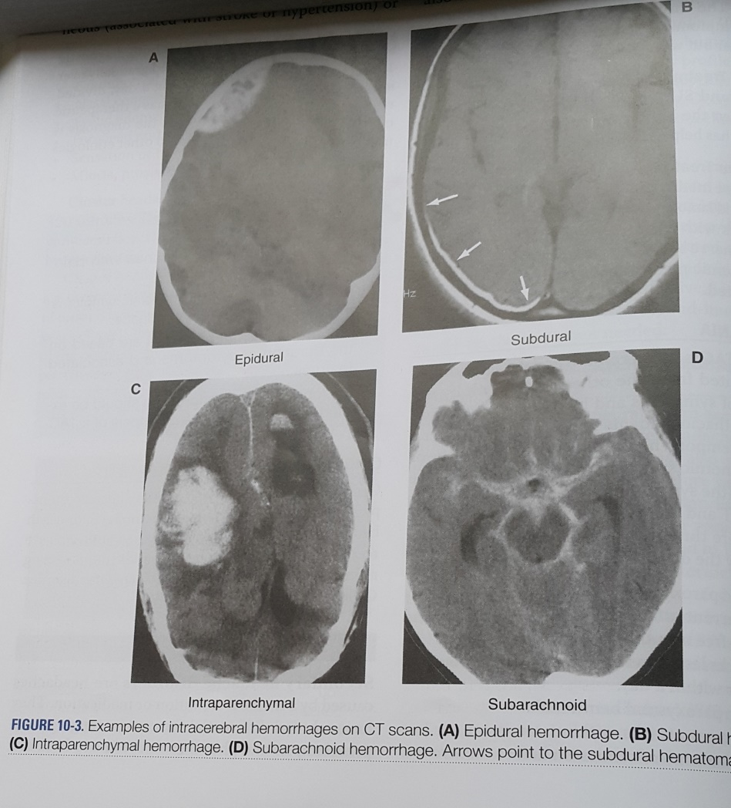

Slide 39
Cerebral thrombosis, either arterial or venous, can also cause headache
Patients with venous sinus thrombosis often have headaches with features of increased intracranial pressure ( ICP)
Thrombosis should be considered particularly in patients with hypercoagulability states, including pregnancy
The diagnosis is made on imaging, including that of cerebral vessels (figure)

Slide 40
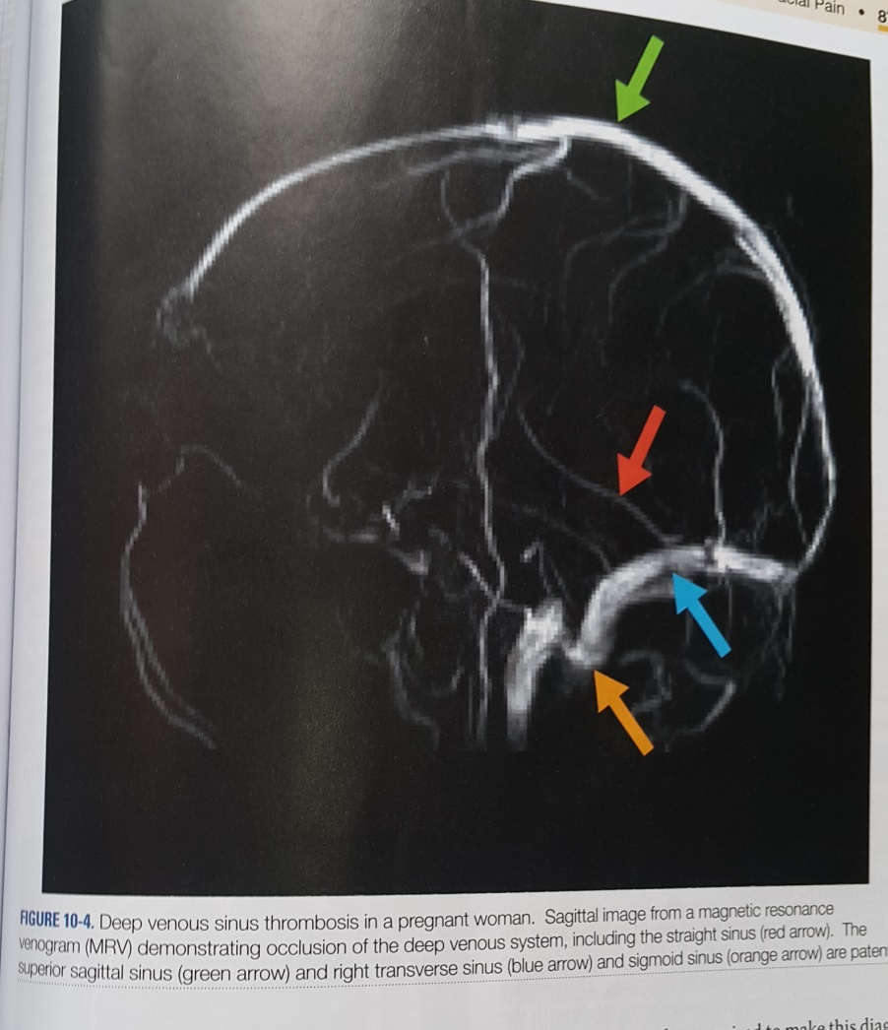

Slide 41
Giant cell arteritis ( GCA) ,
also called temporal arteritis, is a peripheral cranial arterial vasculitis that often presents with unilateral headache
Patients are generally above the age of 50 and report additional symptoms including vision changes( amaurosis fugax), jaw claudication, fever, and scalp tenderness
Involvement of the branches of the external carotid artery, and occasionally the ophthalmic artery, can result in blindness if not readily identified and treated promptly
Patients usually have elevated inflammatory markers( erythrocyte sedimentation rate and C-reactive protein)
Empiric steroids should be started in any patient with a high clinical concern
Temporal artery biopsy is the gold standard, but GCA can cause “ skip lesions” and may require serial biopsies to identify the pathology

Slide 42
2. Infectious or inflammatory:
Intracranial infections , such as encephalitis and meningitis, usually present with headache and often fever
They may also have nuchal rigidity and altered mental status
As the infection progresses , seizures and focal neurological deficits may occur
Infections can be bacterial, viral , fungal, or parasitic; the headache semiology does not help to differentiate the underlying cause

Slide 43
LP is the crucial diagnostic test and necessary in any patient for whom there is concern for a CNS infection
There are often other signs of infection, and the headache has a temporal correlation to the infection
CNS inflammatory and autoimmune conditions such as sarcoidosis and lupus frequently present with headache

Slide 44
3. Neoplastic causes
Intracranial neoplasms may present with headaches, especially when there is significant mass effect
The headache semiology may be nonspecific but may have features of intracranial hypertension, including wakening the patient from sleep , being worse when supine, and worse with Valsalva maneuver
The headache may occur early or late with neoplasms and with any type of primary cancer

Slide 45
4. Traumatic causes
Head and neck injuries often result in headache
To be attributed to trauma, the headache must develop with a temporal association with the injury
The severity of the injury does not necessarily correlate with the severity of the headache; even minor head injuries or whiplash may cause headaches
There is no specific headache semiology that helps with the diagnosis
In patients with a history of significant head or neck injury, it is
important to assess for intracranial hemorrhage or dissection of cervical vessels- which may require additional treatment

Slide 46
5. Intracerebral pressure disorders
Intracranial hypertension and hypotension can cause headaches, but with markedly different semiologies
A) Intracranial hypertension
Intracranial hypertension may be “ idiopathic”( most common in obese young woman) or due to medications or systemic disorders
The headache is often described as worse when supine or sleeping
( awakening the patient from sleep) , or with Valsalva maneuver
Patients often have associated features , including papilledema, pulsatile tinnitus, or visual symptoms

Slide 47
Patients should have imaging to exclude a mass lesion or venous sinus thrombosis
If the imaging is unrevealing , the diagnosis is made with an LP when the patient is in the lateral decubitus position with legs extended
Intracerebral pressure ( ICP) is elevated above 200 mm CSF
Acetazolamide is the first-line treatment for idiopathic intracranial hypertension ( IIH)
Patients require monitoring of their visual fields, and treatment for obesity is warranted when present

Slide 48
B) Intracranial hypotension
Intracranial hypotension may be spontaneous or traumatic
The headache improves when the patient is supine but worsens with standing
The pain is often most severe at the vertex and can be associated with neck pain or tinnitus
It is frequently traumatic- occurring after an attempted epidural puncture or LP
Generally, the dural leak causing the headache heals gradually, without intervention,but when symptoms persist or when the headache etiology is unclear, brain MRI may be helpful ;it may show evidence of sagging( figure)

Slide 49
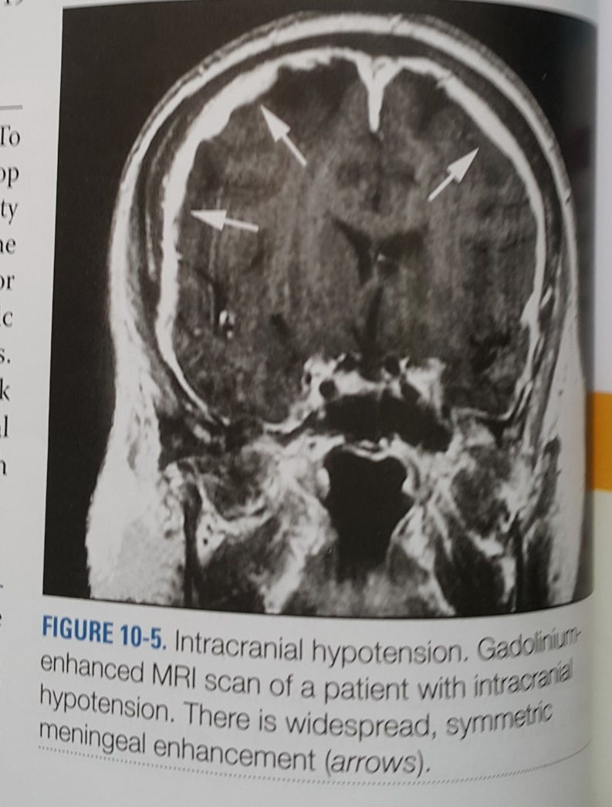

Slide 50
The definitive diagnosis is made with an LP showing an opening pressure below 60 mm CSF
If a patient remains symptomatic from intracranial hypotension, a blood patch may be attempted to cover the dural leak( if it can be found)

Slide 51
6. Medication causes
Medications associated with headaches are numerous
They range from hormonal therapies, including contraceptives, to nitric oxide
Withdrawal of a medication or other treatment may also cause a headache; the most common example is a caffeine withdrawal headache
Headache semiology is nonspecific, but the temporal association to medication change helps establish the diagnosis

Slide 52
Head and neck disorders
There are many different structural disorders that can cause headache
Treatments are based on the specific causes identified, and these disorders may occur simultaneously with other primary or secondary headache disorders
Sinusitis is commonly associated with a headache
It may be bifrontal or unilateral
Acute sinusitis is often associated with other symptoms of a respiratory tract infection

Slide 53
Temporomandibular joint disorder ( TMD) is another common cause of headache and may be unilateral or bilateral
On exam, there may be evidence of dental wearing( chipped and flattened teeth) and discomfort on palpation of the joint
Cervicogenic headaches are also common and may be identified by palpation of myofascial trigger points in the neck
Cervical range of motion is often reduced

Slide 54
Trigeminal neuralgia
The pain of trigeminal neuralgia is shock-like, occurring in one or all branches of the trigeminal nerve
The pain is usually paroxysmal and recurrent
It may be triggered by common activities such as brushing hair or teeth
It may be idiopathic or due to structural causes such as a mass or vascular lesion, or a demyelinating lesion of multiple sclerosis
Carbamazepine is a common first-line treatment

Slide 55
SUMMARY
Migraines, tension headaches, and TACs are the 3 most common types of primary headache disorders
The International Headache Society maintains an evidence-based categorization of primary and secondary headache disorders
If a headache history and pattern is not consistent with a primary headache disorder, the clinician should consider a secondary headache disorder, review the rare types of primary headache disorders, or consider that the headache may be a combination of more than one headache disorder

