Slide 1
Cerebrovascular diseases
Neurology Rotation
Fourth Year Medical Students

Slide 2
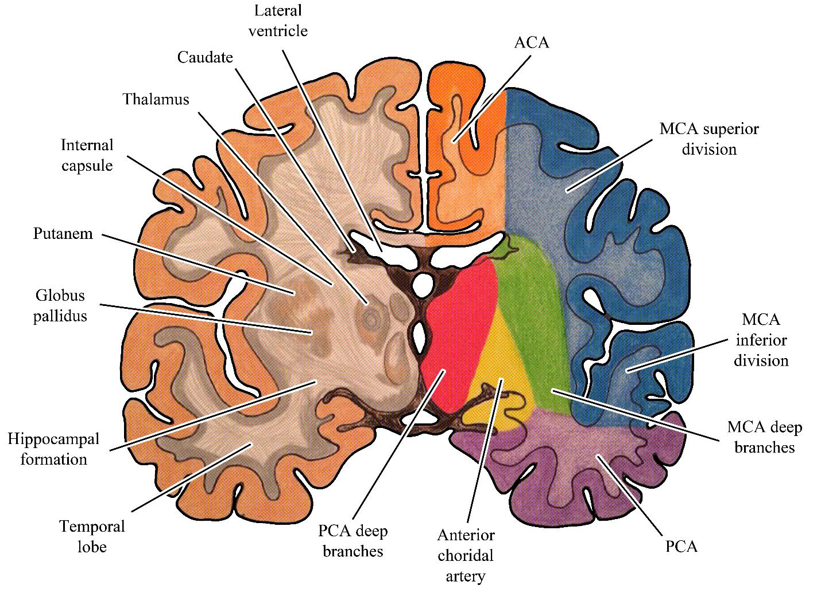
Vascular Anatomy
The cerebral vasculature is divided into the anterior and posterior circulation , with the anterior ( carotid) circulation supplying the cerebral hemispheres except the medial temporal lobes and a portion of the occipital lobes, and the posterior ( vertebrobasilar) circulation supplying the brainstem, thalami, cerebellum and the posterior portion of the cerebral hemispheres

Slide 3
A) Anterior circulation
The right common carotid artery ( CCA) branches from the innominate artery. The left CCA arises directly from the aorta.
The CCA divides in the neck into the internal carotid artery ( ICA) and the external carotid artery.
The ICA travels behind the pharynx , entering the skull where it forms an S-shaped curve –the carotid siphon.
This portion of the ICA gives rise to the ophthalmic artery.
The ICA then penetrates the dura and gives off the anterior choroidal and posterior communicating arteries before bifurcating into the anterior cerebral ( ACA) and middle cerebral arteries ( MCA).

Slide 4
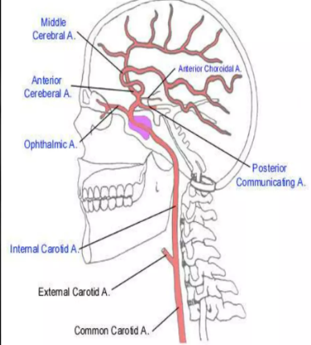
The ACA supplies the anterior medial cerebral hemispheres , the caudate nuclei and the basal frontal lobes.
The anterior communicating artery connects the two ACAs.
The MCA courses laterally , giving off lenticulostriate artery branches to the basal ganglia and internal capsule.
The MCA trifurcates into small anterior temporal branches and large superior and inferior divisions.
The superior division supplies the lateral cerebral hemispheres superior to the sylvian fissure, whereas the inferior division supplies the temporal and inferior parietal lobes.

Slide 5
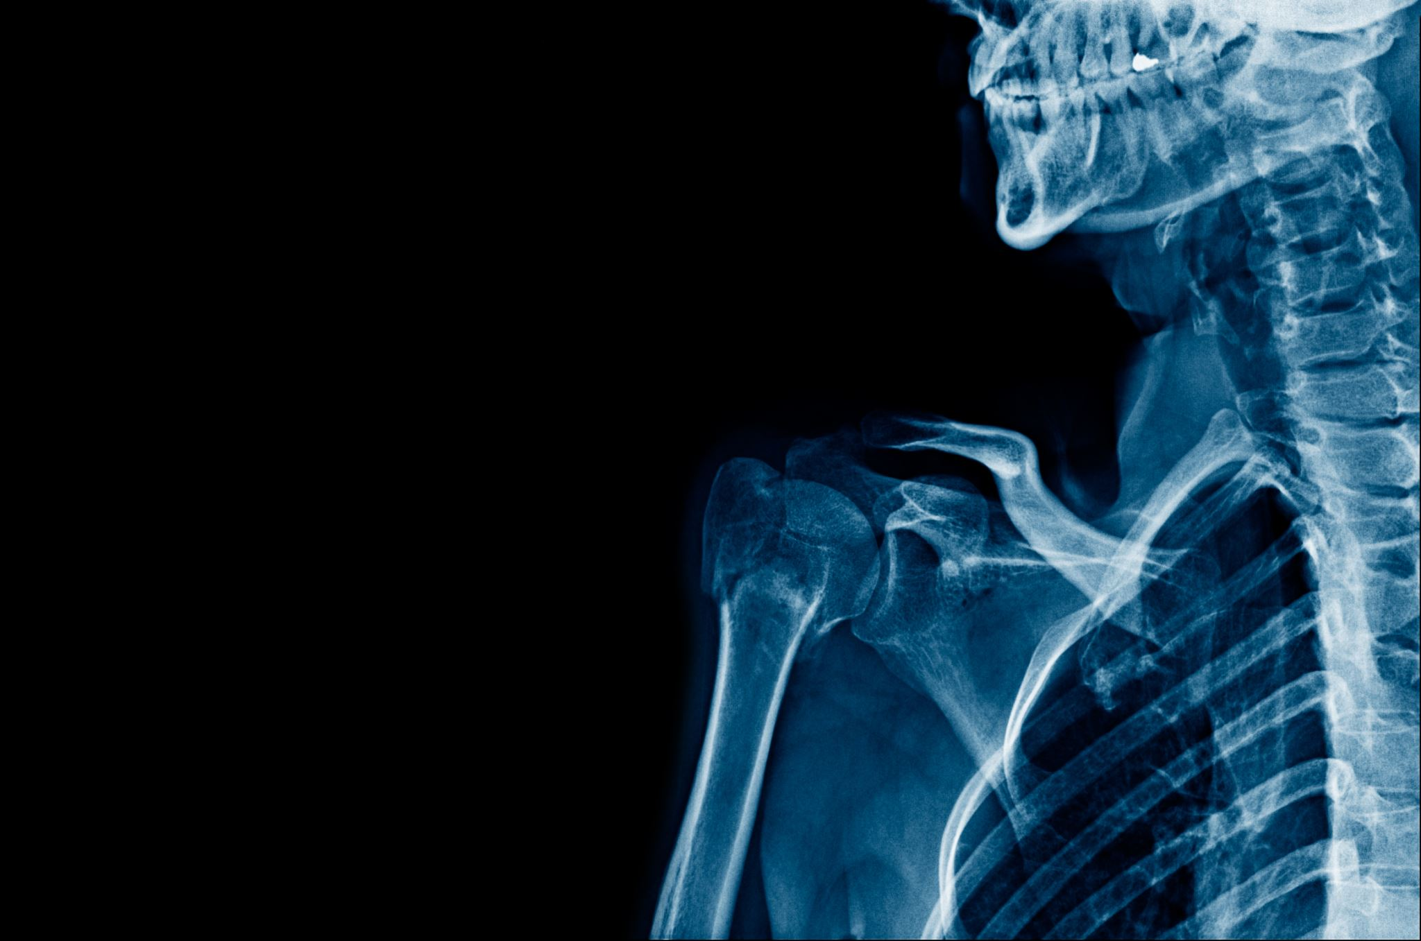
B) Posterior circulation
The first branch of each subclavian artery is the vertebral artery ( VA).
The VA enters the spinal column via the transverse foramina of C5 or C6 and runs within the intervertebral foramina, exiting to course behind the atlas before piercing the dura mater to enter the foramen magnum.
The intracranial VAs join to form the basilar artery at the ponto-medullary junction.

Slide 6
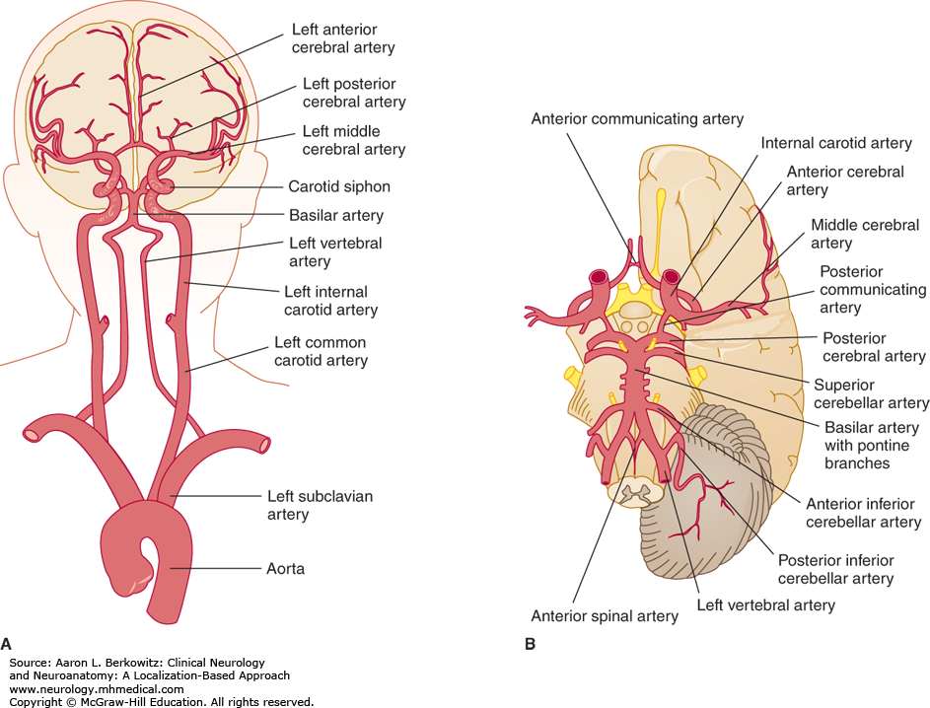

Slide 7
The intracranial VA gives off posterior and anterior spinal artery branches, penetrating arteries to the medulla and the posterior inferior cerebellar artery ( PICA).
The basilar artery then runs in the midline along the clivus giving off bilateral anterior inferior cerebellar artery ( AICA) and superior cerebellar artery ( SCA) branches before dividing at the Ponto mesencephalic junction into the posterior cerebral arteries (PCA).
Small penetrating arteries arise at the basilar artery bifurcation to supply the medial portions of the midbrain and thalami.

Slide 8
The vascular supply of the brainstem includes large paramedian arteries and smaller, short circumferential arteries that penetrate the basal portion of the brainstem into the tegmentum.
Long circumferential arteries course around the brainstem and give off branches to the lateral tegmentum.
The PCA gives off penetrating arteries to the midbrain and thalamus, courses around the cerebral peduncles and then supplies the occipital lobe and the inferior surface of the temporal lobe.

Slide 9
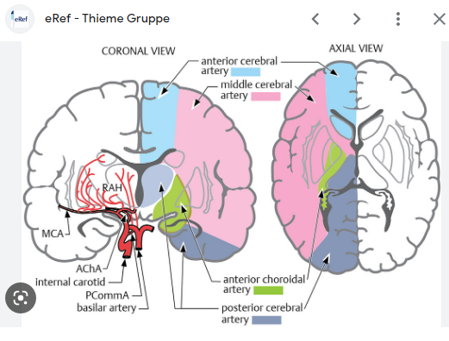
The circle of Willis connects the anterior circulation of each side through the anterior communicating artery, and the posterior and anterior circulation of each side through the posterior communicating artery.
Each carotid artery supplies four-fifths of the brain, the vertebrobasilar circulation, one-fifth

Slide 10
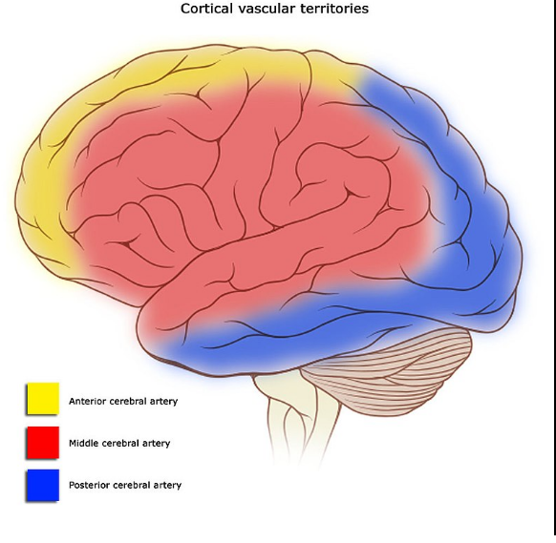

Slide 11
Strokes are a life-threatening emergency, and immediate medical attention is critical to prevent permanent damage or death.
The World Health Organization (WHO) defines stroke as “rapidly developing clinical signs of focal (or global) disturbance of cerebral function, with symptoms lasting 24 hours or longer or leading to death, with no apparent cause other than vascular origin”
Definition
of Stroke

Slide 12
There are three main types of ischemic stroke:
1) Thrombotic strokes: caused by a blood clot that forms in an artery that supplies blood to the brain, also called an atherosclerotic stroke. It affects mostly the large cervical and intracranial arteries. Less commonly a clot forms within the lumen due to a primary hematological disease ( Polycythemia, Essential thrombocytosis or hypercoagulability).
Vessel wall pathologies leading to thrombosis include vasoconstriction, fibromuscular dysplasia and arterial dissection.
Thrombosis of penetrating intracranial arteries is most often the consequence of hypertension, with hypertrophy of the media and deposition of fibrinoid material( lipohyalinosis) .
Types
of ischemic stroke

Slide 13
2) Embolic strokes: When a clot forms somewhere else in the body and travels through the blood vessels to the brain. It gets stuck there and stops the flow of your blood. The material arises proximally, mostly from the heart or from major arteries such as the aorta, ICAs and VAs and from systemic veins. Atrial fibrillation increases the risk of clots forming in the heart that can then travels to the brain.
Cardiac sources of embolism include the heart valves, endocardium and clots or tumors within the atrial or ventricular cavities.
Thrombi originating in systemic veins travel to the brain through cardiac defects such as an atrial septal defect or a patent foramen ovale, a process termed paradoxical embolism.
Occasionally, air, fat, cholesterol crystals, bacteria and foreign bodies enter the vascular system and embolize to brain vessels.
Types
of ischemic stroke

Slide 14
3) Systemic hypoperfusion
Decreased blood flow to brain tissue may be caused by low systemic perfusion pressure .
The most common causes are cardiac pump failure( most often due to myocardial infarction or arrhythmia) and systemic hypoperfusion ( due to blood loss or hypovolemia).
The lack of perfusion is more generalized than in localized thrombosis or embolism and affects brain diffusely and bilaterally.
Poor perfusion is most critical in border zone or so-called watershed regions at the periphery of the major vascular supply territories, for example, between the ACA and MCA or between the MCA and PCA.
Types
of ischemic stroke

Slide 15
Age over 60 years old
History of hypertension, heart diseases, hyperlipidemia, or diabetes.
Arrythmia
Smoking History
Family history of strokes
Risk factors
of ischemic stroke
Complications of ischemic strokes include Permanent weakness, Seizures and Vascular Dementia

Slide 16
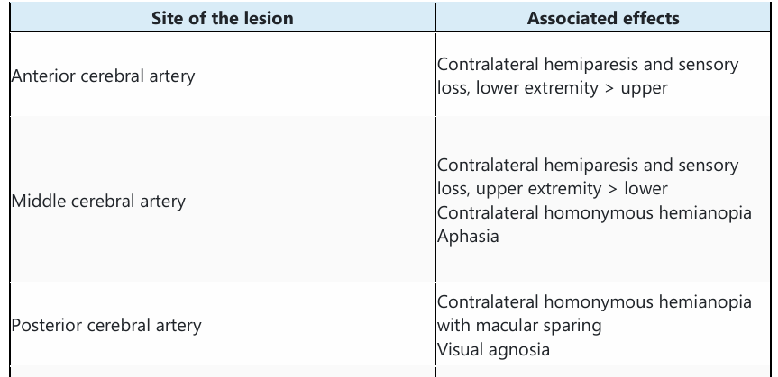
Classification of Ischemic Stroke by Anatomy

Slide 17
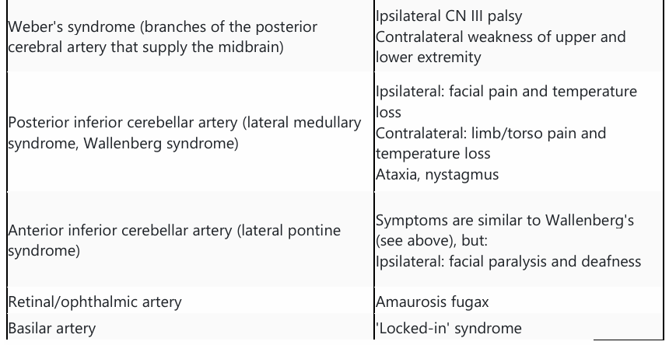

Slide 18
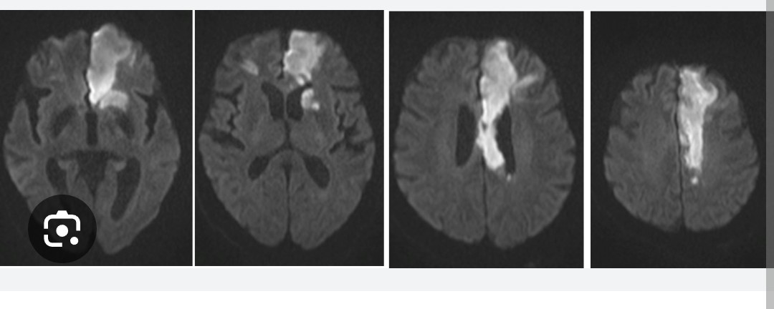

Slide 19
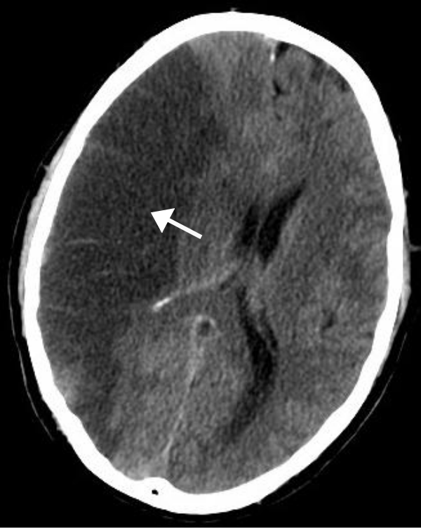

Slide 20
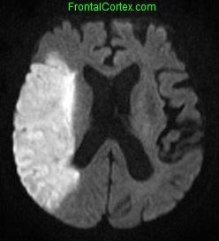
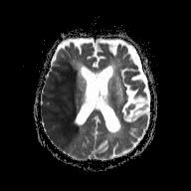

Slide 21
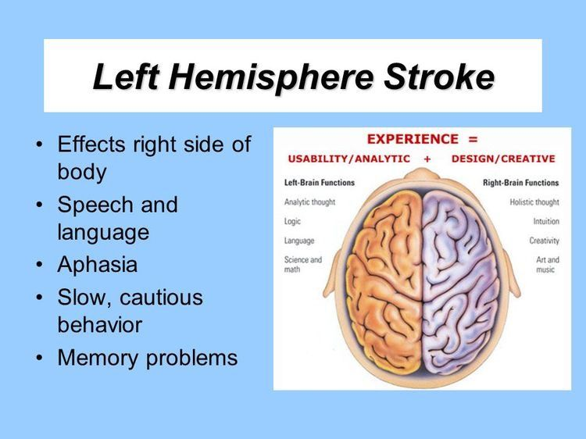
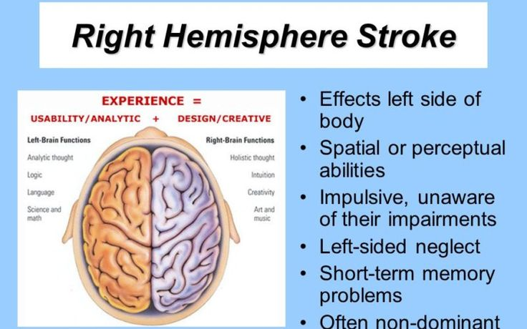
Common Ischemic Stroke Syndromes
Anterior Circulation: Left/Right cerebral hemisphere lesions are most often caused by carotid artery occlusion, embolism to the MCA or its branches or basal ganglionic intracerebral hemorrhages.

Slide 22

Posterior circulation:
1. Lateral medullary stroke ( Wallenberg syndrome, usually due o intracranial VA or posterior inferior cerebellar artery/ PICA occlusion)
2. Bilateral pontine base and often medial tegmentum stroke( usually due to basilar artery occlusion or pontine hemorrhage) causes:
Quadriparesis
Unilateral or bilateral conjugate gaze paresis; sometimes internuclear ophthalmoplegia or 6th nerve palsy
When the medial tegmentum is involved bilaterally, coma.
3. Cerebellar infarction ( usually due to embolism to the PICA or SCA, or cerebellar hemorrhage) causes:
Gait ataxia
Dysarthria
Ipsilateral arm dysmetria

Slide 23
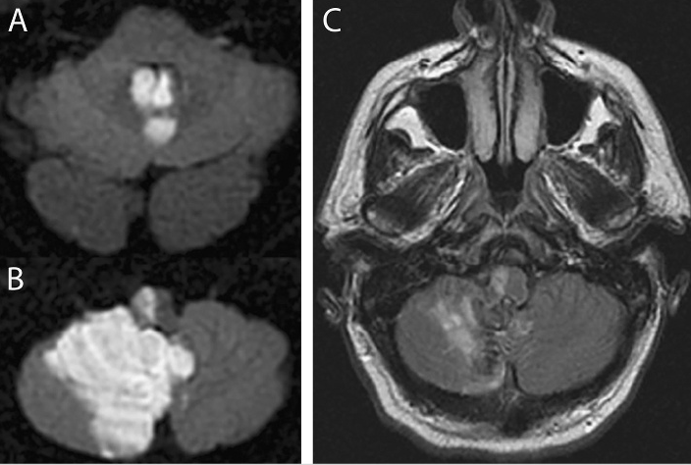

Slide 24
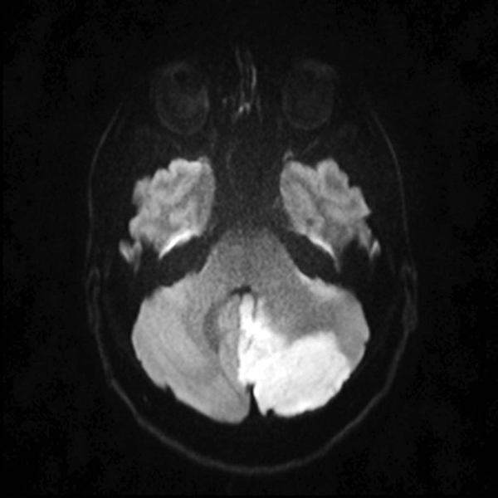

Slide 25
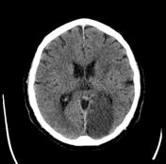
4. Left PCA territory stroke causes:
Right homonymous hemianopia
b) At times, amnesia
c) Alexia (disorder of reading) without agraphia when the splenium of the corpus callosum is involved
5. Right PCA territory stroke causes:
Left homonymous hemianopia
b) At times, left-sided visual neglect
PCA territory infarcts are most often caused by embolism arising from the heart, aorta or VAs

Slide 26
Lacunar syndromes
Lacunar strokes are most often due to occlusion of a penetrating artery. Lacunar strokes may occur in either the anterior or the posterior circulations.
Pure motor stroke: Weakness of the contralateral arm, face and leg without sensory, visual or cognitive/behavioral signs. Common locations include the corona radiata, posterior limb of the internal capsule and pons.
2. Pure sensory stroke: Paresthesia of the contralateral body, limbs and face without motor, visual or cognitive abnormalities. The most common location is due to infarction in the ventral posterior thalamus .
3. Sensorimotor stroke: Combination of motor and sensory lacunes due to infarction in the ventral posterior thalamus and adjacent posterior limb of the internal capsule.
4. Dysarthria-clumsy hand syndrome: Slurred speech and clumsiness of the contralateral hand. The most common location is in the base of the pons.
5. Ataxic hemiparesis: Weakness and ataxia of the contralateral limbs, often greater in the leg and foot than in the arm and hand. The most common locations are the base of the pons, posterior limb of the internal capsule and corona radiata.

Slide 27
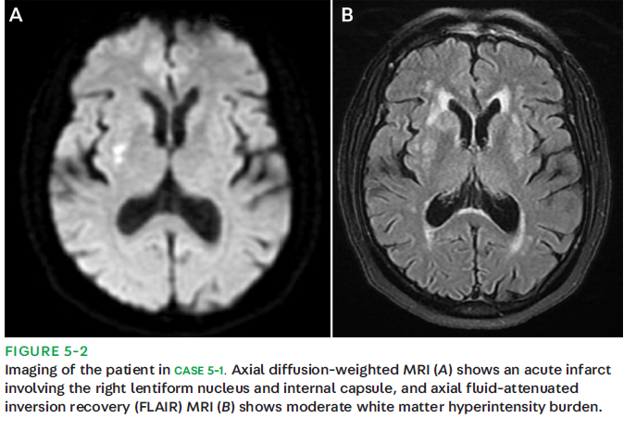

Slide 28
Arterial dissection:
Dissection of the carotid or vertebral arteries may lead to ischemic stroke
a) Carotid dissection:
- Typically presents with severe retro-orbital headache ipsilateral to the lesion
Strokes involve the anterior circulation and occur either by thrombosis of the ICA or more commonly by an embolus arising from the dissection.
On examination: patients may have an ipsilateral Horner’s syndrome due to the involvement of the ascending oculosympathetic tract. Perspiration is preserved because those fibers ascend with the external carotid artery.
b) VA dissection may be produced by neck manipulation or trauma and is commonly associated with ipsilateral neck pain and stroke in the posterior circulation.

Slide 29
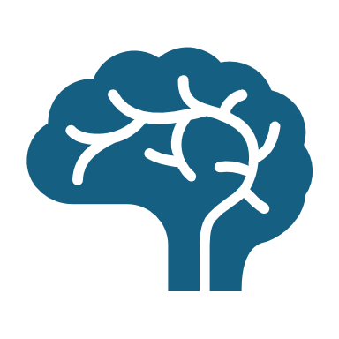
Transient Ischemic Attack
Ischemic strokes also include something called a "mini-stroke" or a TIA (transient ischemic attack). This is a temporary blockage in blood flow to your brain. The symptoms usually last for just a few minutes or may go away in 24 hours.
The mechanisms of TIA are identical to those of ischemic stroke.
Patients who have had a TIA have a 10% risk of stroke in the 90 days following the event, and the greatest risk is within the first 24 hours following a TIA.
Therefore, the evaluation should be identical to that for a completed stroke and should be conducted just as quickly.

Slide 30
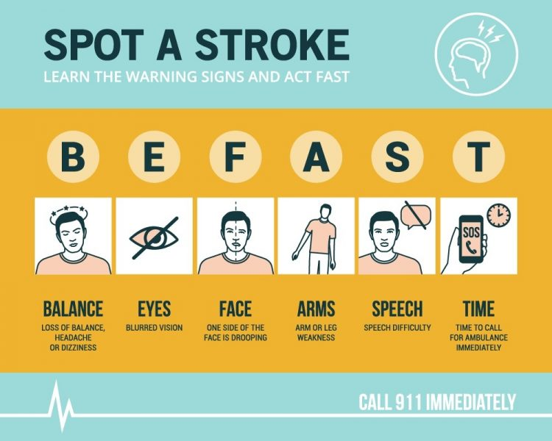
Assessment of Ischemic Strokes
Whilst the diagnosis of stroke may sometimes be obvious in many cases the presenting symptoms may be vague and accurate assessment difficult.
The BE FAST screening tool is widely known and has a positive predictive value of 78%. A variant of BE FAST called the ROSIER score is useful for medical professionals.

Slide 31
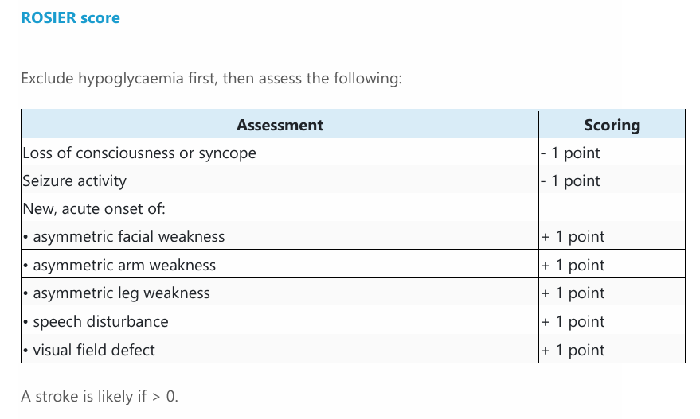

Slide 32
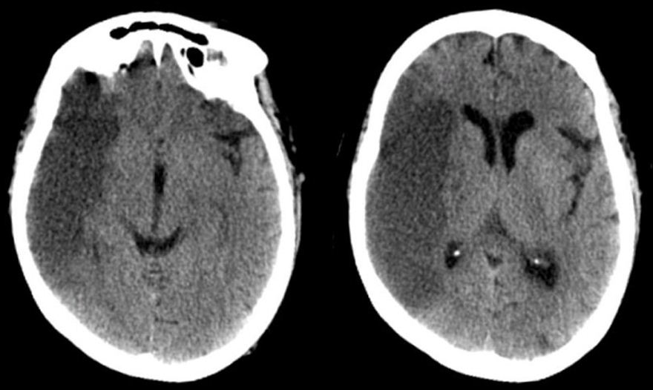
Assessment of Ischemic Strokes
A non-contrast CT brain scan is the first line radiological investigation for suspected stroke as it helps to exclude hemorrhagic strokes or another pathology such as brain tumors before considering the usage of any antiplatelets or thrombolytics and thrombectomy in acute Stroke Management.
Acute ischemic strokes show areas of low density in the grey and white matter of the territory. Acute hemorrhagic strokes typically show areas of hyperdense material (blood) surrounded by low density (oedema).
MRI Brain with diffusion weighted imaging is more sensitive to acute brain infarction than is CT.

Slide 33
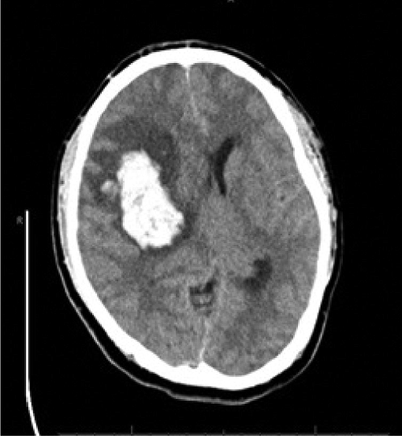

Slide 34
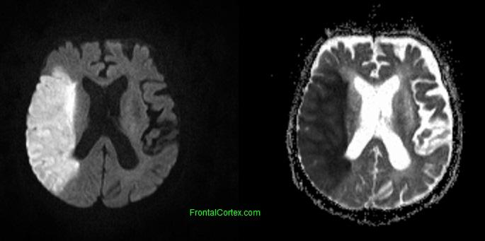
Acute Right MCA stroke on MRI (DWI on the left and ADC sequence on the right)

Slide 35
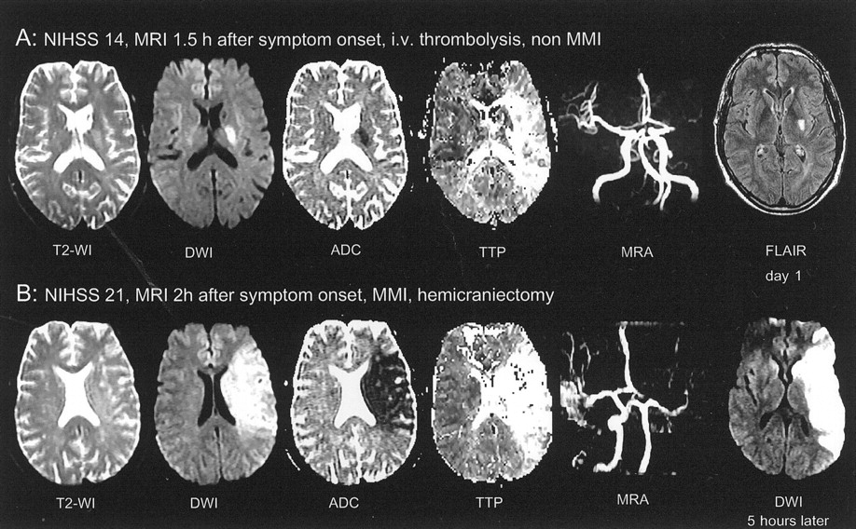

Slide 36
Diagnostic Work up for Ischemic Strokes
Laboratory Work Up: Complete blood count, PT, PTT, Kidney function test, liver function test, Cardiac enzymes, Electrolytes, RBS level, HBA1C, Lipid Profile. Rheumatological work up is sometimes needed when history is significant for Antiphospholipid syndrome, Bechet disease or Vasculitis.
Computerized tomography (CT) scan.
Magnetic resonance imaging MRI/MRA/DW Images.
Carotid ultrasound: shows buildup of fatty deposits called plaques and blood flow in the carotid arteries.
Echocardiogram: can find a source of clots in the heart that may have traveled to the brain and caused a stroke.
In cases of suspected arterial dissection, CTA or MRA with fat-suppressed imaging (“fat sats”) to evaluate the cervical carotid and vertebral arteries should be obtained.
Intensive investigation for coagulopathy may be required for some patients.

Slide 37
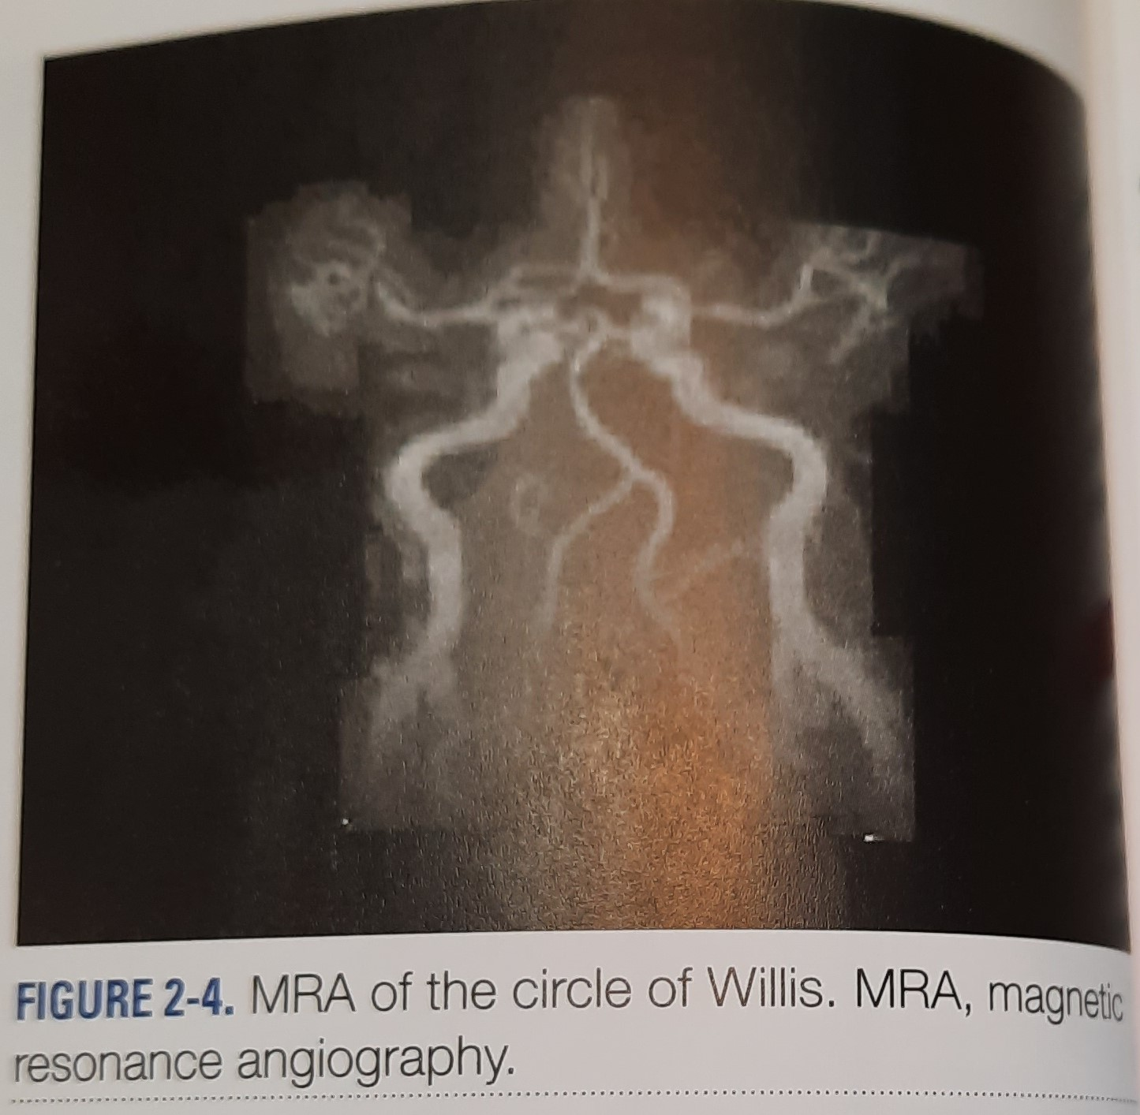
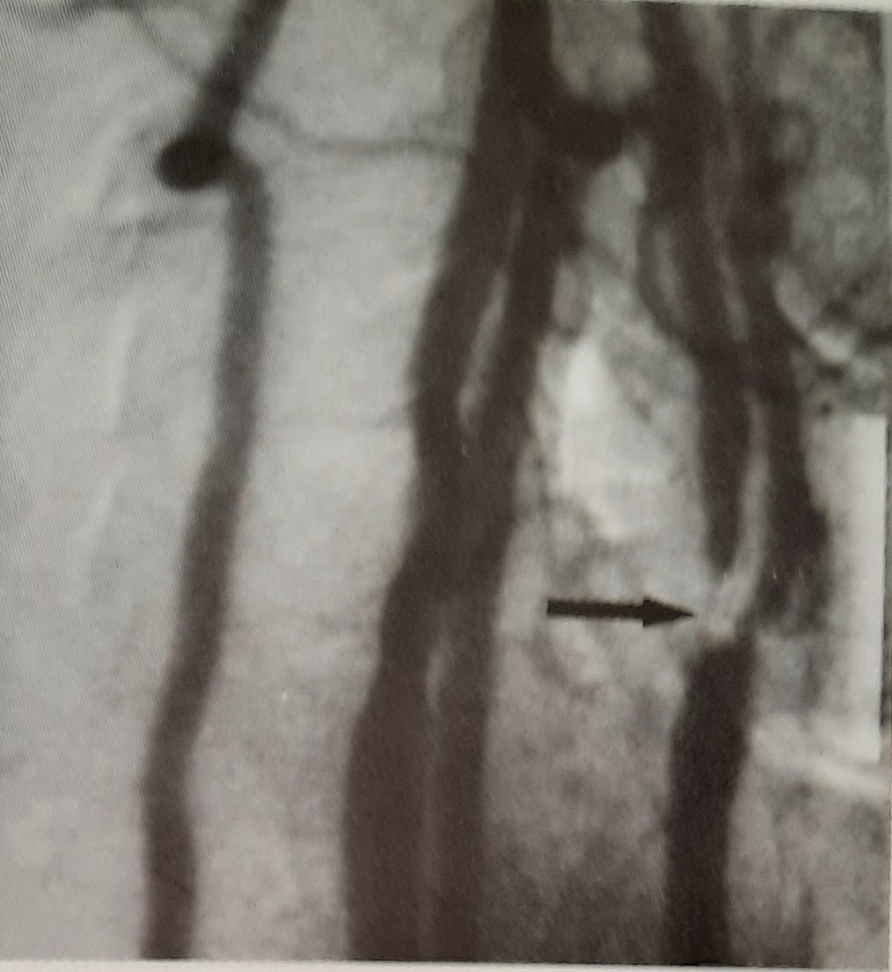

Slide 38
Management of Ischemic Strokes
Blood glucose, hydration, oxygen saturation and temperature should be maintained within normal limits.
Blood pressure should not be lowered in the acute phase unless there are complications such as Hypertensive Encephalopathy.
Aspirin 300mg orally or rectally should be given as soon as possible if a hemorrhagic stroke has been excluded.
Thrombolysis with alteplase should only be given if:
it is administered within 4.5 hours of onset of stroke symptoms.
Brain hemorrhage has been definitively excluded (Imaging has been performed)
Patients with acute ischemic stroke otherwise eligible for treatment with thrombolysis should have their blood pressure reduced to below 185/110 mmHg before treatment.

Slide 39
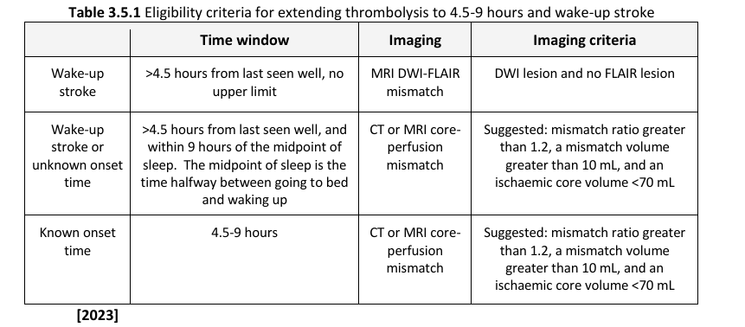

Slide 40
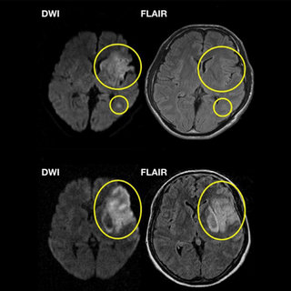
You can Give Thrombolytics
You can not Give Thrombolytics

Slide 41
Absolute Contraindications for thrombolytics:
Symptoms suggestive of SAH even if CT scan of brain is normal
Large or ruptured aneurysm > 10 mm
Use of therapeutic dose of LMWH in the last 24 hours
Associated or suspected aortic arch dissection
CT hypodensity > 1/3 MCA territory
Major surgery in the last 14 days
Moyamoya disease

Slide 42
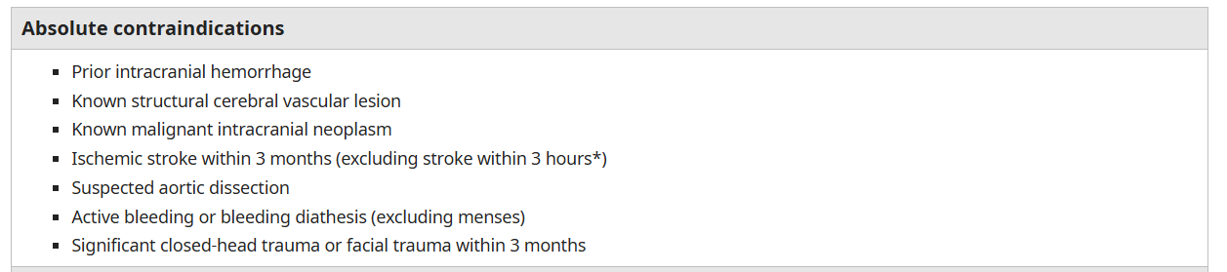

Slide 43
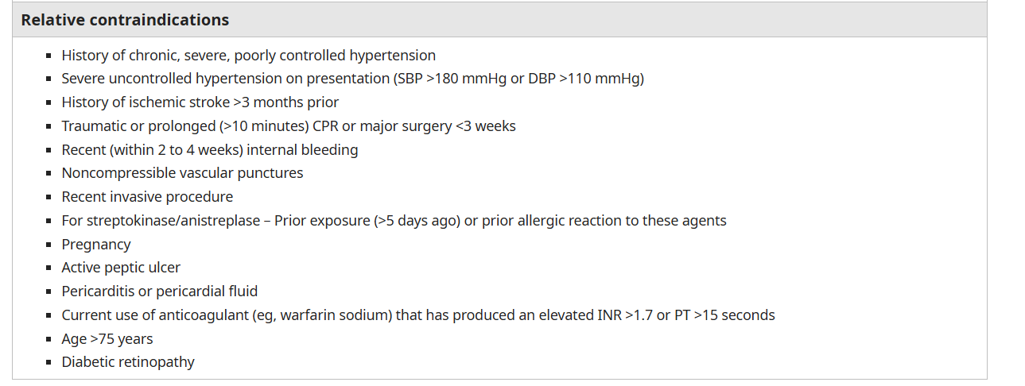

Slide 44
Thrombectomy for acute ischemic strokes
NICE recommend a pre-stroke functional status of less than 3 on the modified Rankin scale and a score of more than 5 on the National Institutes of Health Stroke Scale (NIHSS).
Offer thrombectomy as soon as possible and within 6 hours of symptom onset, together with intravenous thrombolysis (if within 4.5 hours), to people who have: acute ischemic stroke and confirmed occlusion of the proximal anterior circulation demonstrated by computed tomographic angiography (CTA) or magnetic resonance angiography (MRA).
Offer thrombectomy as soon as possible to people who were last known to be well between 6 hours and 24 hours previously (including wake-up strokes): confirmed occlusion of the proximal anterior circulation demonstrated by CTA or MRA and if there is the potential to salvage brain tissue, as shown by imaging such as CT perfusion or diffusion-weighted MRI sequences showing limited infarct core volume.
Consider thrombectomy together with intravenous thrombolysis (if within 4.5 hours) as soon as possible for people last known to be well up to 24 hours previously (including wake-up strokes): who have acute ischemic stroke and confirmed occlusion of the proximal posterior circulation (that is, basilar or posterior cerebral artery) demonstrated by CTA or MRA and if there is the potential to salvage brain tissue, as shown by imaging such as CT perfusion or diffusion-weighted MRI sequences showing limited infarct core volume.

Slide 45
Secondary Prevention of ischemic strokes
With regards to carotid artery endarterectomy: It is recommended if patient has suffered stroke or TIA in the carotid territory and are not severely disabled. It should only be considered if carotid stenosis > 70% according ECST (European Carotid Surgery Trialists' Collaborative Group) criteria or > 50% according to NASCET (North American Symptomatic Carotid Endarterectomy Trial) criteria.
Patients with high-risk TIA and low NIHSS stroke should be treated with clopidogrel load in the first 24 hours followed by DAPT for 21 days.
Statin should be prescribed for patients who have high lipid profile.
Patients with ischemic stroke or transient ischemic attack and atrial fibrillation should receive oral anticoagulant therapy for secondary stroke prevention.
In patients with stroke due to intracranial atherosclerosis ,dual antiplatelet therapy with aspirin and clopidogrel is favored.

Slide 46
Hemorrhagic Strokes
Bleeding inside the skull can be divided into subarachnoid, intracerebral, epidural and subdural hemorrhages.
The latter 2 types of hemorrhage are almost always traumatic.
Intracerebral hemorrhage ( ICH) and subarachnoid hemorrhage (SAH) have different causes, clinical findings and management.

Slide 47
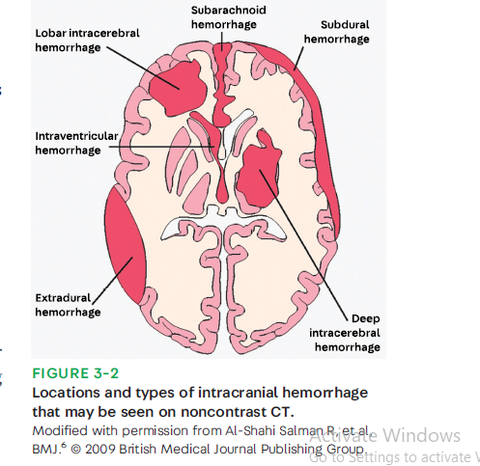

Slide 48
Subarachnoid hemorrhage (SAH)
SAH is often due to traumatic injury. More serious, though, is SAH caused by bleeding from an aneurysm located along the circle of Willis.
When blood under arterial pressure is suddenly released into the space around the brain, patients develop sudden-onset, severe headache.
Often ,they vomit and cease what they are doing at the time of the hemorrhage.
When the intracranial pressure increases rapidly or the insulae are affected, coma or death may ensue.

Slide 49
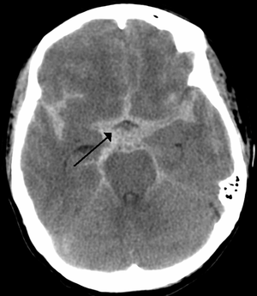
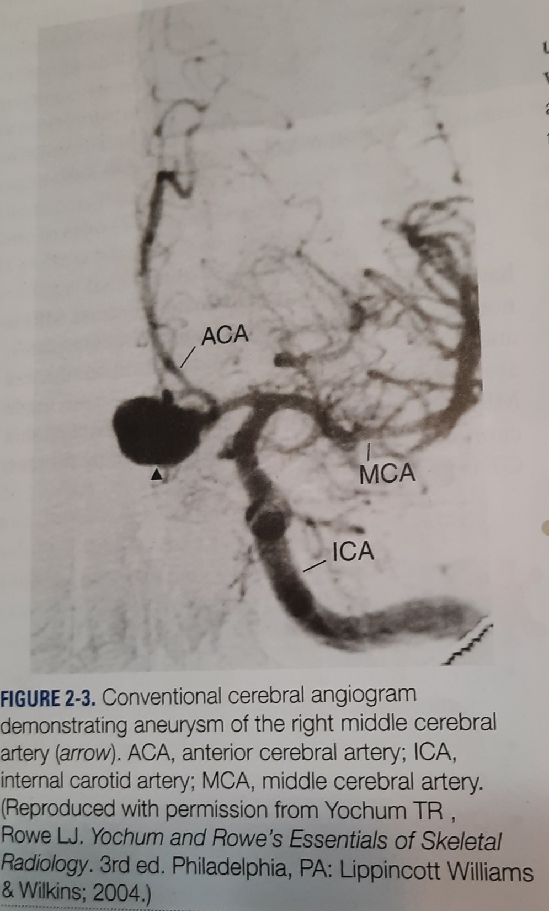

Slide 50
Treatment is aimed at preventing the rebleeding and vasoconstriction that often follow SAH.
Aneurysms can be clipped surgically or “ coiled” by interventional techniques.
The calcium-channel blocker nimodipine is used to minimize vasoconstriction and delayed brain ischemia.

Slide 51
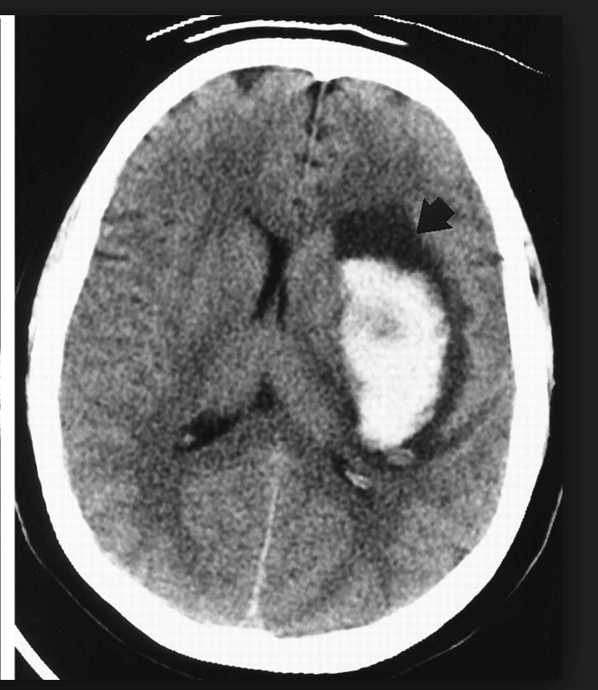
Intracerebral hemorrhage
ICH is bleeding directly into brain parenchyma.
The earliest symptoms are headache and neurologic signs referable to the region in which the bleeding occurs.
Hypertension (leading to Charcot-Bouchard microaneurysms) is the most common cause of ICH.
The most common locations for hypertensive ICH are the basal ganglia-internal capsule, caudate nucleus, thalamus, pons and cerebellum.

Slide 52
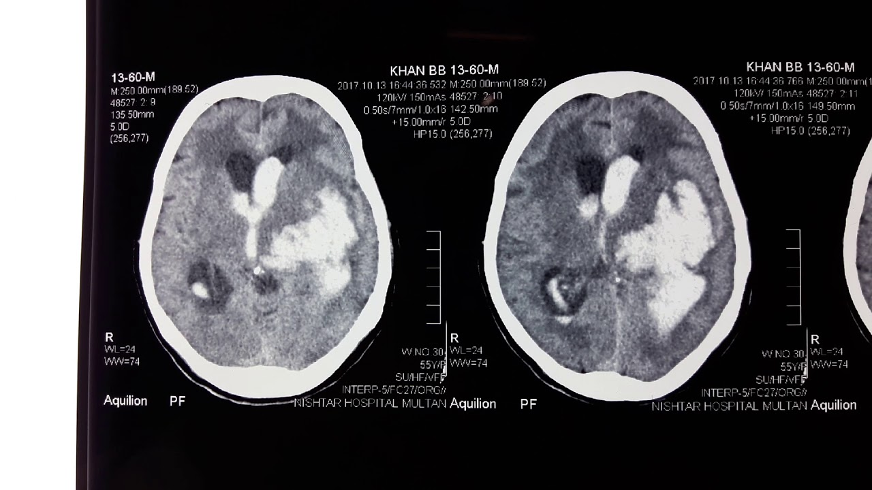

Slide 53
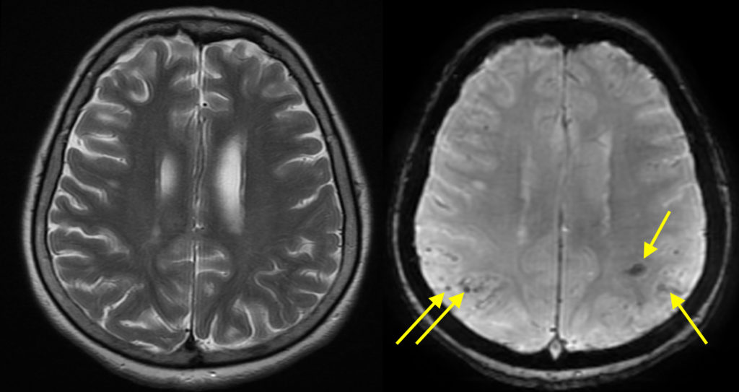
Cerebral amyloid angiopathy is a cause of ICH that is more frequent in the elderly. and preferentially affects the parietal and occipital lobes.
Trauma, vascular malformations and bleeding diatheses ( especially with patients who are taking anticoagulants) are other common causes.
ICH is often a devastating condition , and large hemorrhages are associated with high mortality rates.

Slide 54
Treatment involves correcting any coagulopathy.
In certain situations( particularly cerebellar hemorrhages) , surgical decompression is necessary.
Management of risk factors for hemorrhage, specifically hypertension, is necessary to prevent recurrence.

Slide 55
Vascular malformations:
Variety of congenital and acquired vascular anomalies that have the potential to bleed, either within the brain ( ICH) or around it.
* Arteriovenous malformations ( AVMs) contain arteries that empty into arterialized veins.
These lesions contain no recognizable normal capillary bed, but abnormal gliotic parenchyma can be found between the component vessels.
In addition to causing ICH , AVMs may result in seizures.
AVMs may be treated with embolization or surgical resection.

Slide 56
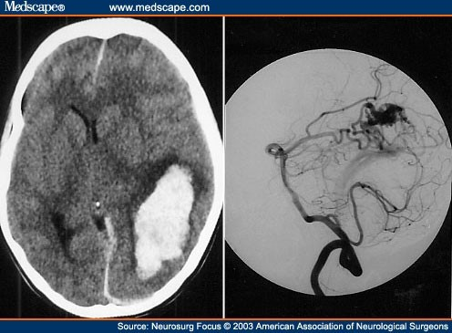

Slide 57
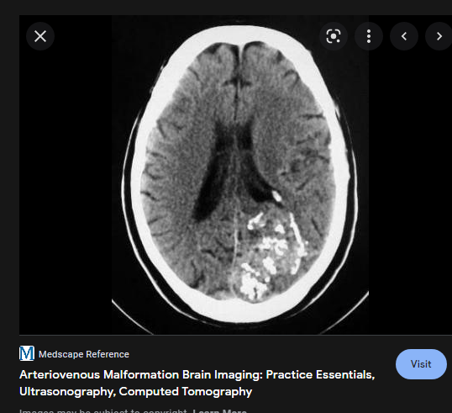

Slide 58
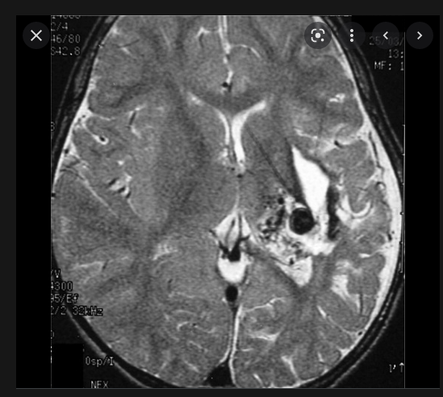

Slide 59
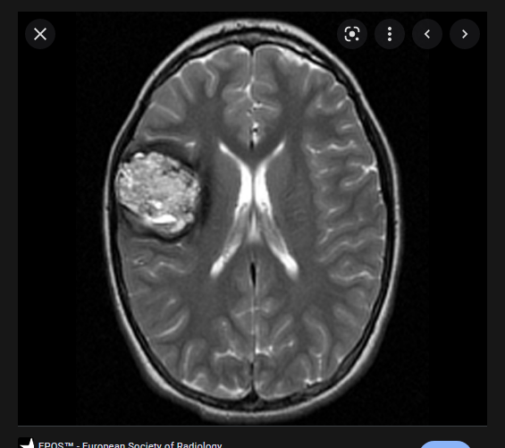
Cavernous angiomas: consist of a relatively compact mass of sinusoidal vessels close together, without intervening brain parenchyma.
The lesions are well encapsulated.
Cavernous angiomas bleed or lead to seizures, occasionally, but are not threatening as AVMs are.
They may be followed with serial neuroimaging studies.
Surgery is required rarely.
They may require antiseizure drug treatment if recurrent seizures develop.

Slide 60
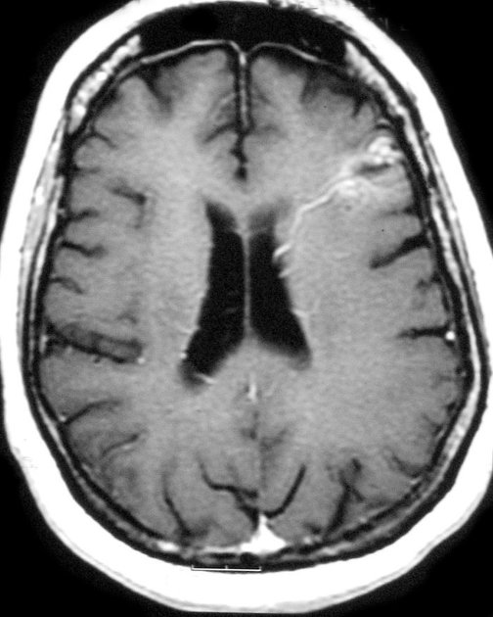
Developmental venous anomalies (DVAs): are composed of anomalous veins usually separated by morphologically normal brain parenchyma are the most common vascular malformations of the brain.
They seldom hemorrhage and are generally not treated surgically or followed with serial neuroimaging studies.
Telangiectasias are dilated capillaries with intervening brain parenchyma.
They are incidental findings and do not require treatment.

Slide 61

Register your attendance with your university number
Make sure that the settings of your phone allow tracking location
Go to settings > privacy> location> services> make sure that location services is ON

