Slide 1
Uveitis: Clinical Patterns, Causes, and Systemic Clues
A case-based seminar for 5th-year medical students
Moayad Shaf’ei, MD

Slide 2
Learning Objectives
Identify uveitis types and anatomical classification
Discuss key systemic associations
Recognize typical signs and imaging features
Interpret case-based scenarios
Outline basic management principles

Slide 3
Warm-Up Quiz
Which of the following is most commonly affected in uveitis?
A. Choroid
B. Retina
C. Ciliary body
D. Iris

Slide 4
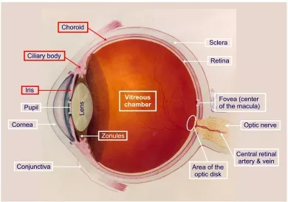
The Uveal Tract – Overview
Includes the iris, ciliary body, and choroid
Affected differently based on uveitis type

Slide 5
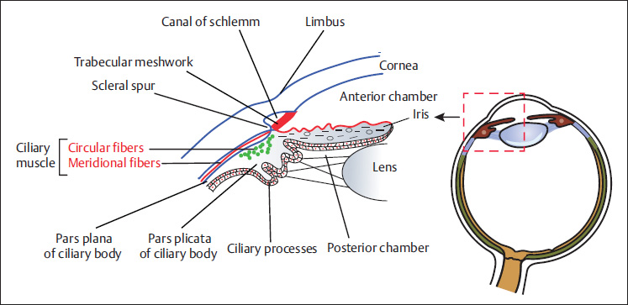

Slide 6
Classification of Uveitis
Type | Main Site Involved | % of Cases | Example Terms
Anterior | Iris, CB (Ant. part) | ~52% | Iritis, Iridocyclitis
Intermediate | Vitreous, Pars plana | ~13% | Pars planitis
Posterior | Retina, Choroid | ~19% | Chorioretinitis
Panuveitis | All segments | ~16% | Behçet's uveitis

Slide 7
Clinical Presentation
Feature | Acute Anterior | Chronic Anterior | Posterior | Intermediate
Pain | +++ | +/- | + | -
Redness | +++ | +/- | +/- | -
Photophobia | +++ | + | - | -
Floaters | - | - | ++ | +++

Slide 8
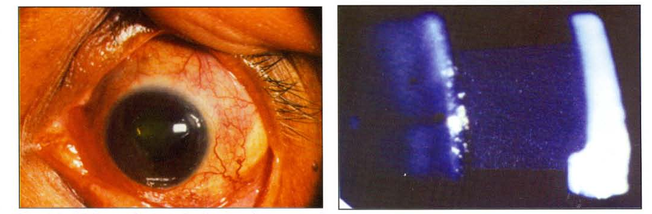
Case 1 – Acute Red Eye and photophobia (25 Y/O man)

Slide 9
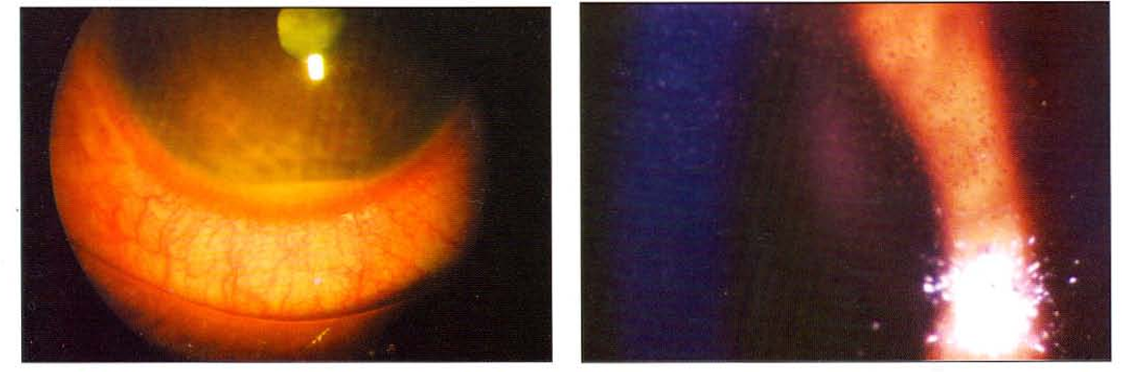
5 months later, the other eye!
Notes:
Acute • Circumcorneal congestion • Fine keratic precipitates • Aqueous flare and cells (graded according to severity) • Hypopyon • Posterior synechiae • Iris bombe

Slide 10
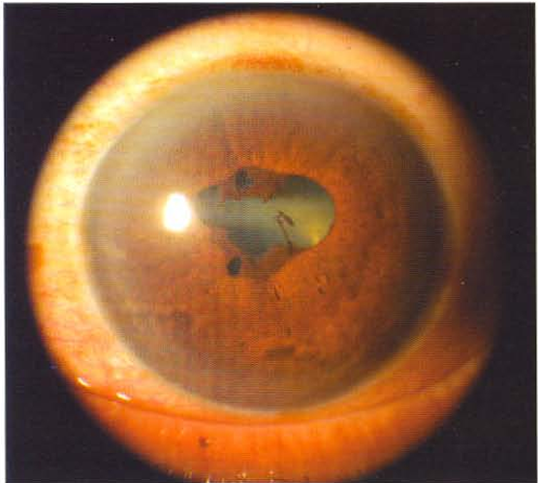
Notes:
Chronic • Old pigmented keratic precipitates • Broken posterior synechiae • Seclusio and occlusio pupillae • Posterior subcapsular cataract

Slide 11
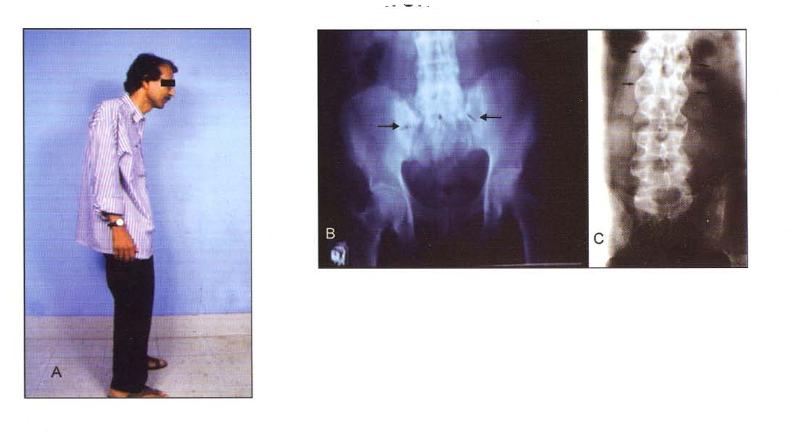
Notes:
Investigations • Complete blood count • Rheumatoid factor, antinuclear antibody • Human leucocyte antigen (HLA-B27) Treatment • Topical steroids: Prednisolone acetate, Betametha sone, Dexamethasone. In acute cases, topical steroids can be used every hourly and gradually tapered. • Cycloplegic agents: Atropine, Homatropine, Cyclopentolate • In severe cases, periocularl systemic steroids can be used.

Slide 12
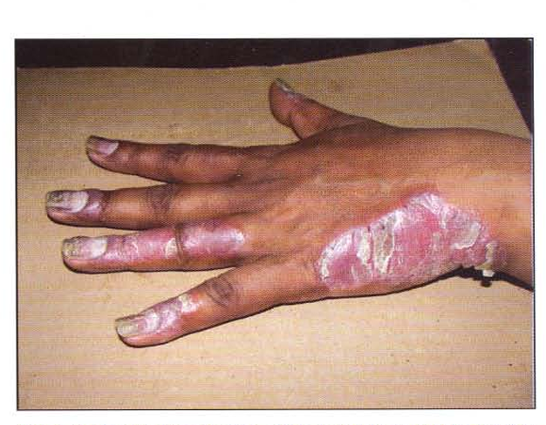

Slide 13
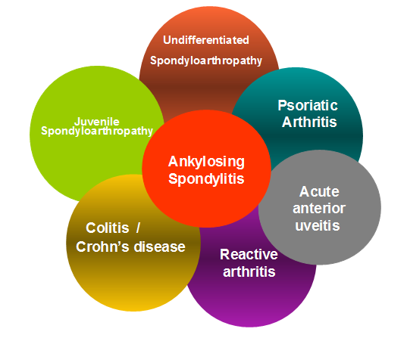
Notes:
Inflammation of the iris and ciliary body is called anterior uveitis. It can be nongranulomatous or granulomatous. Idiopathic nongranulomatous anterior uveitis is the most common type of anterior uveitis which is known to be associated with the human leukocyte antigen (HLA) 827 in 50-60 percent of patients. It is characterized by male predominance and may be associated with seronegative arthritic syndromes such as ankylosing spondylitis, Reiter syndrome, psoriatic arthritis, and inflammatory bowel disease.

Slide 14
Signs on Slit Lamp
Aqueous cells and flare
Keratic precipitates, Hypopyon
Posterior synechiae, iris nodules (e.g., sarcoid)
Granulomatous vs non-granulomatous features

Slide 15
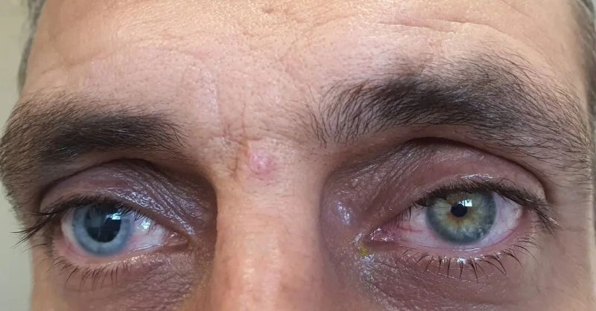
Notes:
Fuchs' heterochromic iridocyclitis is a chronic, unilateral nongranulomatous anterior uveitis characterized by a white eye, stellate keratic precipitates, iris atrophy with or without iris heterochromia, abnormal angle vessels and absence of posterior synechiae. It is bilateral in approximately 10 percent of patients. The etiology of the disease is still unknown. Several theories including infection from Toxoplasma gondii, an immune dysfunction, infiltration of sensitized lymphocytes, and chronic herpetic infection have been proposed. Ocular Features Symptoms Decreased vision due to cataract, floaters due to vitreous opacification. Signs • Small, nonpigmented, translucent stellate keratic precipitates with fine filament projections described as stellate scattered over the entire posterior corneal surface. • Minimal anterior chamber cells and flare. • Iris heterochromia is present in most patients and usually seen as flattening of the anterior iris features resulting from loss of the anterior iris border layer and iris stroma, especially in the peripupillary area. .. • White iris nodules may occur along the border. • Posterior synechiae are absent. Radial iris vessels are seen on the iris surface because of iris atrophy. • Fine blood vessels on the trabecular meshwork may bleed when the intraocular pressure suddenly drops during surgery or paracentesis. (Amsler sign). • Posterior subcapsular cataract • Vitreous opacification • Secondary glaucoma is seen in about 60 percent cases Investigations Diagnosis is always clinical. No laboratory investigations are required. Treatment Topical corticosteroids for the anterior segment inflam mation. Cataract and glaucoma are managed with surgery with steroid prophylaxis.

Slide 16
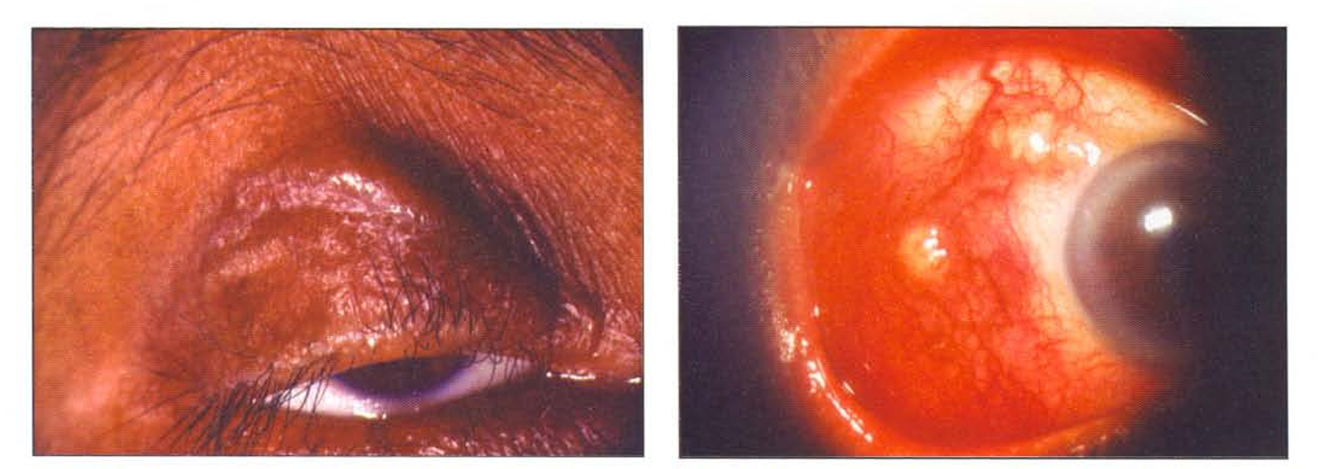
Case 2 – Floaters and Blurred Vision
Notes:
Ocular Features • Lacrimal gland: Keratoconjunctiva sicca • Conjunctival nodules • Uveitis: • Anterior: Granulomatous, mutton fat keratic preci pitates, Koeppe and Bussaca nodules, cataract, glaucoma. • Intermediate: Snowball exudates and snow banking in pars plana • Posterior: Vitritis, periphlebitis, candle wax drippings (Taches de bougies), choroidal granulomas Disc granuloma, retrobulbar optic neuritis, optic atrophy Hemorrhagic retinopathy, arterial macro aneurysms Complications Cystoid macular edema, cataract, glaucoma, retinal ischemia, neovascularization

Slide 17
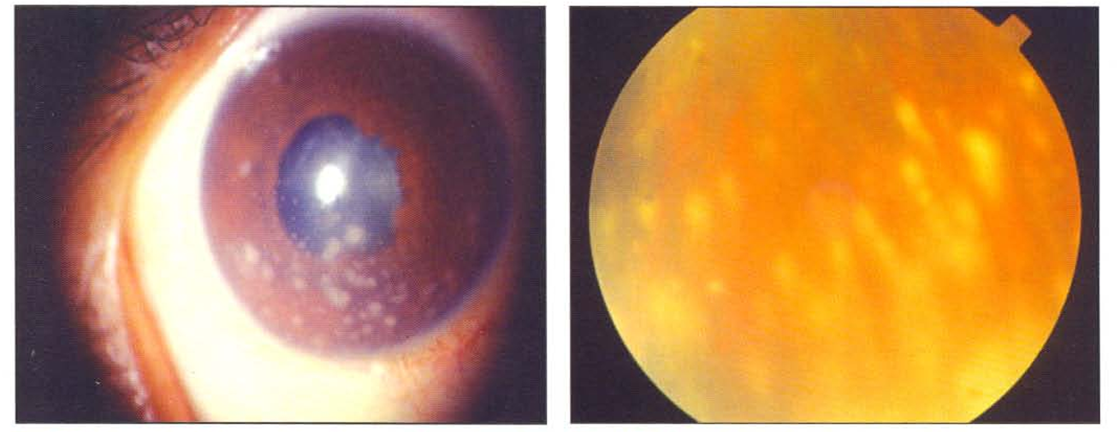

Slide 18
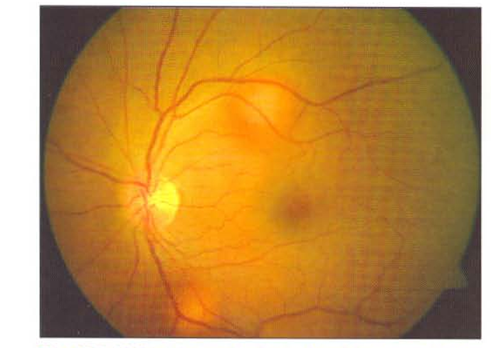
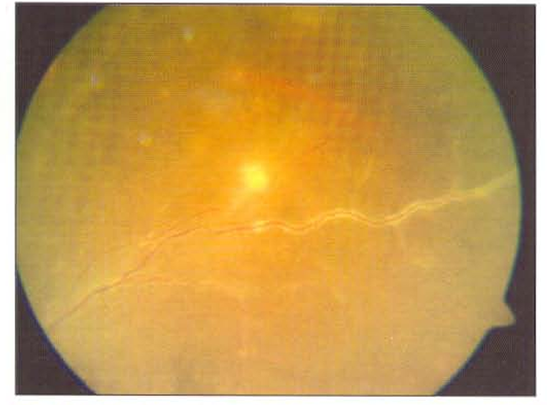
The other eye!
Notes:
Investigations • Serum ACE and lysozyme • Serum calcium, phosphorus • Mantoux test • Chest X-ray • CT scan chest • Whole body Gallium scans • Bronchoalveolar lavage

Slide 19
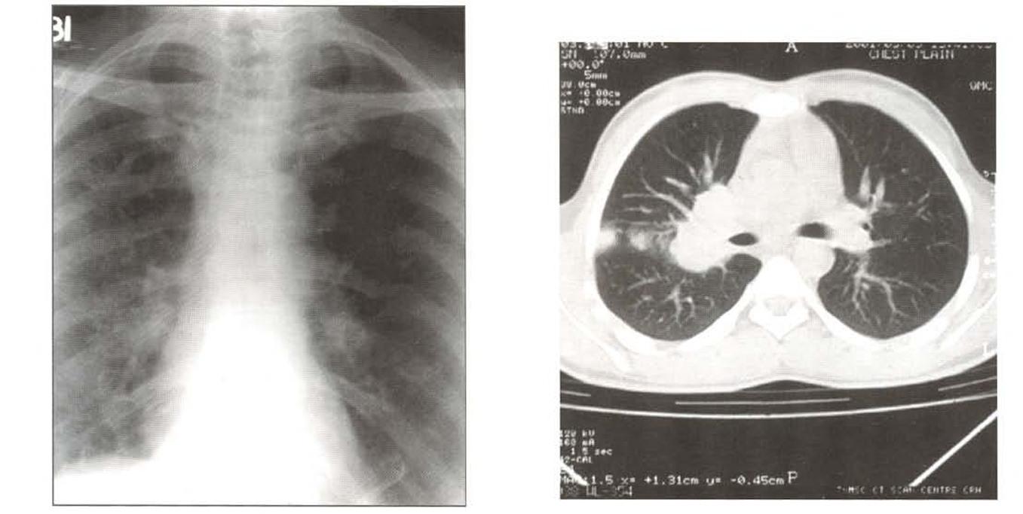
Notes:
Systemic Features Lungs Stage I: Bilateral hilar lymphadenopathy. Stage II: Bilateral hilar lymphadenopathy with paren chymal involvement. Stage III: Lung infiltration only. Stage IV: Lung fibrosis. Skin: Nodules, plaques, psoriasiform lesions, ulcerations, lupus pernio, erythema nodosum Joints: Arthritis. Heart: Arrhythmias, conduction defects.

Slide 20
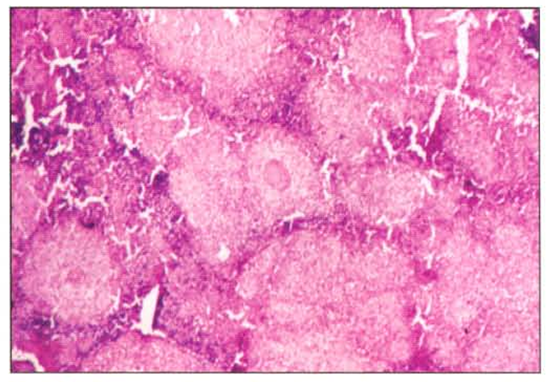
Notes:
Sarcoidosis is a chronic multisystem granulomatous disease of unknown etiology. It occurs worldwide but is more common in US blacks, Scandinavian and Irish white population. It primarily affects adults in the age group 20-50 years but may also be seen in children and elderly. Sarcoidosis affects lungs, thoracic lymph nodes, skin and eyes. Ocular involvement is seen in 25-60 percent of patients with systemic sarcoidosis.

Slide 21
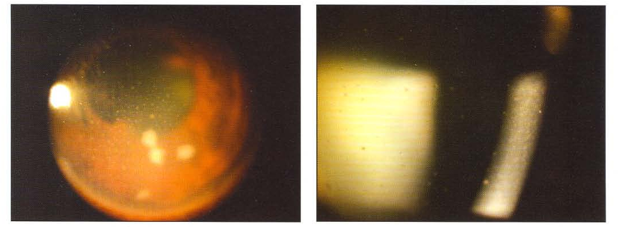

Slide 22
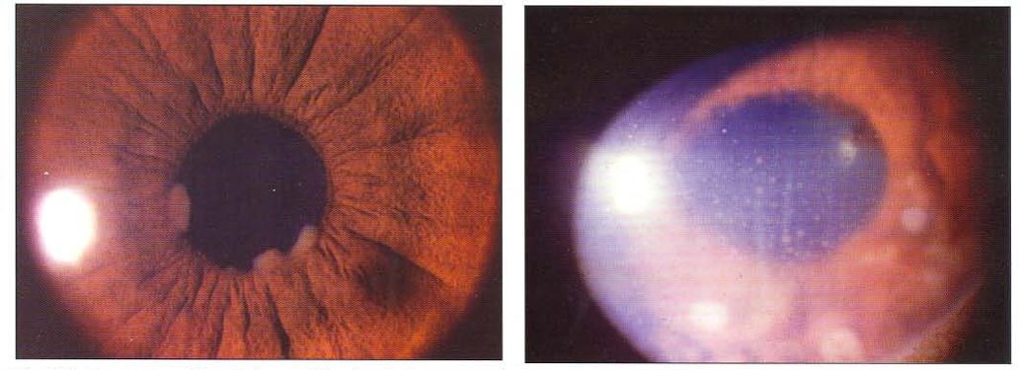
Notes:
• Erythrocyte sedimentation rate • Mantoux test • Serum angiotensin converting enzyme • Fluorescent treponemal antibody absorption test (ITA-ABS) • Venereal Disease Research Laboratory Test (VORL) Rapid Plasma Reagin (RPR) • Chest X-ray

Slide 23
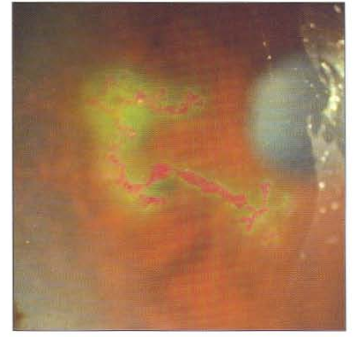
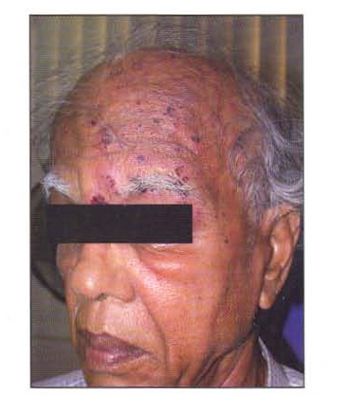

Slide 24
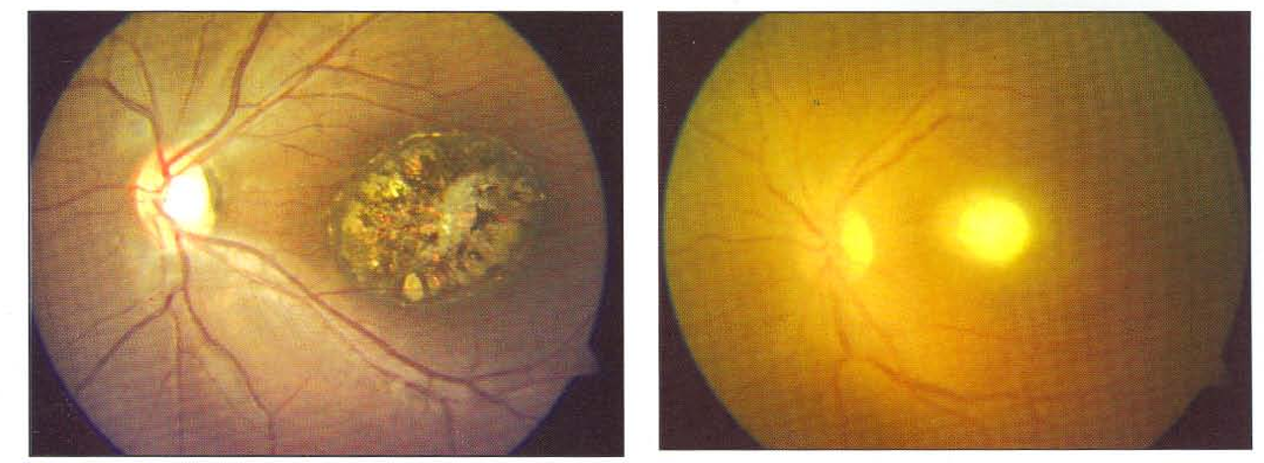
Posterior Uveitis Findings
Notes:
Toxoplasmosis is the most common cause of infectious retinochoroiditis in humans. It is caused by Toxoplasma gondii, an obligate intracellular protozoan parasite. Cat is the only definitive host. Human is the intermediate host. T gondii exists in three forms: 1. Oocyst-soil form 2. Tachyzoite-active infectious form 3. Tissue cysl/bradyzoite-latent form Human infection is either congenital or acquired by ingestion of the raw or undercooked meat, contaminated fruits,vegetables, drinking water or unpasteurized milk.
Ocular Features Ocular toxoplasmosis causes 30~50 percent cases of posterior uveitis. Symptoms Children: Decreased vision, nystagmus, strabismus. Adults: Blurred vision, floaters. Signs Dense vitritis, yellowish white focal retinitis adjacent to a pigmented chorioretinal scar, vasculitis, papillitis, neuroretinitis, optic neuritis. In immunosuppressed patients, lesions may be bilateral, multifocal and atypical.

Slide 25
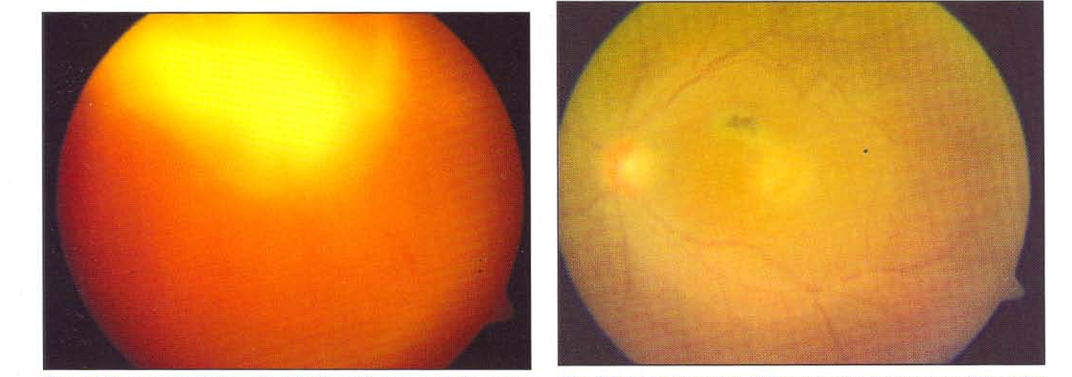
Notes:
Investigations • ELISA (serum and aqueous), Antitoxoplasma IgG and IgM antibodies • Polymerase chain reaction (peR) of aqueous aspirate CT /MRI Brain in cases of toxoplasmic encephalitis especially in immunosuppressed patients. Treatment • Antitoxoplasmic drugs-Pyrimethamine, sulphadia~ zine, c1indamycin, azithromycin, trimethoprim + sulphamethoxazole, atovaquone. Spiramycin is the drug of choice in pregnancy. • Corticosteroids

Slide 26


Slide 27
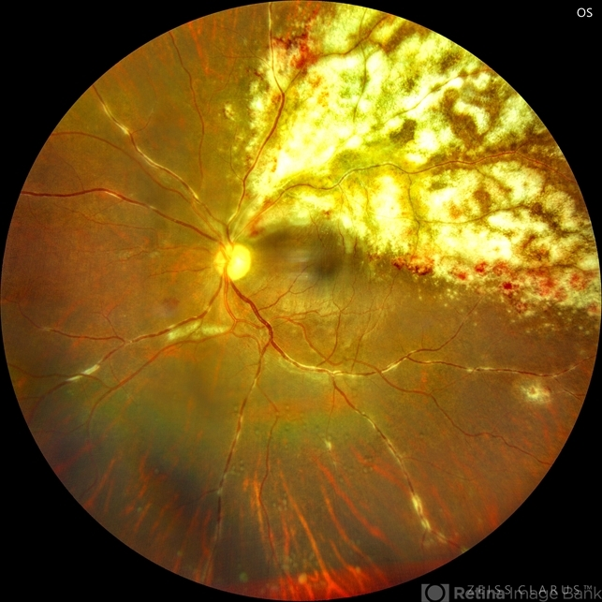
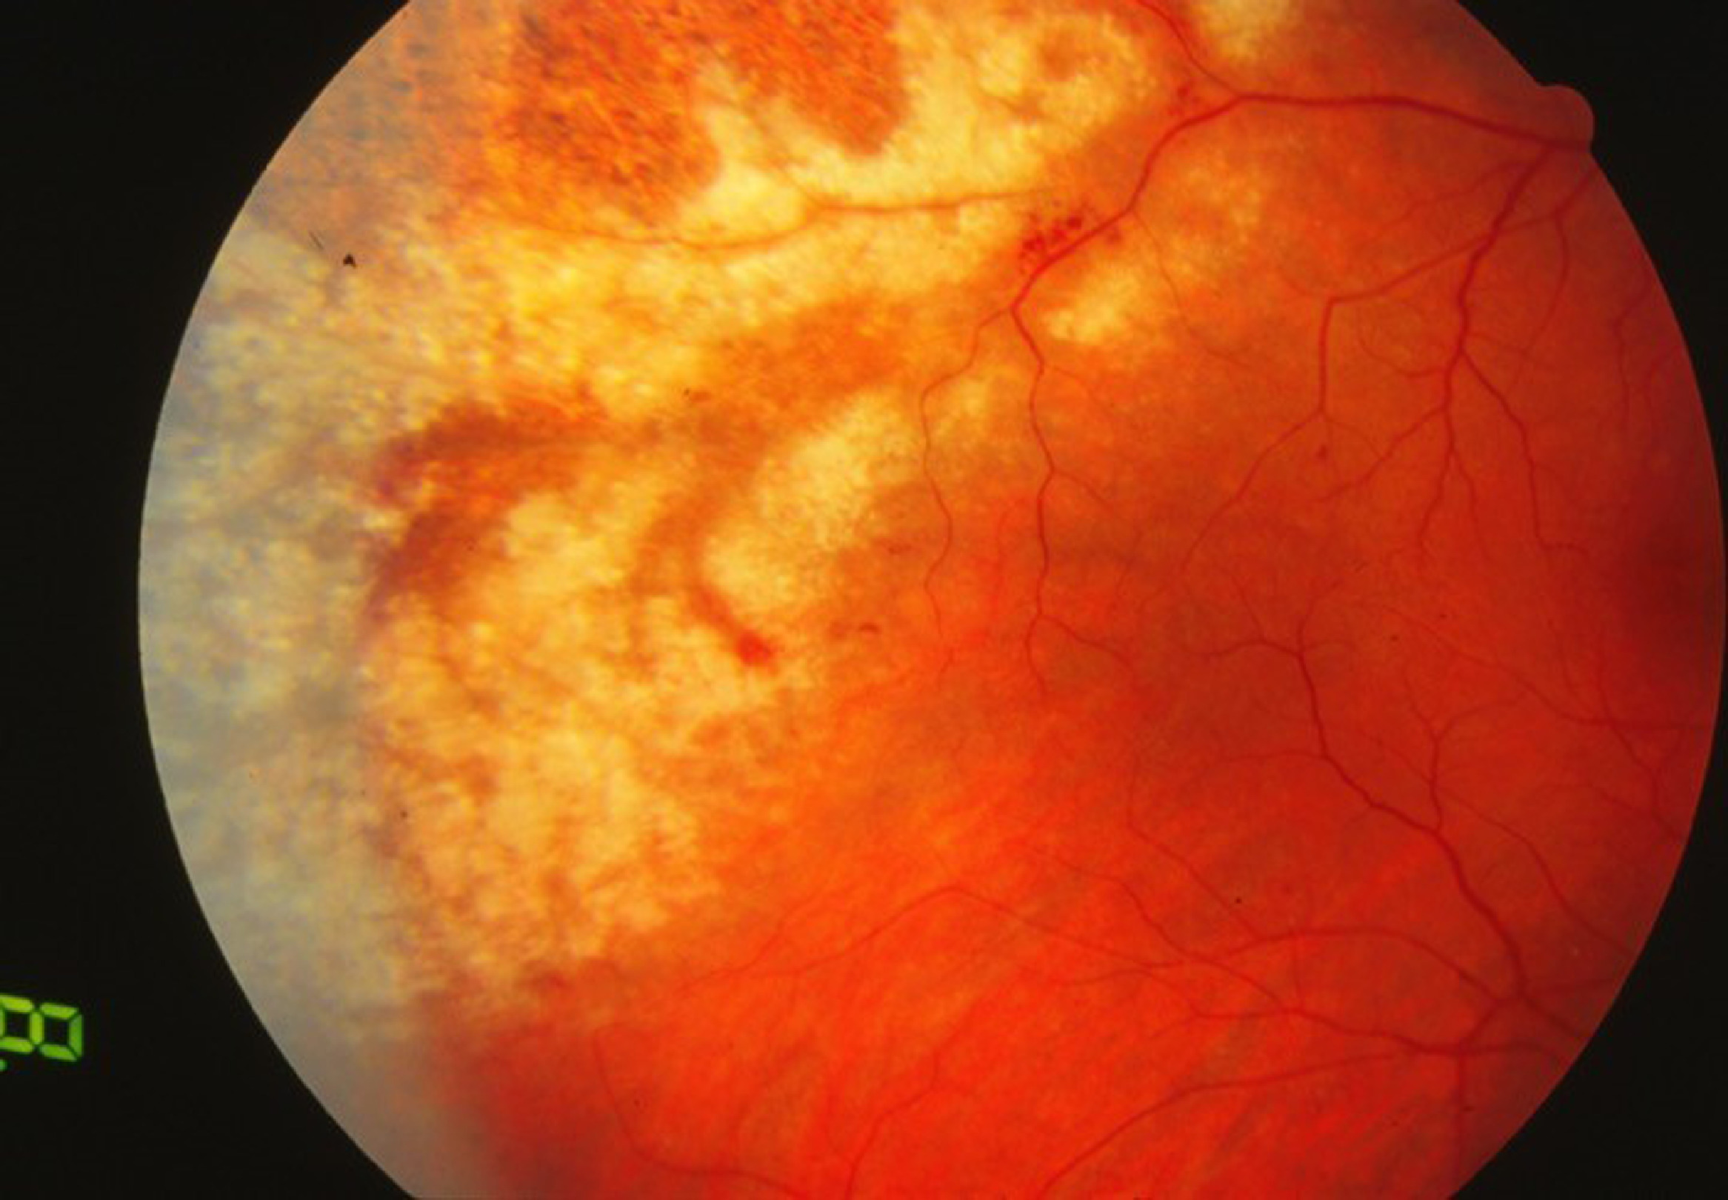

Slide 28
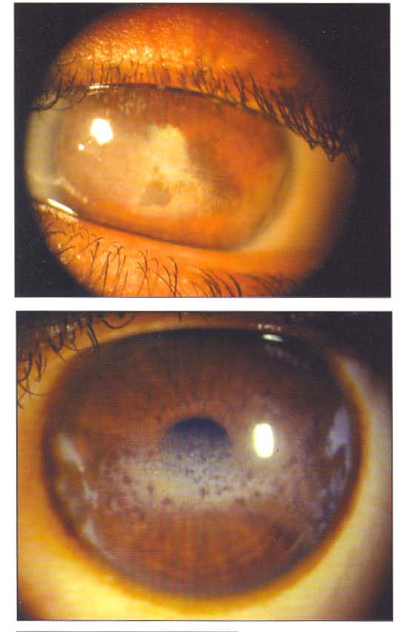
Case 4 – Uveitis in a Child
7 y/o girl, white eye, ANA+
Dx: JIA-associated chronic anterior uveitis
Risk: Cataract, glaucoma from chronicity
Notes:
Juvenile idiopathic arthritis (JIA) associated with uveitis is the most frequent cause of chronic intraocular inflammation among children. Chronic iridocyclitis occurs in 10-20 percent of all patients with JIA. Severe loss of vision may occur in 30·40 percent of patients with JIA associated uveitis. JIA is subdivided into three types. • Systemic onset JIA (Still's disease) • Polyarticular onset JIA • Paudarticular onset JIA Ocular Features Symptoms Decreased vision. Signs • Bilateral nongranulomatous anterior uveitis (70-80%) • Band keratopathy, small-medium sized keratic precipitates • Anterior chamber flare • Posterior synechiae; pupillary membrane • Posterior subcapsular cataracts .. • Vitritis, CME, hypotony macu]opathy • Secondary glaucoma or hypotony late in the disease. Investigations • Rheumatoid factor • Antinuclear antibody (ANA) Treatment • Topical steroids: Prednisolone acetate, Betametha sone, Dexamethasone • Cycloplegic agents: Atropine, Homatropine, Cyclopentolate. • Periocular/ systemic steroids and immunosuppressive agents are frequently required in J IA-related anterior uveitis in refractory cases or/ and as a steroid-sparing agent.

Slide 29
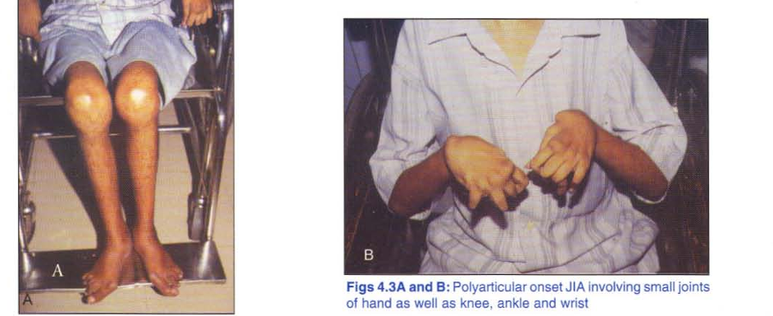

Slide 30
Investigations Approach
Known cause? Mild, unilateral → Limited tests
Recurrent, bilateral, granulomatous → Full panel
Labs: CBC, ESR, ANA, HLA-B27, CXR, PPD, ACE, toxoplasma IgG

Slide 31
Treatment Summary
Anterior: Topical steroids + cycloplegics
Intermediate: Systemic/periocular steroids
Posterior: Systemic steroids ± anti-infectives
Panuveitis: Immunosuppressives (e.g., Behçet)

Slide 32
Red Flags for Referral
Vision loss, floaters, vitritis
Posterior involvement
Granulomatous findings
Chronic/recurrent course

Slide 33
Final Quiz – Rapid Fire
What is snowballing?
Most common infectious posterior uveitis?
Disease with cataract + heterochromia?
Hilar LAP + uveitis? –
Recurrent painless anterior uveitis?

