Slide 1
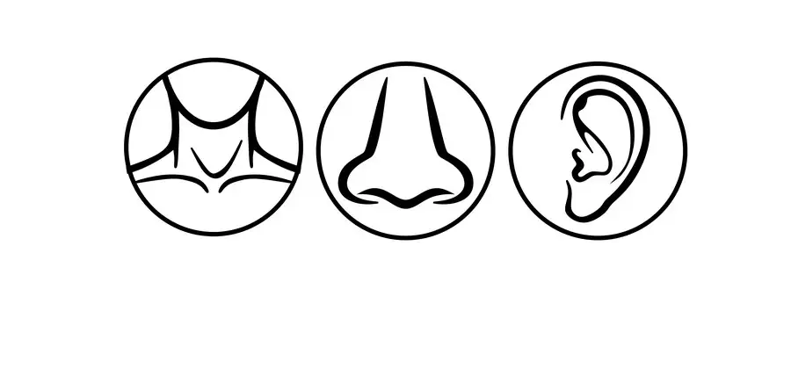

ENT Pictorial Review v2.0

Slide 2
Rhinology

Slide 3
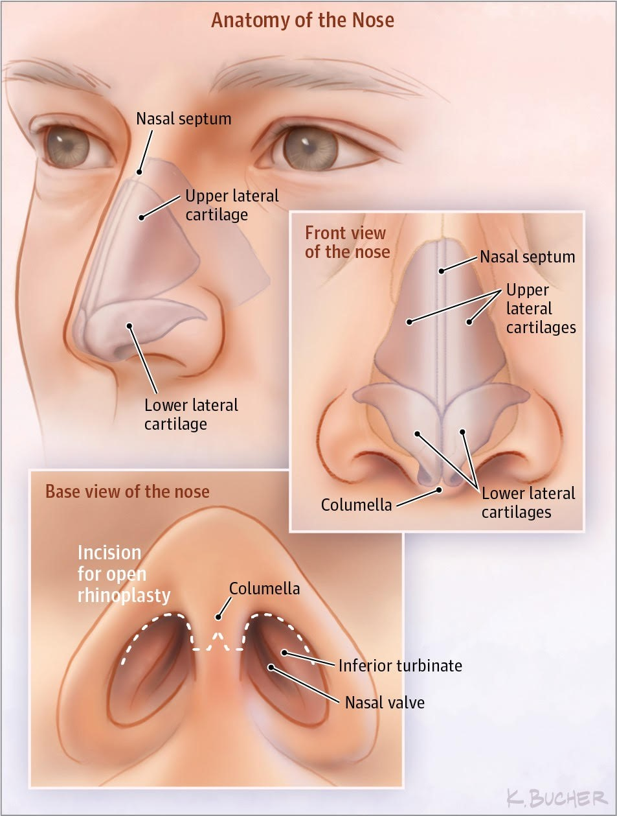
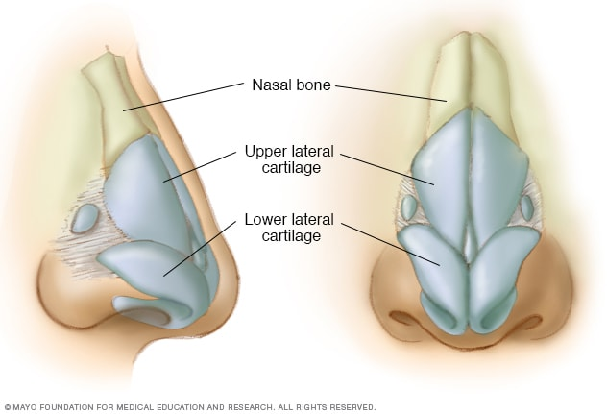

Slide 4
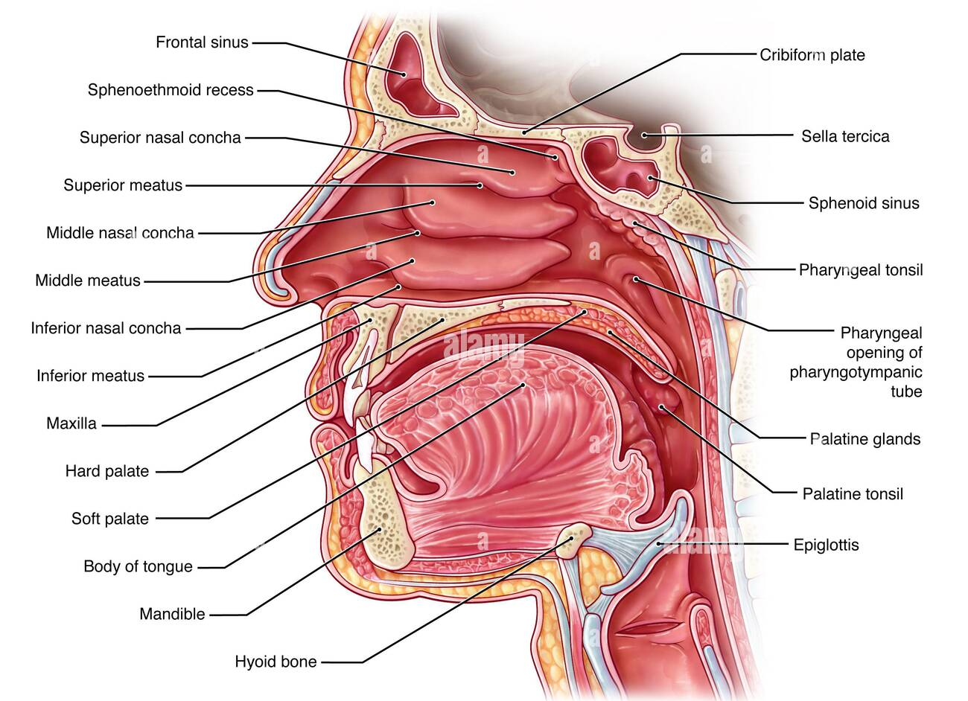

Slide 5
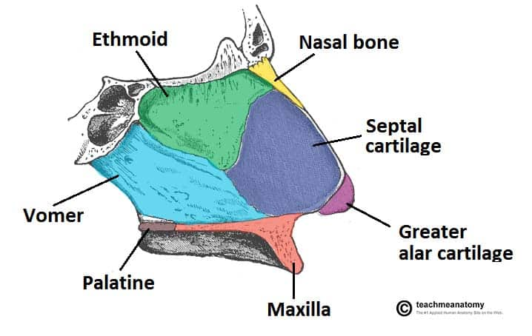

Slide 6
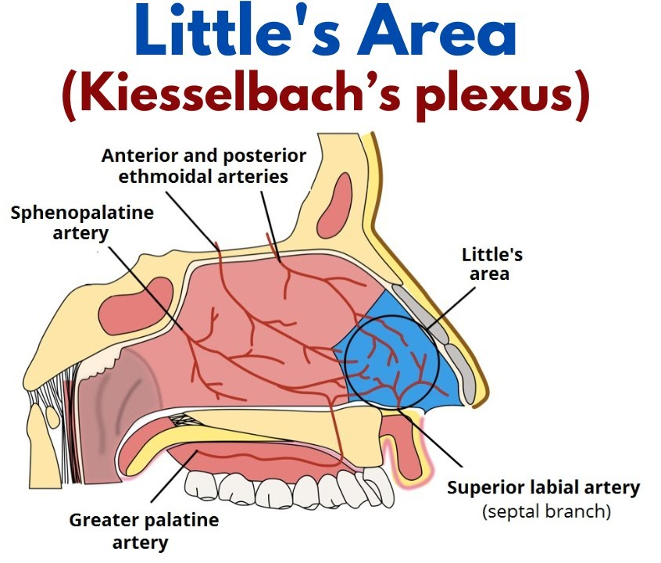

Slide 7
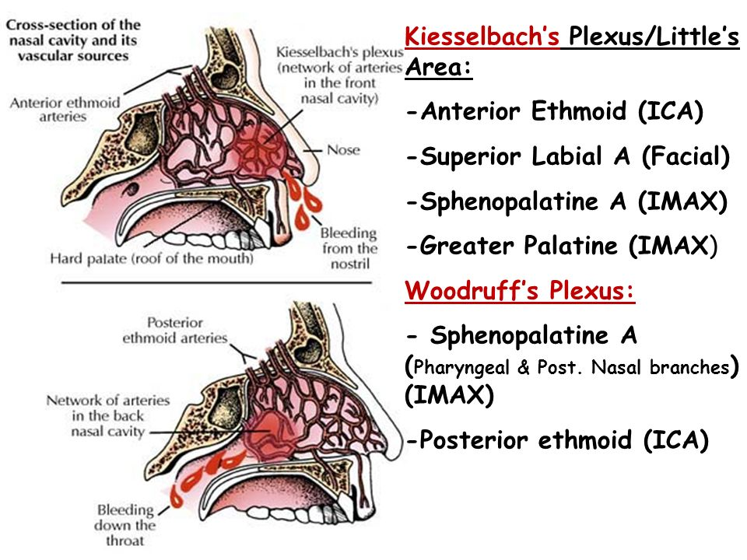

Slide 8
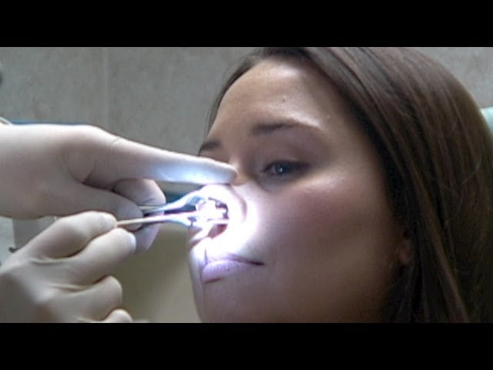
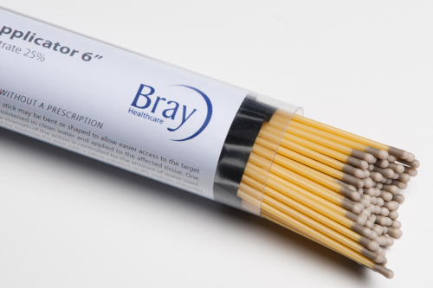

Slide 9
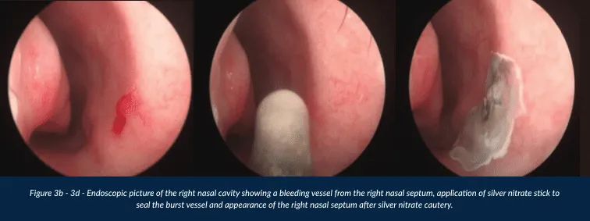

Slide 10
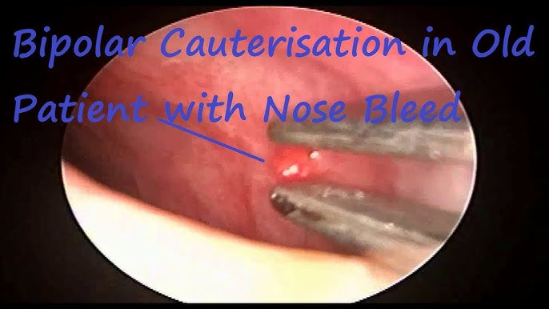
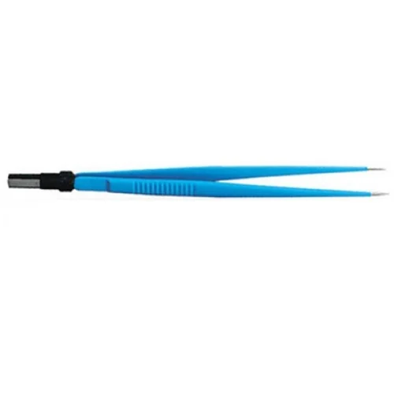

Slide 11
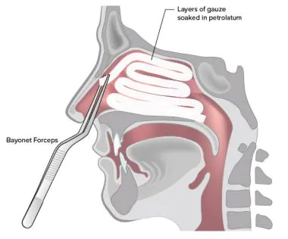

Slide 12
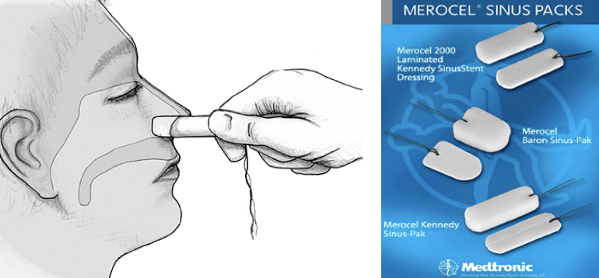
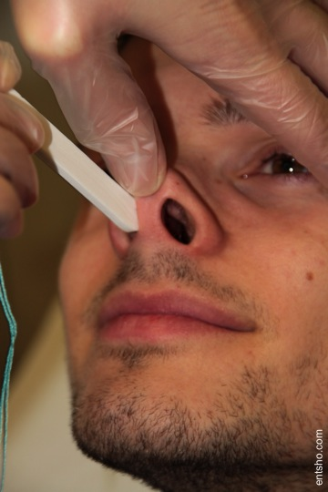

Slide 13
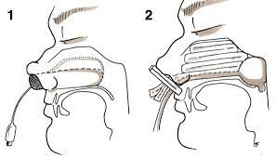

Slide 14
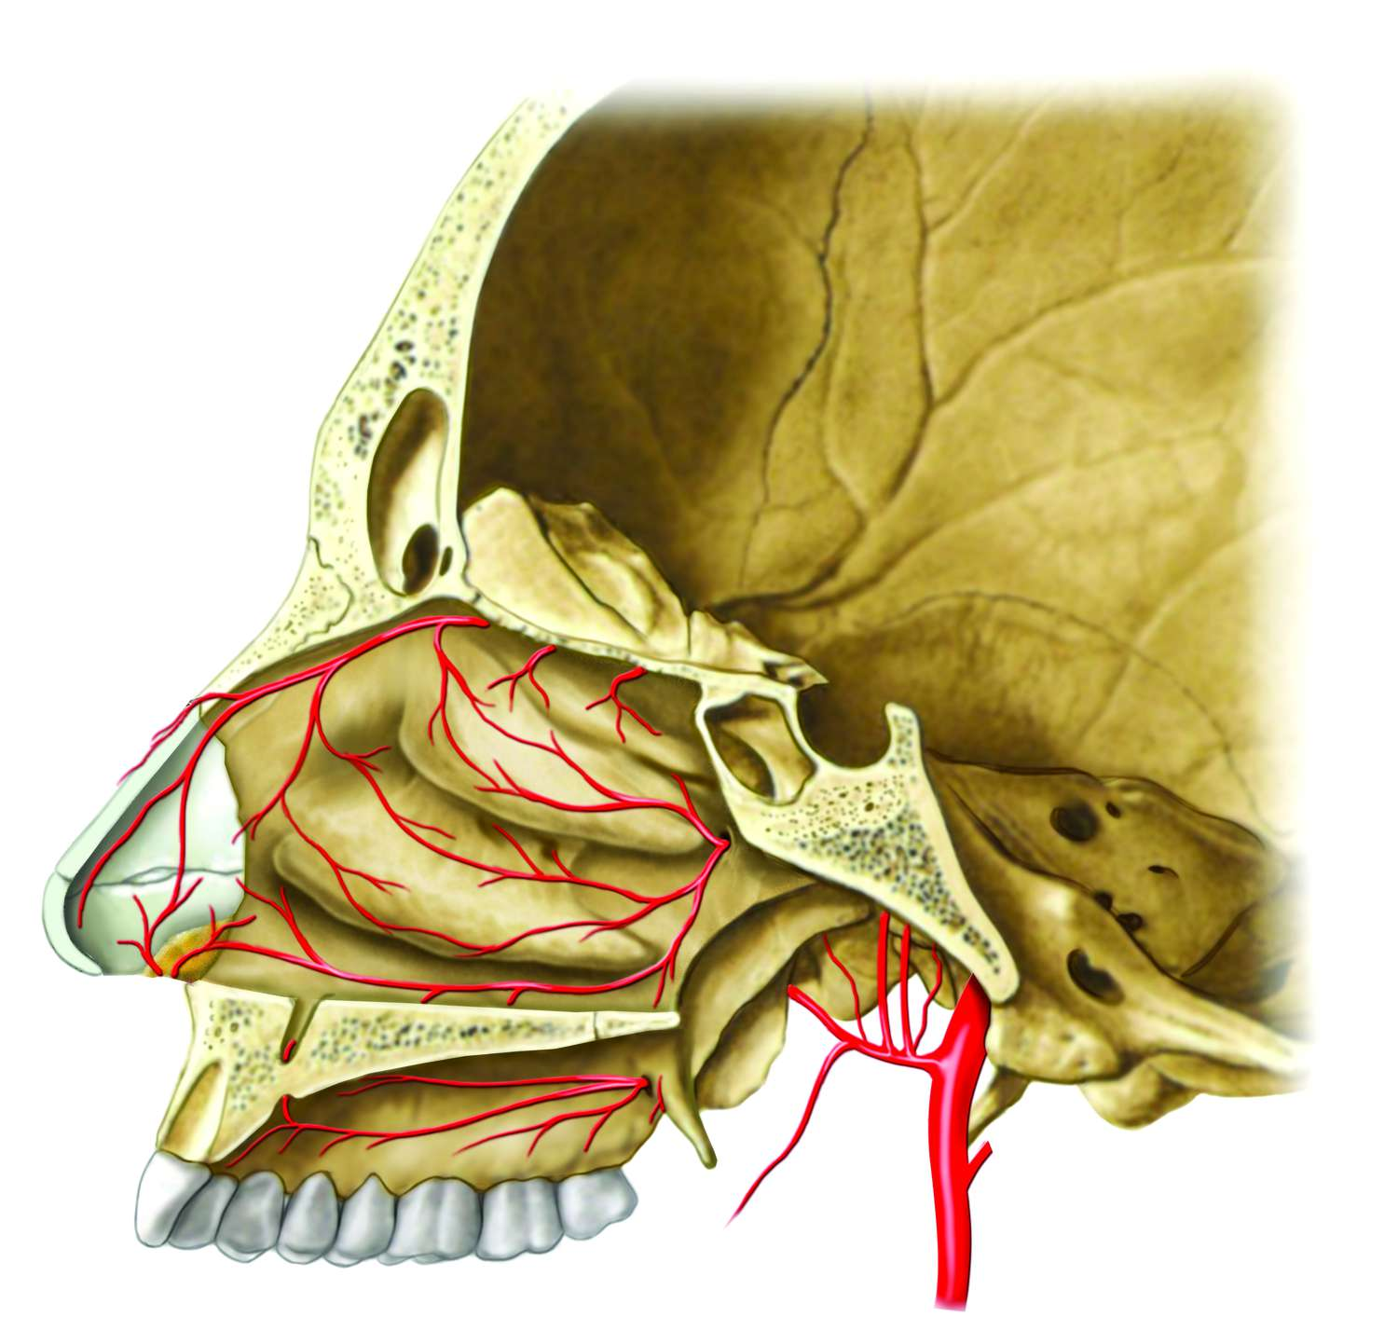
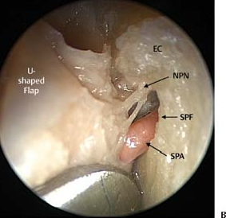

Slide 15
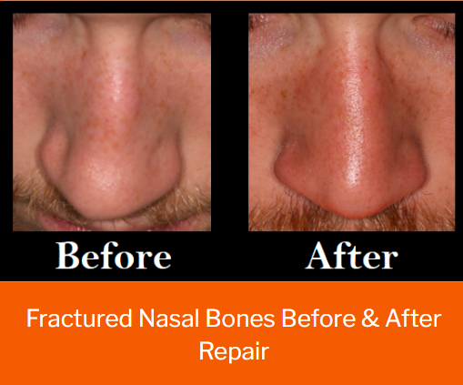
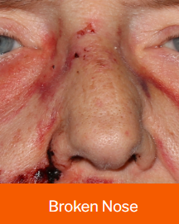

Slide 16
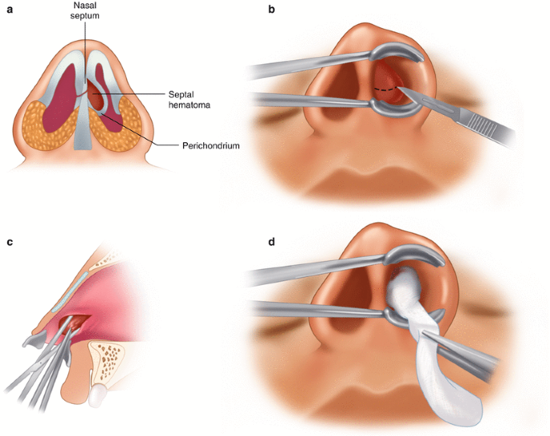
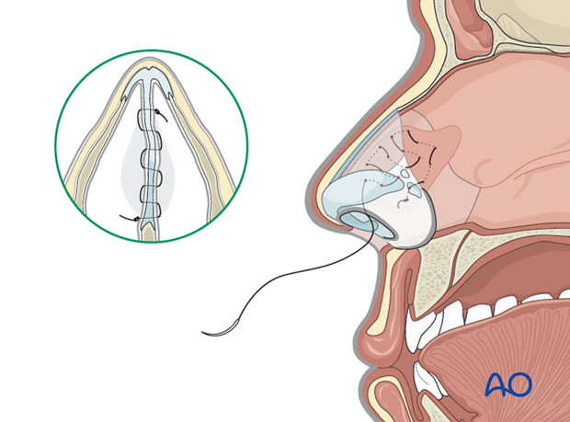
Notes:
Treatment of a septal hematoma is urgent, because the septal cartilage depends on the mucoperichondrial blood supply. When the septal cartilage is dissociated from the mucoperichondrium by a hematoma or abscess, cartilage ischemia and ultimately a saddle nose deformity can result. Infection in the periseptal space can propagate through the valveless venous system and cause sepsis.
Contiguous spread of the septal infection can then lead to further complications, such as osteomyelitis, orbital and intracranial abscesses, meningitis, and cavernous sinus thrombosis
Septal hematomas and abscesses are generally treated with incision and drainage via a hemi-transfixion or Killian incision, which is usually performed in the operating room under general anesthesia in children and under local anesthesia in older and more cooperative patients.
Once the hematoma or abscess is fully evacuated, a quilting stitch may be placed to coapt the mucoperichondrial flaps. Splints are often placed for several days with oral antibiotic prophylaxis

Slide 17
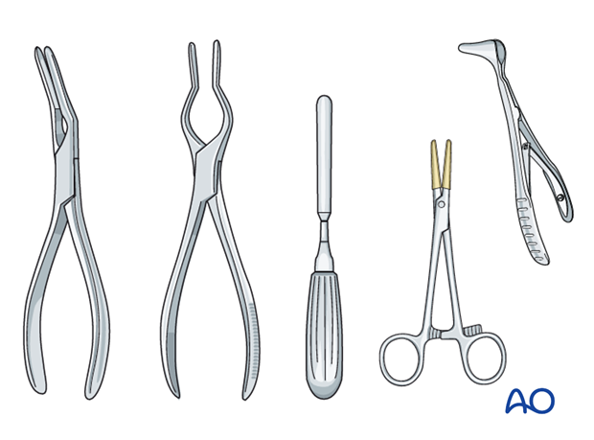
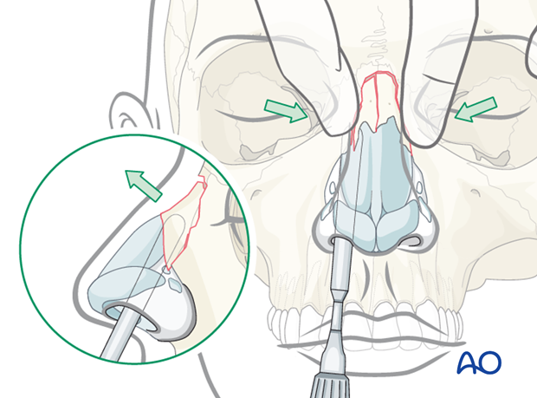
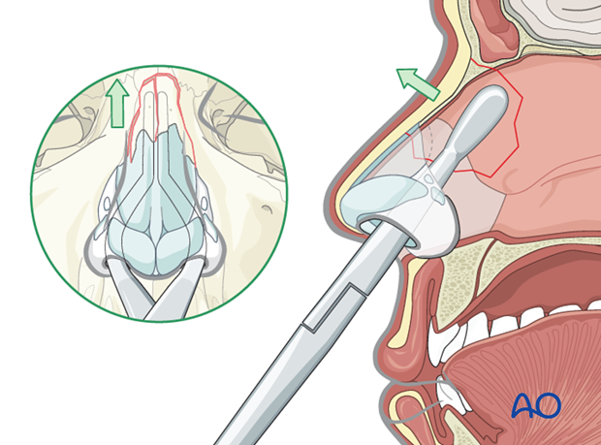
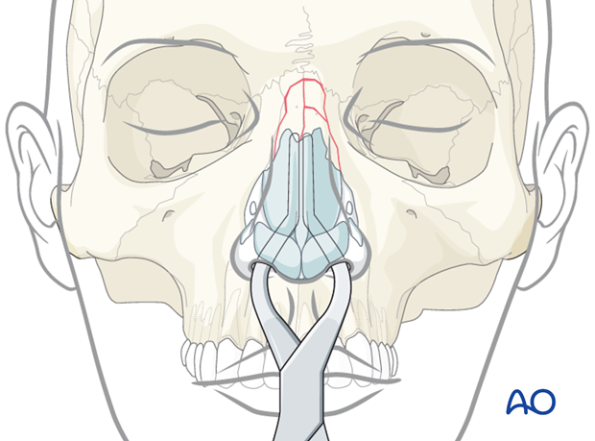
Notes:
Asch septum-straightening forceps
Walsham septum-straightening forceps
Boies nasal fracture elevator
Mayo hemostat with rubber tubing
Killian nasal septum speculum

Slide 18
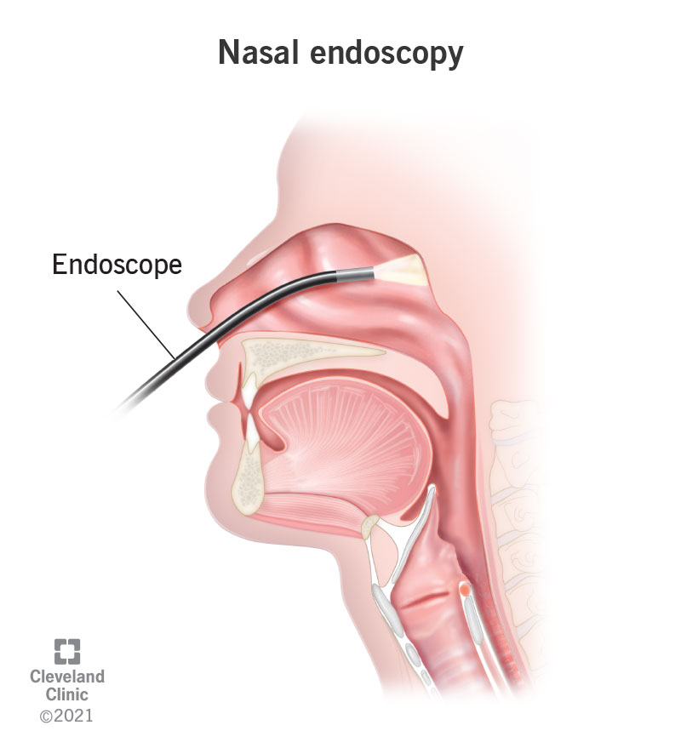

Slide 19
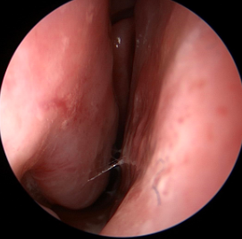
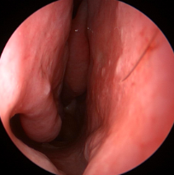

Slide 20
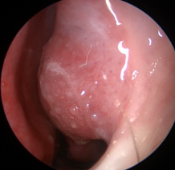
Notes:
Enlarged IT

Slide 21
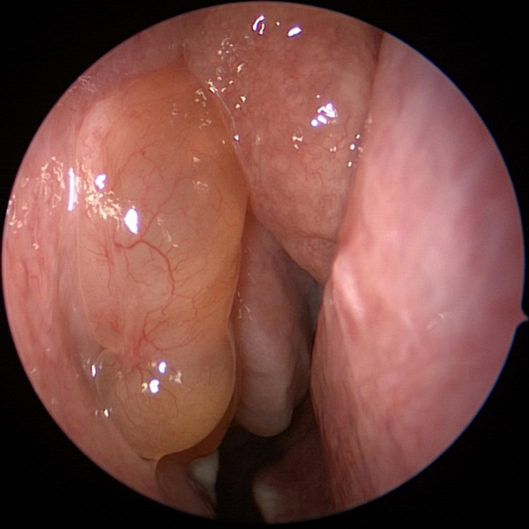
Notes:
Nasal Polyp

Slide 22
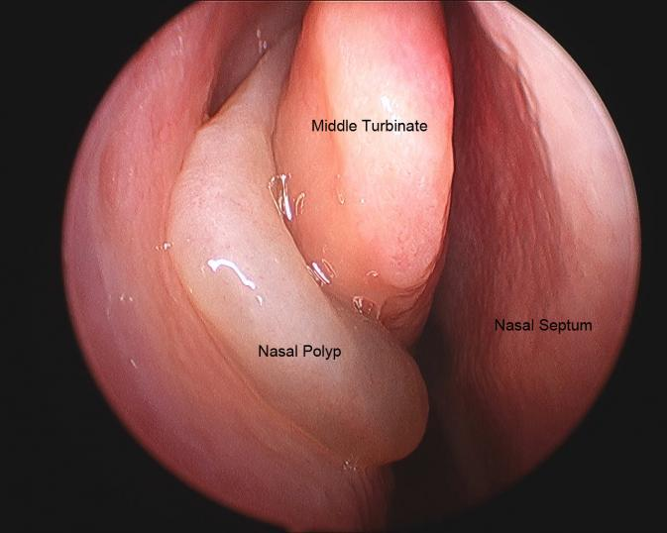

Slide 23
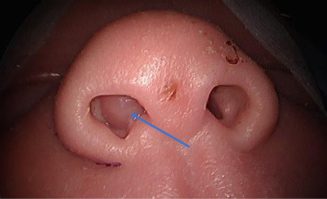
Notes:
DDx for nasal mass
Encephalocele (target question: not to do biopsy)
Polyps
JNA (target question: CT Angio)
Inverted papilloma
….
…

Slide 24
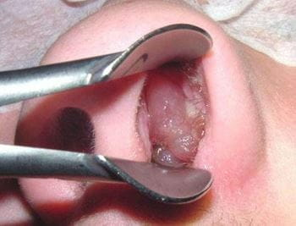

Slide 25
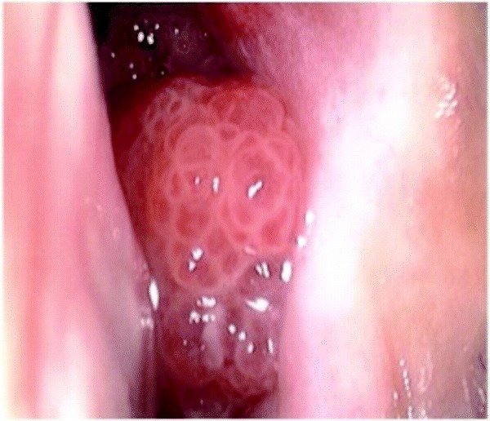
Notes:
Inverted papilloma

Slide 26
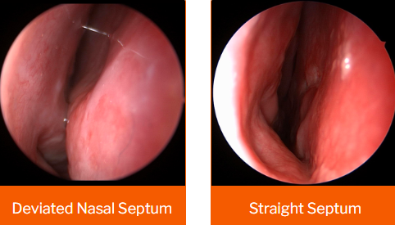

Slide 27
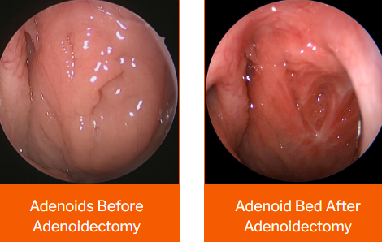

Slide 28
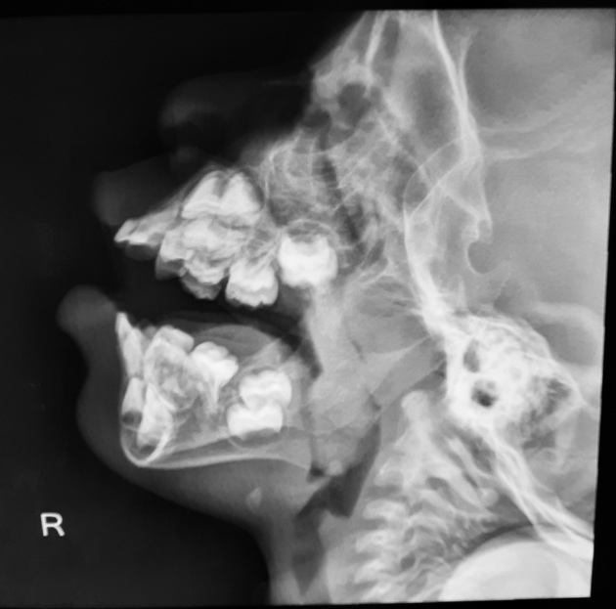

Slide 29
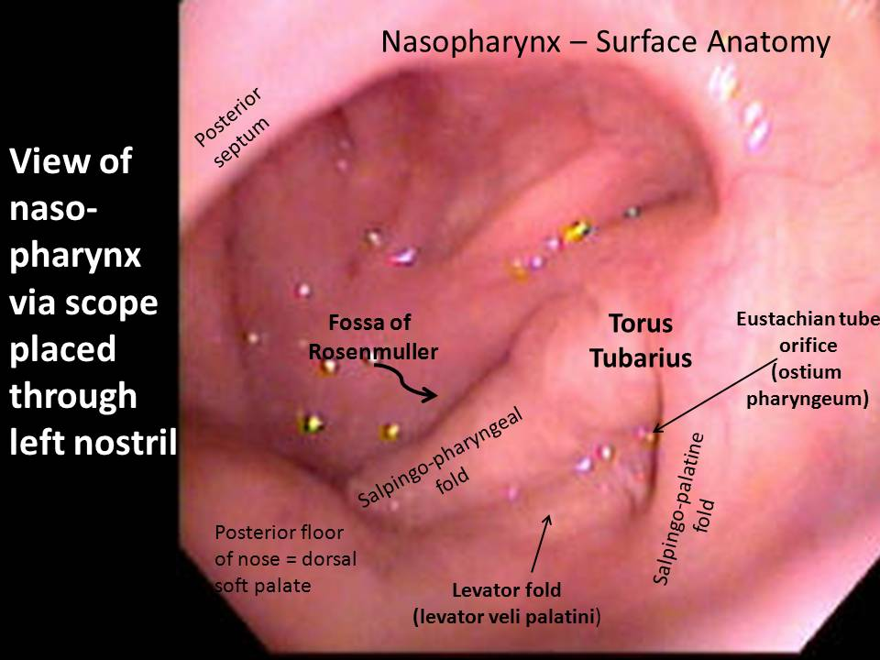

Slide 30
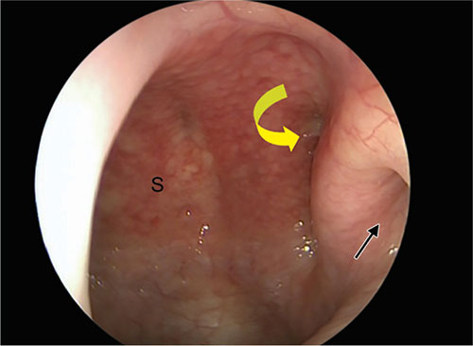
Notes:
Fossa of rosenmuller

Slide 31
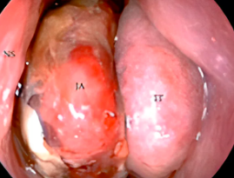

Slide 32
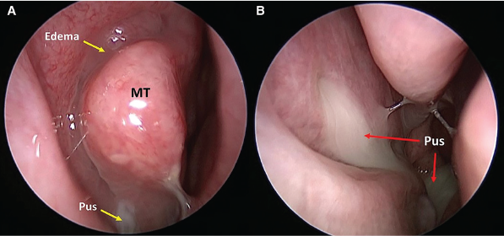

Slide 33
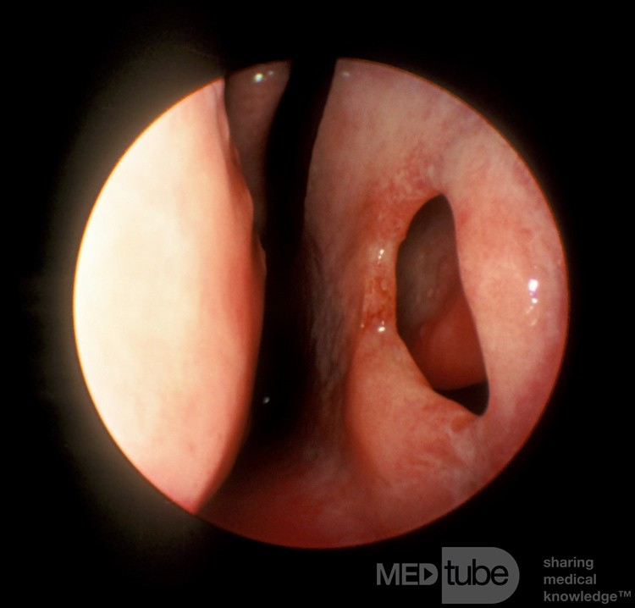

Slide 34
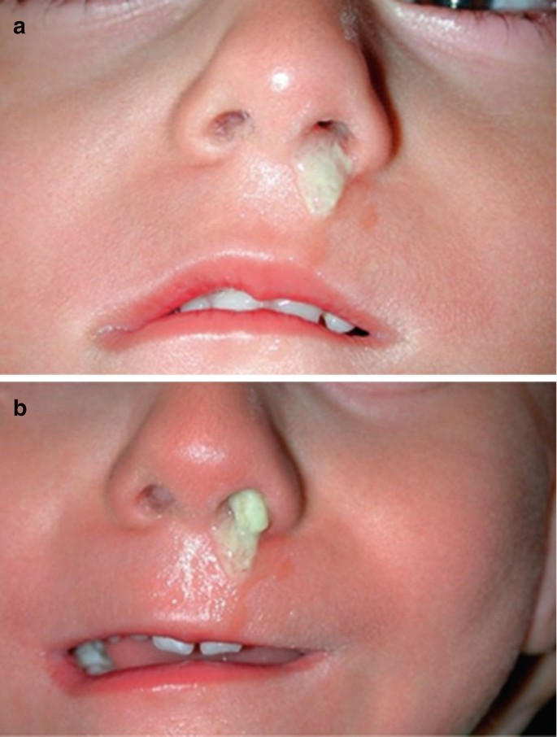
Notes:
Unilateral nasal DDx

Slide 35
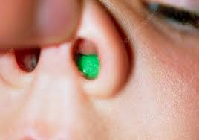

Slide 36
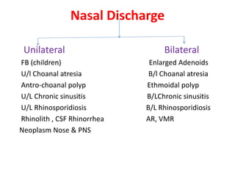

Slide 37
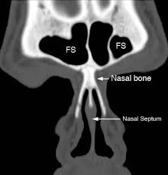

Slide 38
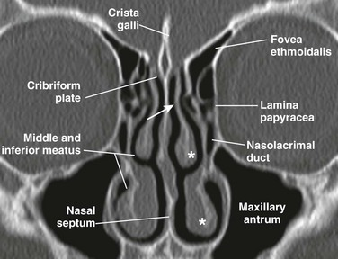

Slide 39
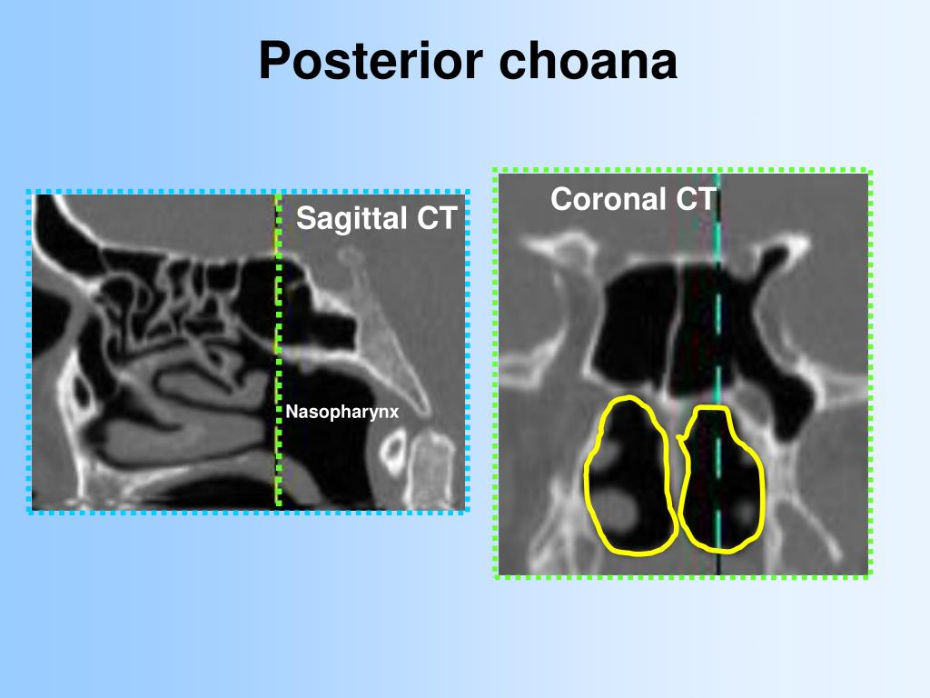

Slide 40
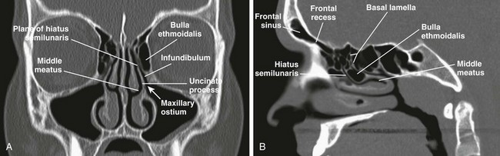

Slide 41


Slide 42


Slide 43


Slide 44


Slide 45


Slide 46


Slide 47


Slide 48



Slide 49


Slide 50


Slide 51


Slide 52


Slide 53



Slide 54


Slide 55


Slide 56


Slide 57


Notes:
Fungal ball

Slide 58
Otology

Slide 59


Slide 60


Slide 61


Slide 62


Slide 63


Slide 64


Slide 65


Slide 66


Slide 67


Slide 68


Slide 69


Slide 70




Slide 72


Slide 73


Slide 74


Slide 75


Slide 76


Slide 77


Slide 78


Slide 79


Slide 80


Slide 81


Slide 82


Slide 83


Slide 84


Slide 85


Slide 86

Notes:
Hyperemia Stage

Slide 87

Notes:
Exudative Stage

Slide 88


Slide 89


Slide 90


Slide 91



Slide 92

DDx for Postauricular Swelling

Slide 93


Slide 96



Slide 98


Slide 99


Slide 100



Notes:
A typical attic retraction cholesteatoma (primary acquired cholesteatoma).
Keratinizing epithelium has migrated through a perforation into the middle ear (secondary acquired cholesteatoma)
Behind or within an intact tympanic membrane (congenital cholesteatoma)

Slide 101


Slide 102


Slide 103



Slide 104


Slide 105


Slide 106


Slide 107


Slide 108


Slide 109


Slide 110


Slide 111


Slide 112


Slide 113


Slide 114


Slide 115


Slide 116


Slide 118


Slide 119


Slide 120


Slide 121


Slide 122


Slide 123

Notes:
From this slide onward, students should be able to correctly identify the type and side of hearing loss
Mention possible differential and treatments for each case.

Slide 124


Slide 125


Slide 126


Slide 127


Slide 128


Slide 129


Slide 130


Slide 131


Slide 132


Slide 133


Slide 134

Rinne Negative on the Right
Right BC > AC
How would you interpret this result?
What is the diagnosis?

Slide 135
Laryngology + Head & Neck

Slide 136



Slide 137


Slide 138


Slide 139


Slide 140


Slide 141


Slide 142


Slide 143


Slide 144


Slide 145


Slide 146

Notes:
most common cause of stridor in the newborn
Laryngomalacia is characterized by the onset of high-pitched inspiratory stridor within the first two weeks of life. Stridor is exacerbated by feeding, crying, and lying in a supine position. Symptoms typically peak around 6 months of age, and spontaneously resolve by 12–24 months
hort aryepiglottic folds (100 %), floppy cuneiforms (60 %), and an omega-shaped epiglottis (20 %)

Slide 147


Slide 148


Slide 149


Slide 150



Slide 151


Slide 152


Slide 153


Slide 154


Slide 155



Slide 156


Slide 157


Slide 158


Slide 159


Slide 160


Slide 161


Slide 162

Notes:
Peritonsillar Abscess (compare with SCC in the next pic)

Slide 163


Notes:
Potential airway compromise or comorbidities – Patients with impending airway compromise require airway management and emergency surgical intervention (drainage or tonsillectomy).
In randomized trials comparing needle aspiration with incision and drainage, the procedures had similar initial success rates of >90 percent [39,42,54-56]. In one meta-analysis, needle aspiration had a 94 percent success rate for acute resolution (range 85 to 100 percent)

Slide 164

Notes:
Compare to the previous picture (peritonsillar abscess), notice the ugly looking mass here which is typical of oropharyngeal scc

Slide 165

Notes:
Tongue SCC

Slide 166

Notes:
Palate SCC

Slide 167


Notes:
Retropharyngeal abscess

Slide 168

Notes:
Epiglottitis, thumb sign

Slide 169

Notes:
Steep sign, croup

Slide 170


Slide 171


Slide 172


Slide 173

Notes:
Before and after total laryngectomy for laryngeal ca

Slide 174


Slide 175


Slide 176


Slide 177


Slide 178


Slide 179



Slide 180


Slide 181


Slide 182


Slide 183


Slide 184


Slide 185

Notes:
Midline vs lateral neck masses

Slide 186


Slide 187


Slide 189

Notes:
Parapharyngeal abscess
Keep this DDx in mind in neck masses

Slide 190



Slide 191


Slide 192


Slide 193


Slide 194


Slide 195




Slide 196





Slide 197
Common Methods of Presentation Summary

Slide 198

Epistaxis

Slide 199

Hoarseness of Voice

Slide 200

Dysphagia

Slide 201

Feeling a Lump in the Throat

Slide 202


Lump in the Neck

Slide 203

Mouth/Tongue Ulcer

Slide 204


Stridor

Slide 205

Facial Nerve Palsy

Slide 206

Nasal Obstruction

Slide 207

Ear Discharge

Slide 208

Dizziness & Vertigo

Slide 209

Otalgia

Slide 210


Hearing Loss

Slide 211

Tinnitus

Slide 212

Facial Pain

Slide 213


