Slide 1
Introduction to Nuclear Medicine

Slide 2
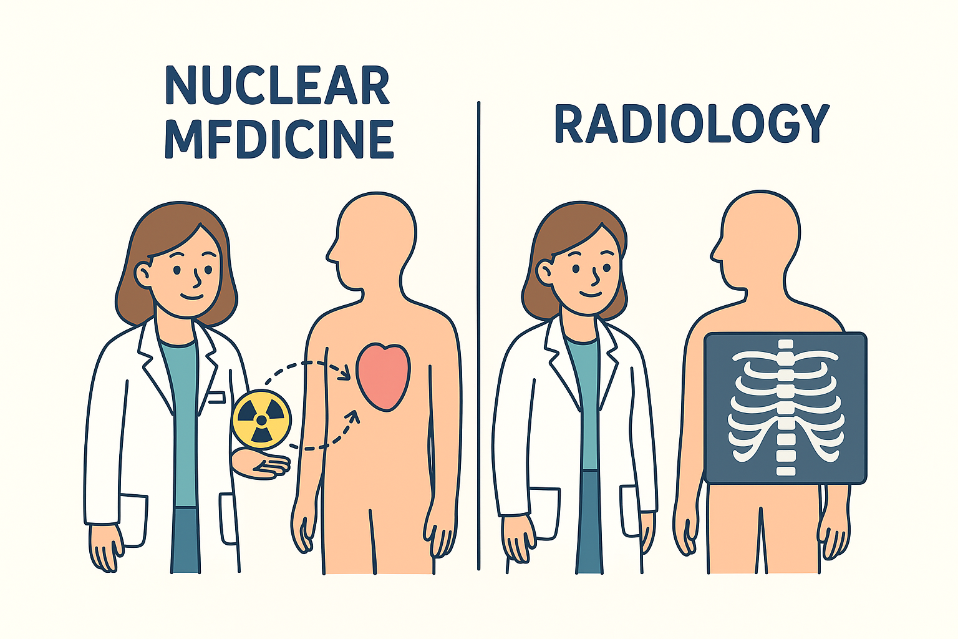
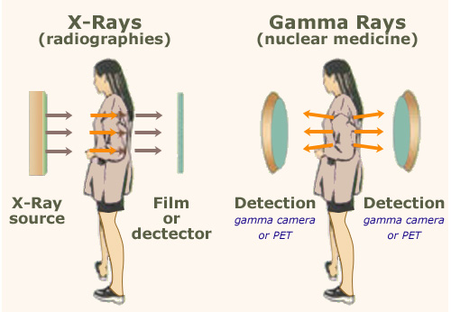
Difference between types of Radiation
Notes:
Difference between the Radiology and Nuclear medicine

Slide 3
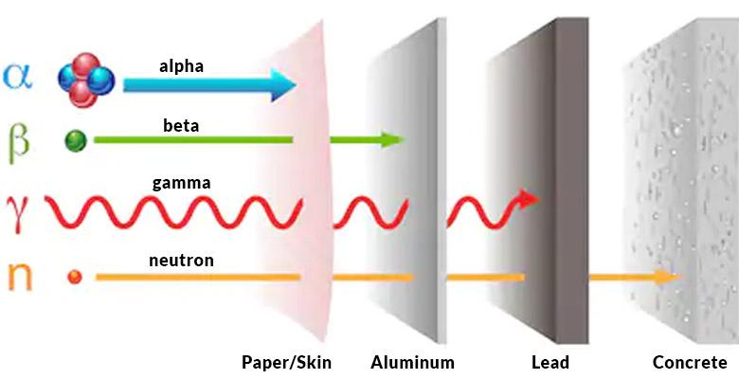
Continue

Slide 4
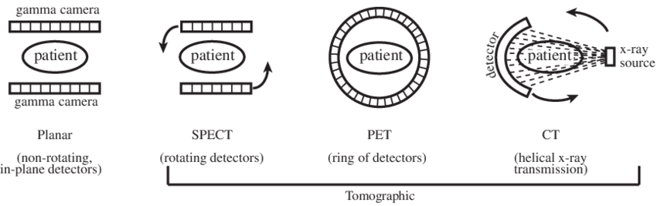
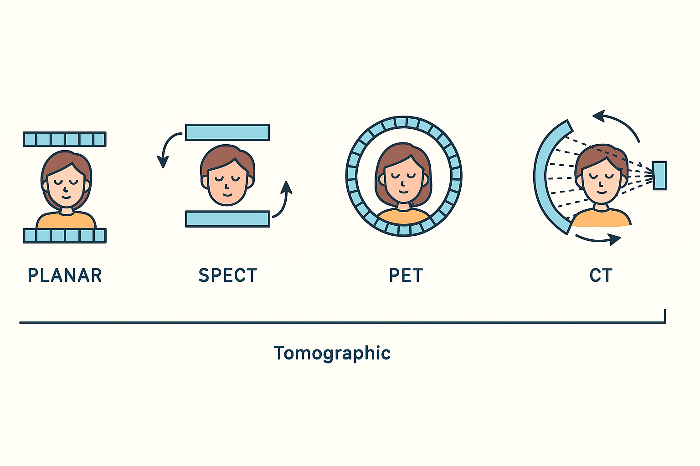
Types of Modality
Notes:
Higher resolution in PET

Slide 5
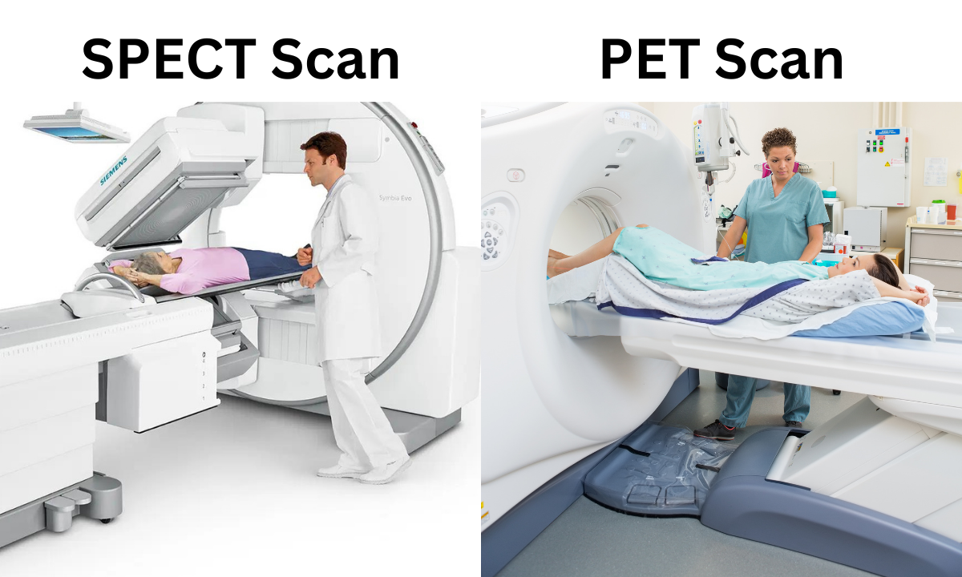

Slide 6
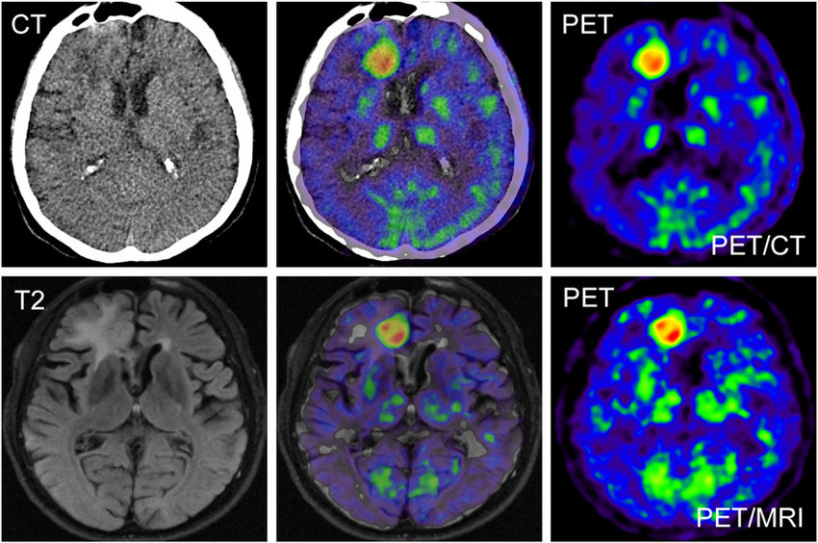
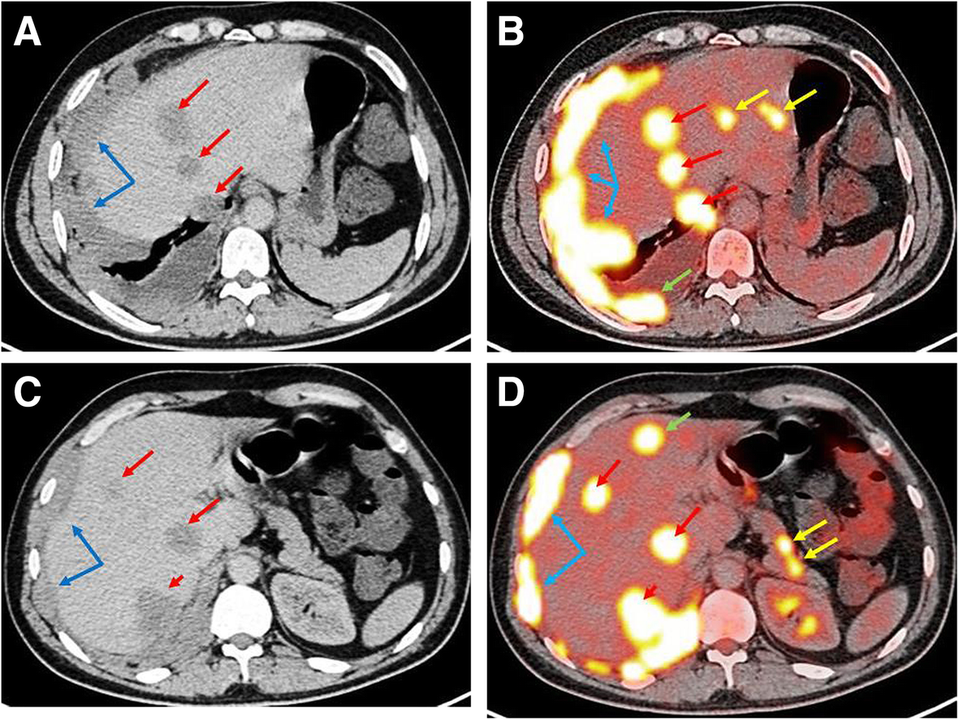
Notes:
The key distinction between nuclear medicine and almost all other imaging modalities– images may indicate dynamic information – function, not just structure

Slide 7
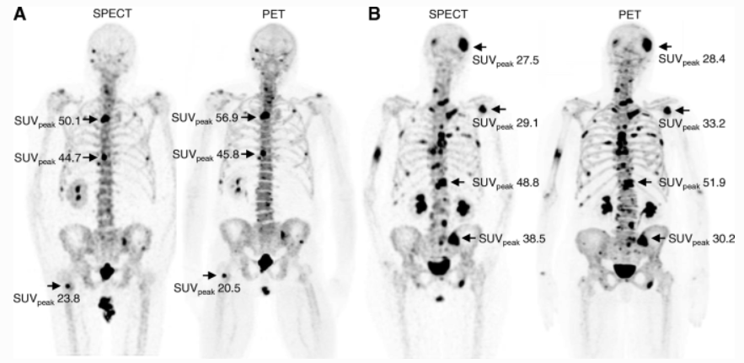

Slide 8

What is a radio-pharmaceutical?
  A radionuclide (radioactive and emits something we can detect, usually gamma rays); ^{99m}Tc.
A pharmaceutical (which gives the physiologic function);
DTPA 🡺 glomerular filtration rate.
MDP 🡺 bone scan.
Notes:
Nuclide
– It is identified by an exact nuclear composition including the
mass # A and atomic # Z
• Radionuclide
– Unstable or radioactive nuclide
• Isotopes
– Nuclides with the same atomic # and exhibit the same
chemical properties
• Isomers
– Nuclides having the same number of protons and neutrons
but differing in energy states

Slide 9
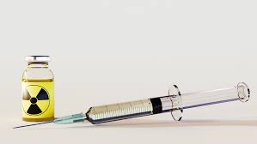
Ideal diagnostic radiopharmaceutical
Pure Gamma Emitter
  Alpha and Beta Particles are unimageable and deliver high radiation dose to the target.
  Energy of Gamma Rays
  Ideal: 100 - 250 keV (^{99m}Tc, ¹²³I, ¹¹¹In)
  Suboptimal: < 100 keV (²⁰¹Tl)
  > 250 keV (⁶⁷Ga, ¹³¹I)
    High target to non-target (background) ratio.
Easily available.
Suitable effective half-life.
Notes:
It should be short enough to minimize the radiation dose to patients and long enough to perform the procedure. Ideally 1.5 times the duration of the diagnostic procedure.

Slide 10
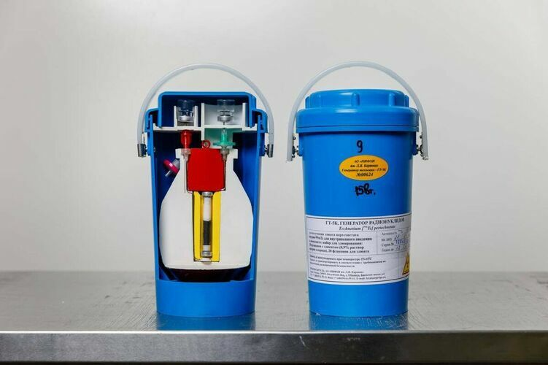
^{99m}Tc (99-metastable-Technitium)
Most used radionuclide
Pure gamma radiation
140 keV energy level
Half life of 6 hours
Available
Cheap
Produced by a generator from ⁹⁹Mo

Slide 11
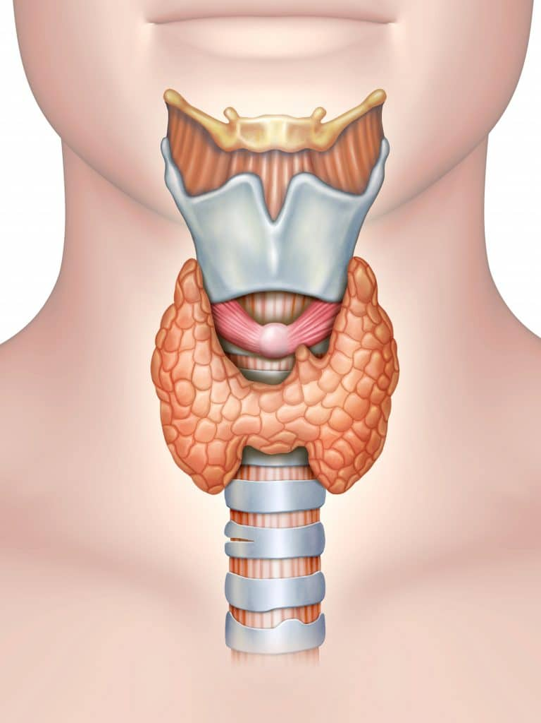
Thyroid Scintigraphy
^{99m}Tc-pertechnetate and ¹³¹I
Notes:
Tc undergoes trapping but no organification

Slide 12
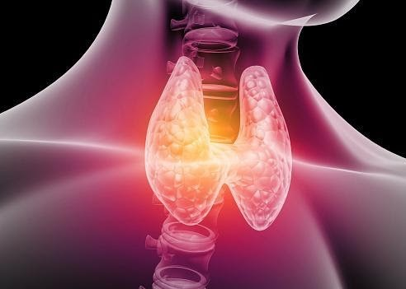
Indications
Low TSH (hyperthyroidism)
  Diffuse toxic goiter (Graves’ disease)
  Toxic multinodular goiter (Plummer's disease)
  Single toxic nodule
  Early-phase of subacute thyroiditis (de Quervain's thyroiditis)
Evaluate nodule (hot vs. cold)
Notes:
Thyrotoxicosis: a group of symptoms and signs due to elevated thyroid hormones in the body of any cause.
Hyperthyroidism: a group of symptoms and signs due to increased production of thyroid hormones by hyper functioning thyroid gland.

Slide 13
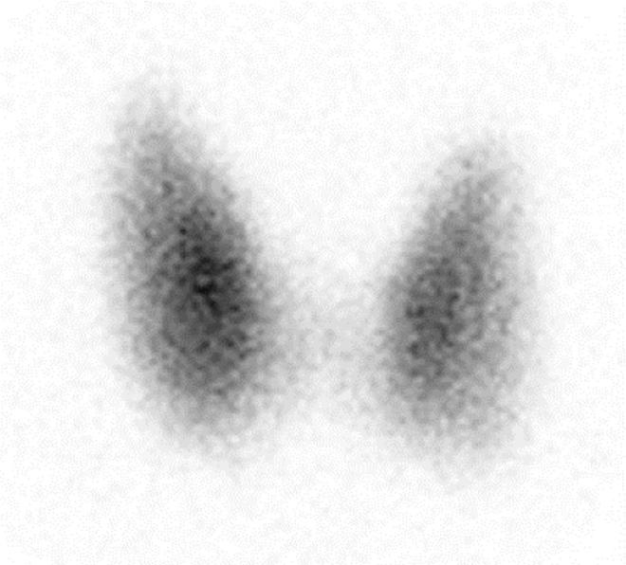
Normal Scan - RAIU 10-30 %

Slide 14
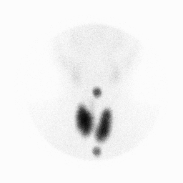
Notes:
Graves with markers

Slide 15
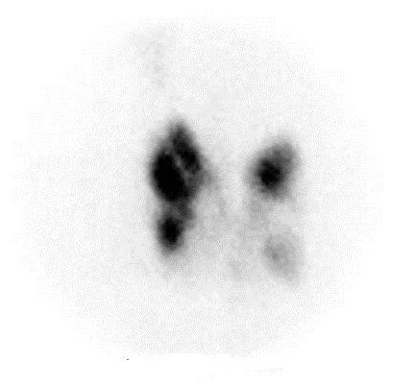
Notes:
Toxic MNG

Slide 16
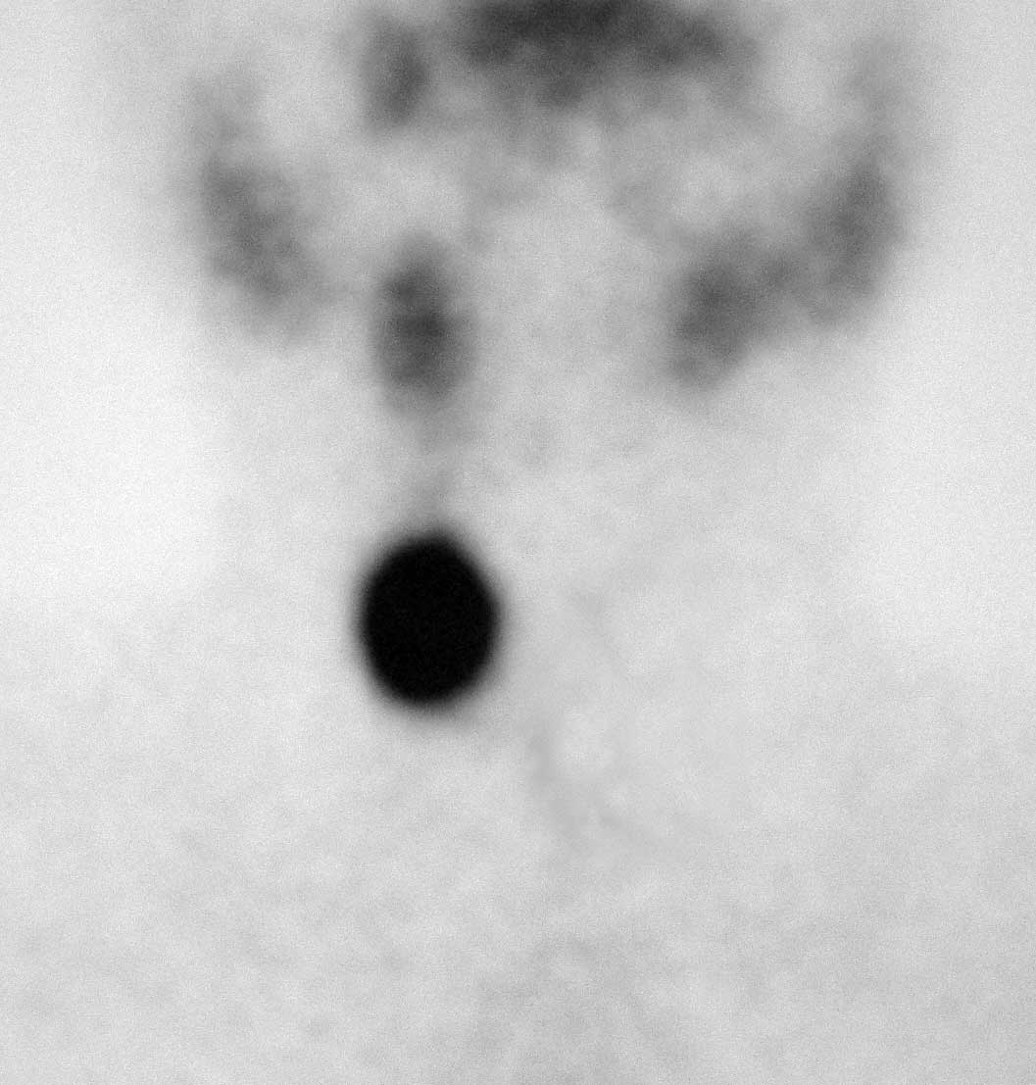
Notes:
Toxic adenoma

Slide 17
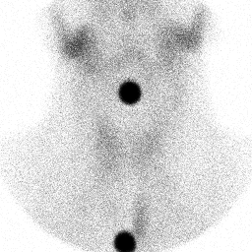
Notes:
Subacute thyroiditis with markers

Slide 18
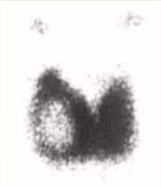
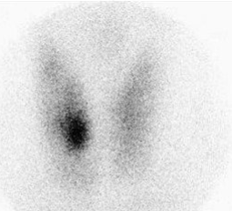
Hot nodule
Cold nodule
Notes:
Malignancy risk about 15-20%

Slide 19
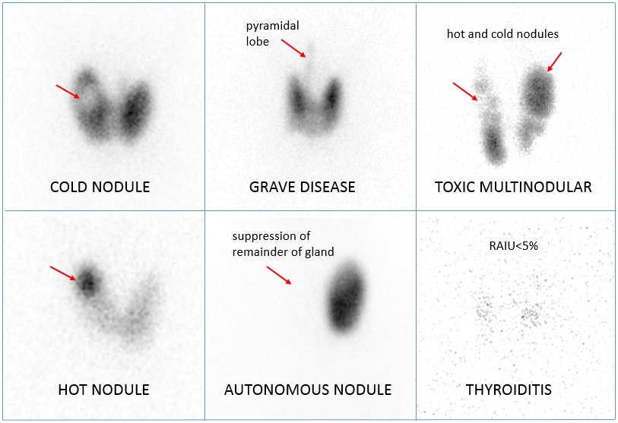
TOXIC ADENOMA
SUBACUTE THYROIDITIS

Slide 20
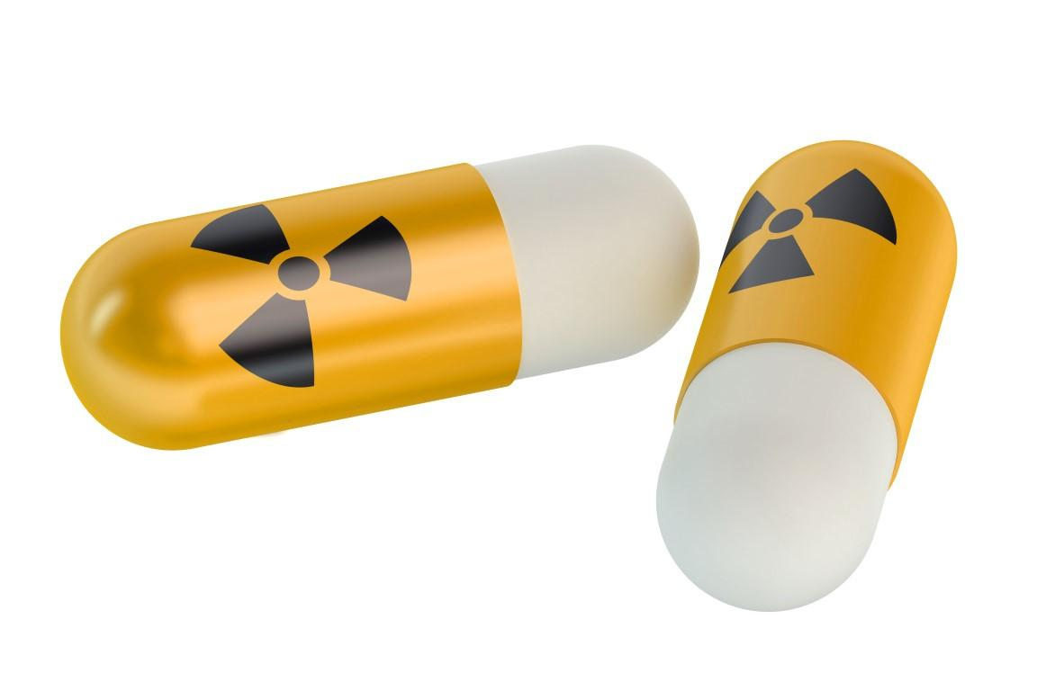
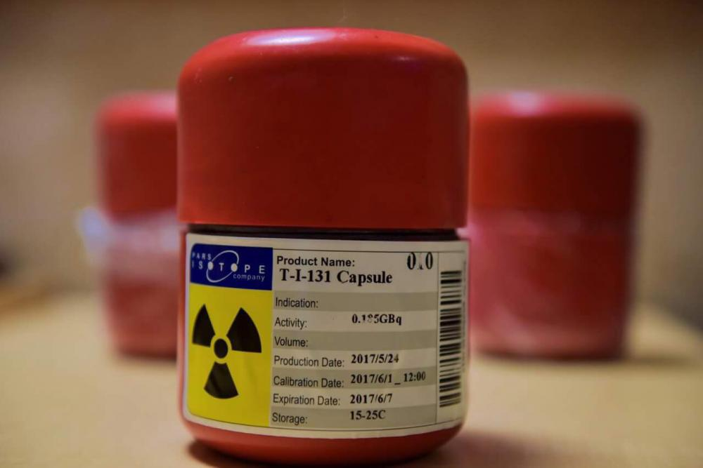
¹³¹I Treatment
Beta-emitting radionuclide
Energy level 606 keV (beta) and 364 keV (gamma)
Produced by reactor (fission)
Half-life of 8 days
Used as primary or secondary after medications or surgery
Indications:
Hyperthyroidism
    Graves’ disease
    Toxic multinodular goiter
    Toxic adenoma
  Differentiated thyroid cancer
    Papillary thyroid cancer
    Follicular thyroid cancer

Slide 21
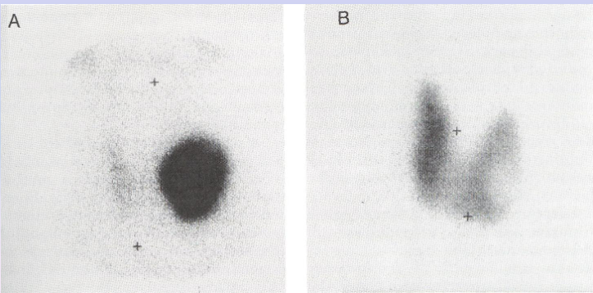
Post ¹³¹I Treatment
Notes:
Single Toxic Adenoma treated with RAI

Slide 22
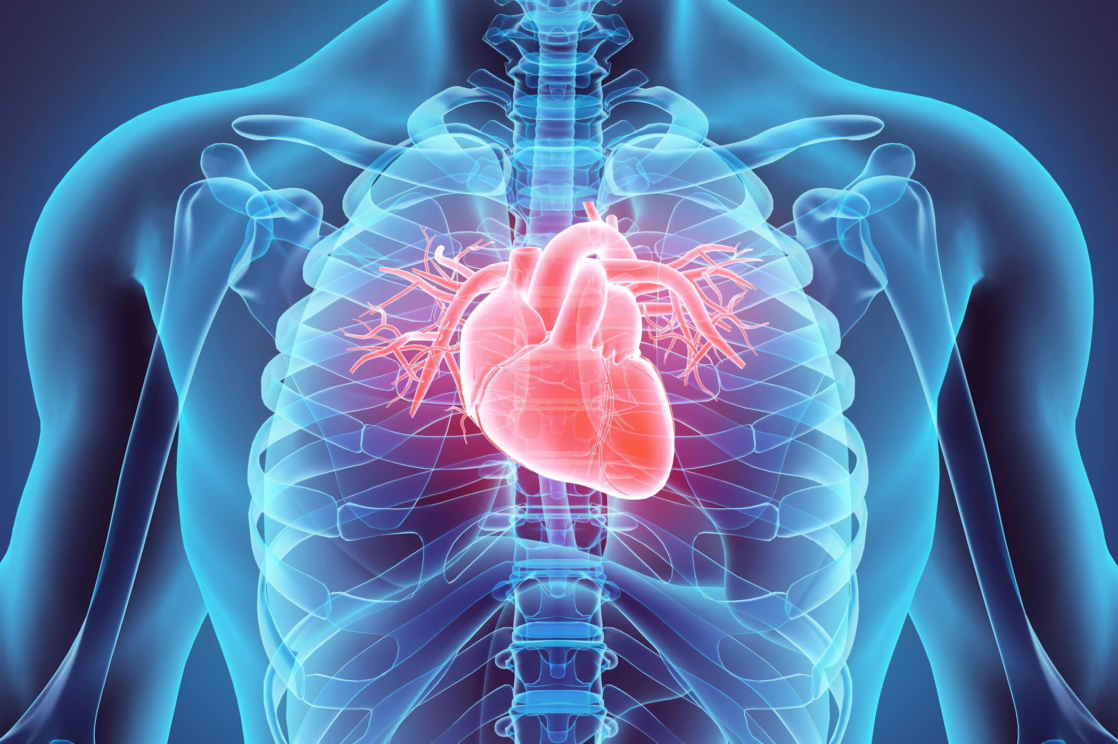
Myocardial Perfusion

Slide 23
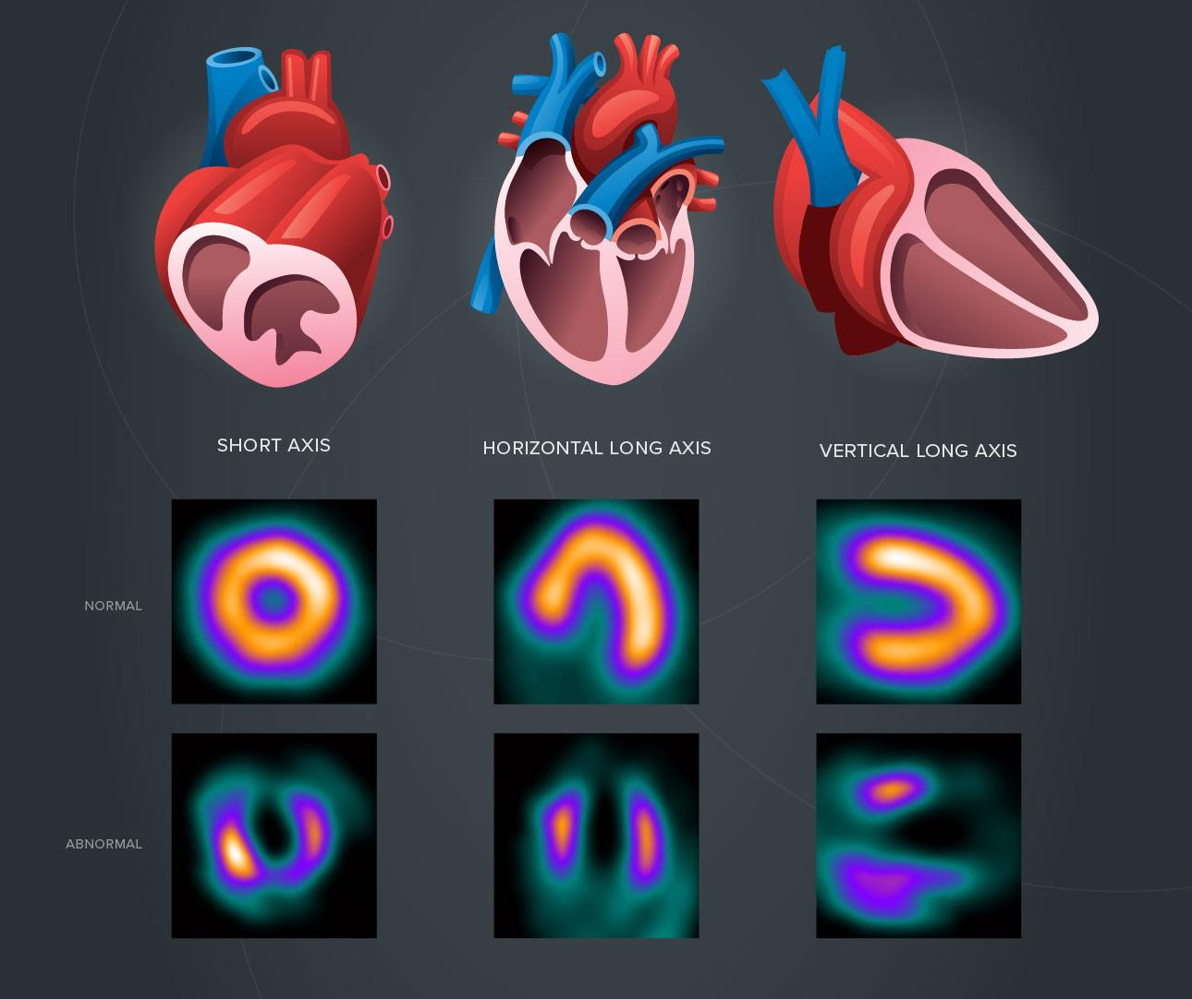
Radiopharmaceuticals
SPECT (Perfusion)
  ^{99m}Tc-sestamibi
  ^{99m}Tc-tetrofosmin
  ²⁰¹Thalium
PET (Viability)
  ¹⁵O-water
  ¹³N-ammonia
  ⁸²Rubidium
  ¹⁸F-flurpiridaz

Slide 24
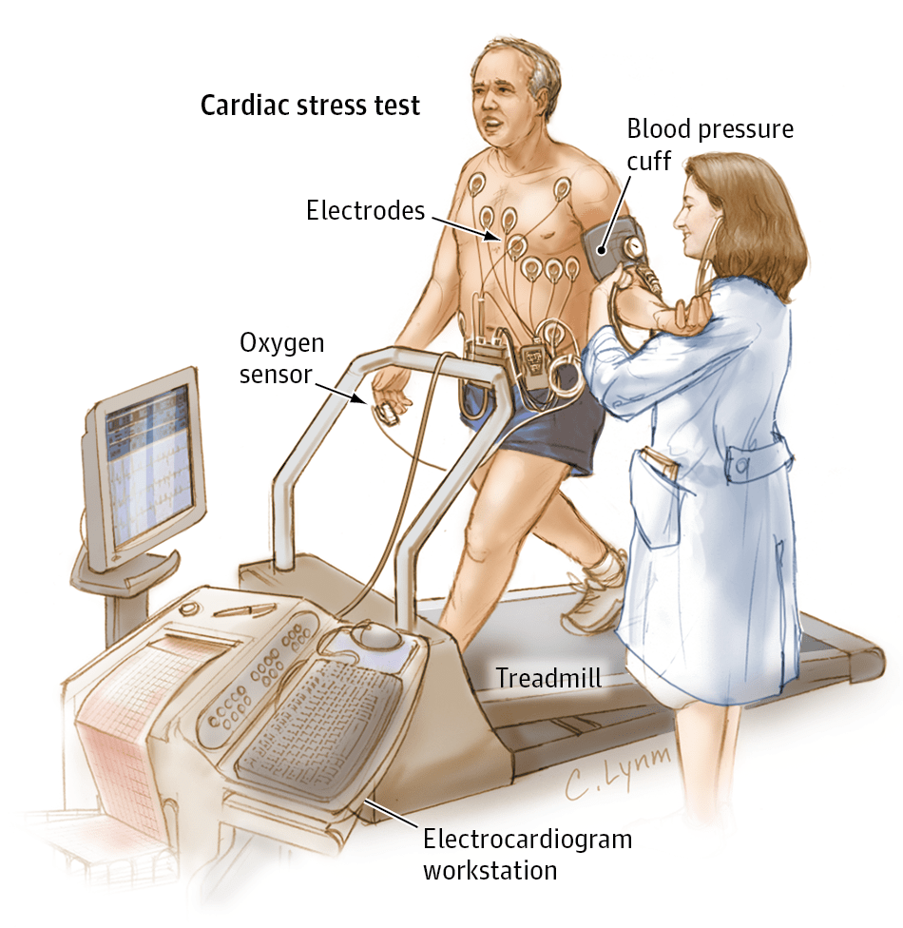
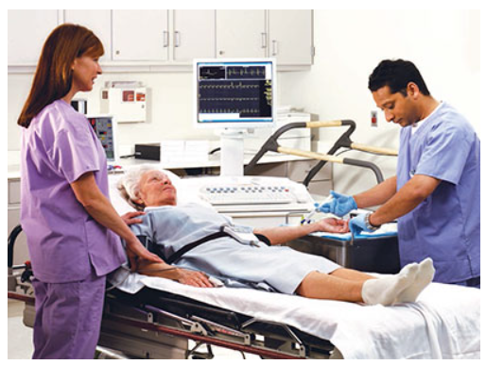
Methods of Inducing Stress
Pharmacologic
  Adenosine
  Dobutamine
  Dipyridamole
  Regadenosone
Exercise
  Treadmill
  Bicycle

Slide 25
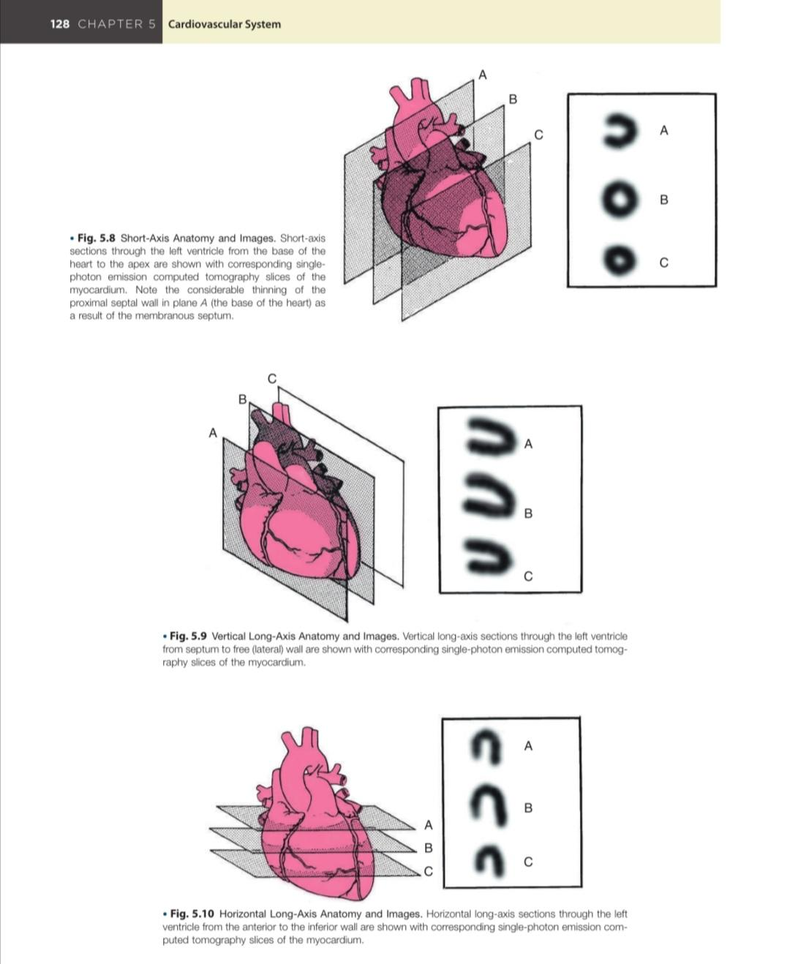
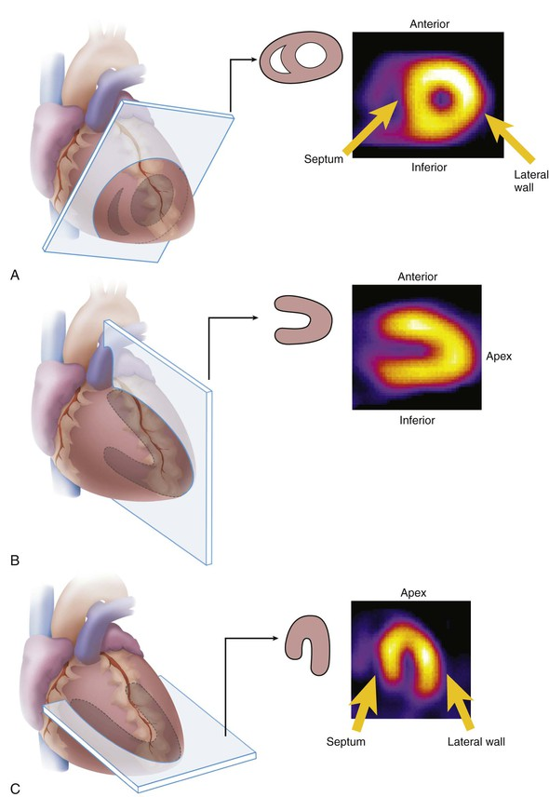
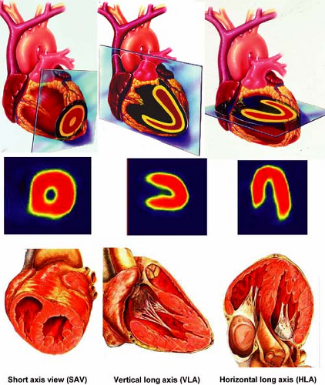

Slide 26
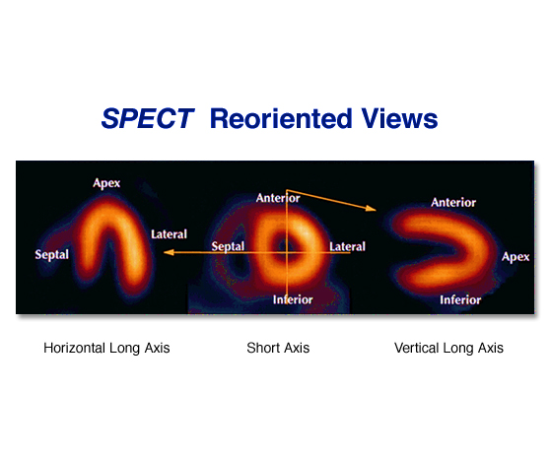
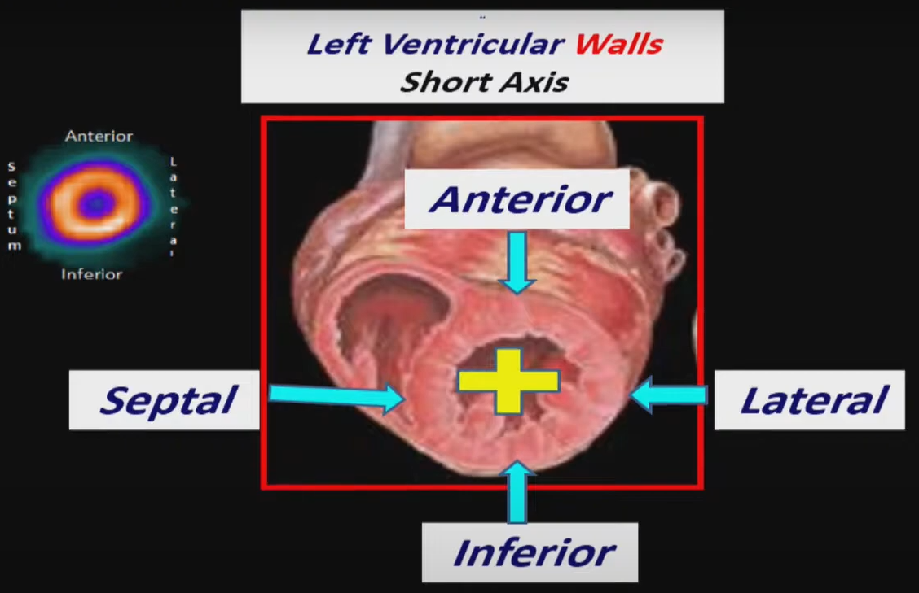

Slide 27
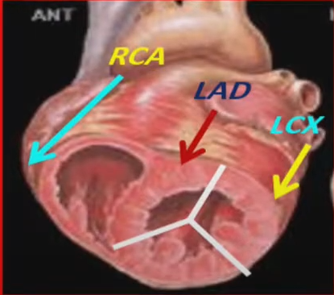
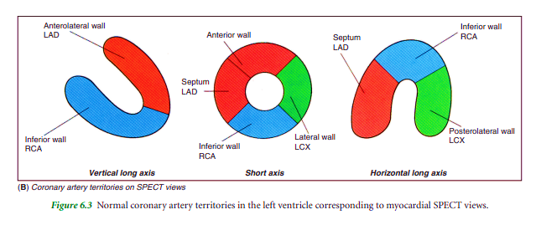

Slide 28
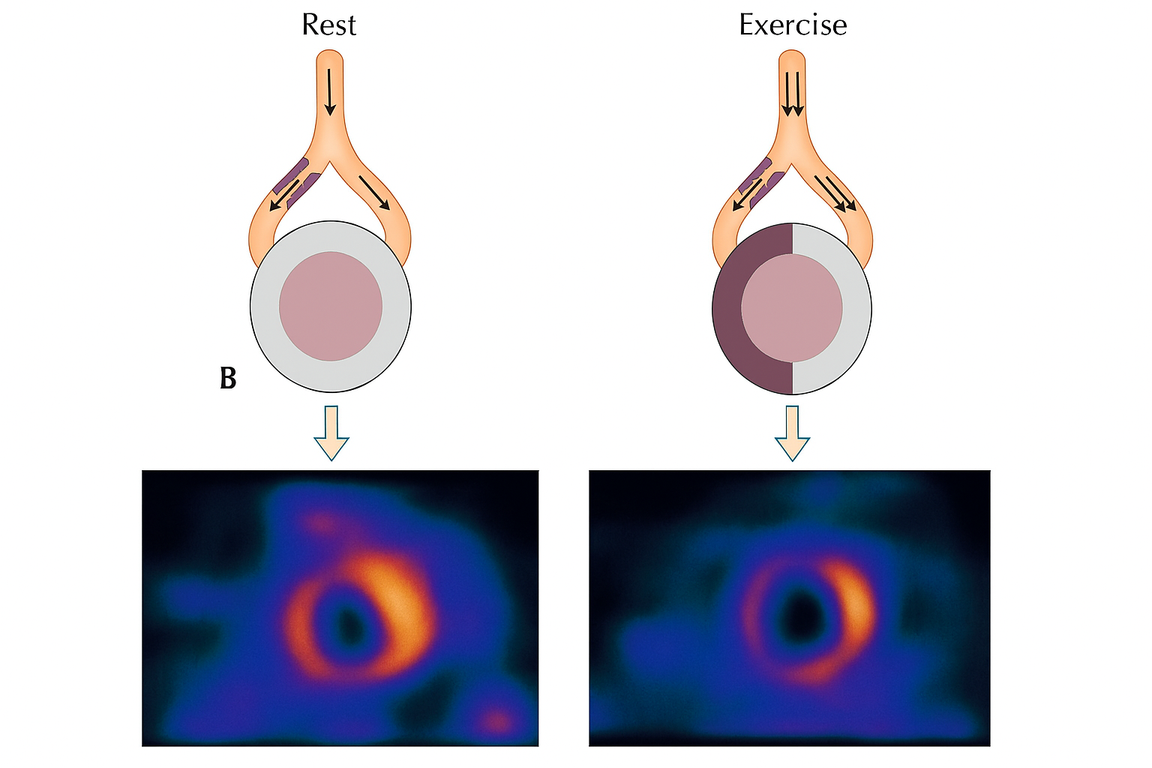
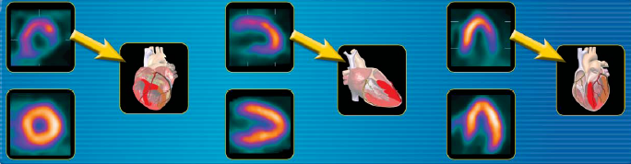
Rest
Notes:
Septal with anteroseptal and inferoseptal extension Ischemia in the superior image.
Inferolateral ischemia in the inferior image.
This may indicate “ischemia” in this region of the heart – which is supplied by the LCX (left circumflex artery). There may be stenosis in that coronary artery.

Slide 29
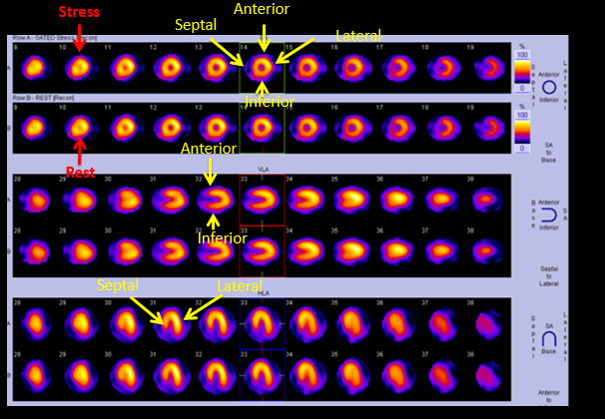
Notes:
Wall of the heart on the stress and rset images (all axis)

Slide 30
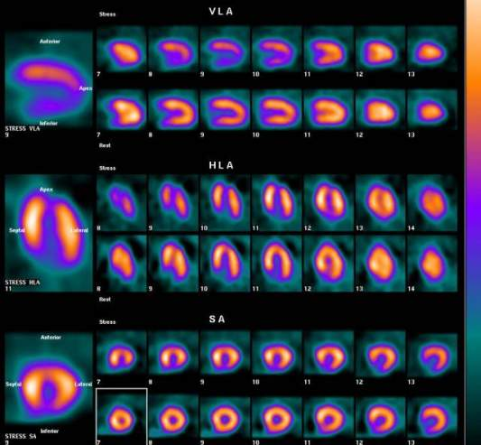
Ant
Stress
Apex
Rest
Inf
Septum 🡪 Lateral
Apex
Stress
Sep
Lat
Rest
Inferior 🡪 Anterior
Ant
Stress
Sep
Lat
Rest
Inf
Apex 🡪 Base
Notes:
30
Complete reversible apical and inferior wall ischeamia

Slide 31
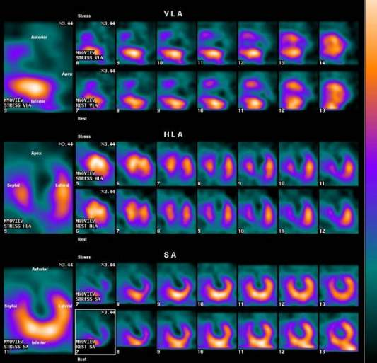
Ant
Stress
Apex
Rest
Inf
Septum 🡪 Lateral
Apex
Stress
Sep
Lat
Rest
Inferior 🡪 Anterior
Ant
Stress
Sep
Lat
Rest
Inf
Apex 🡪 Base
Notes:
31
Apical and Anterior wall infarction

Slide 32
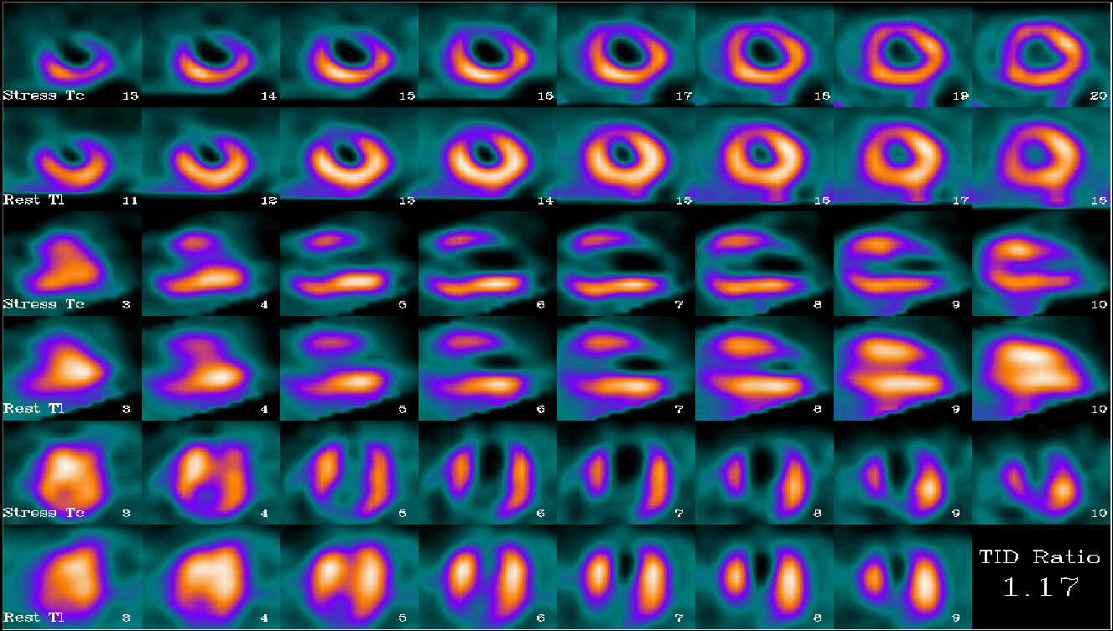
Notes:
Anterior and apical infarction

Slide 33
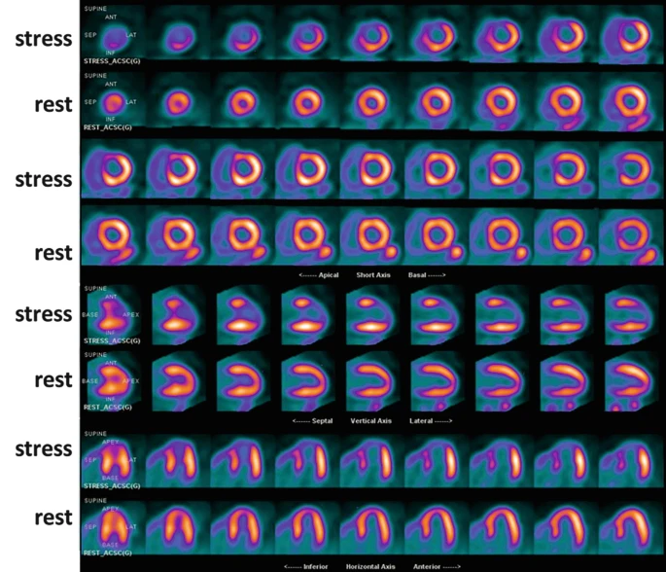
Notes:
apical, anteroseptal, septal walls ischemia with complete reversibility on rest images

Slide 34
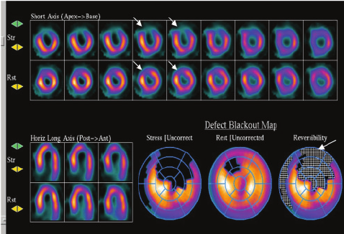
Notes:
Partial reversible anterior wall ischemia

Slide 35
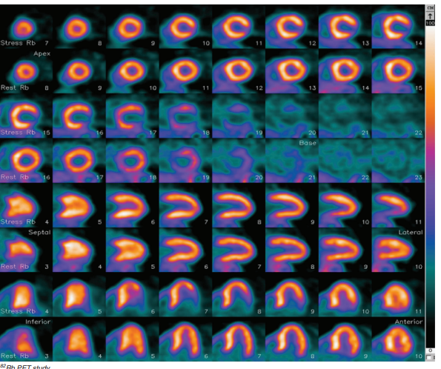
Notes:
Lateral wall ischemia

Slide 36
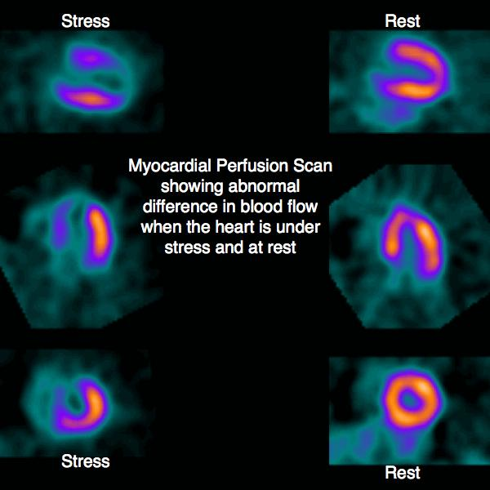
Notes:
Anterior, septal and apical ischemia

Slide 37
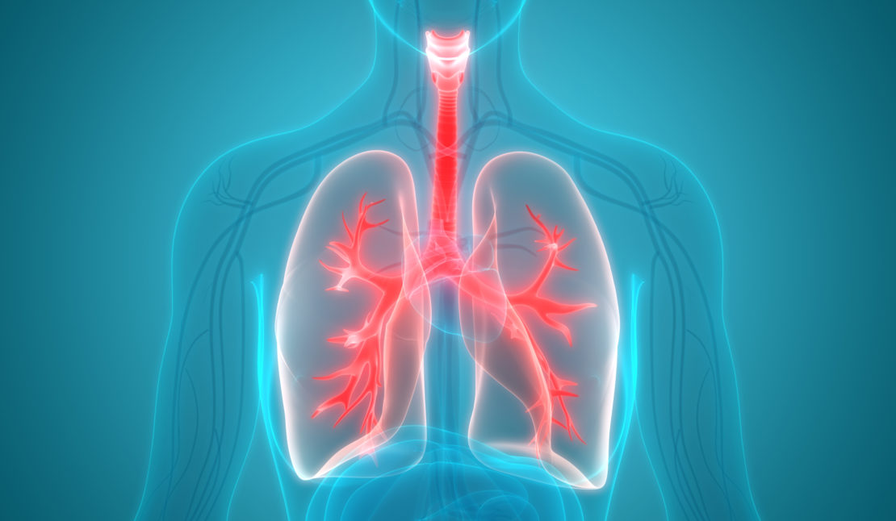
Lung Scintigraphy

Slide 38
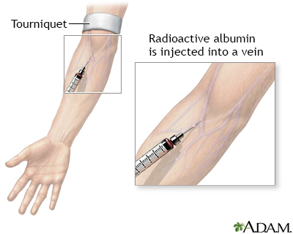
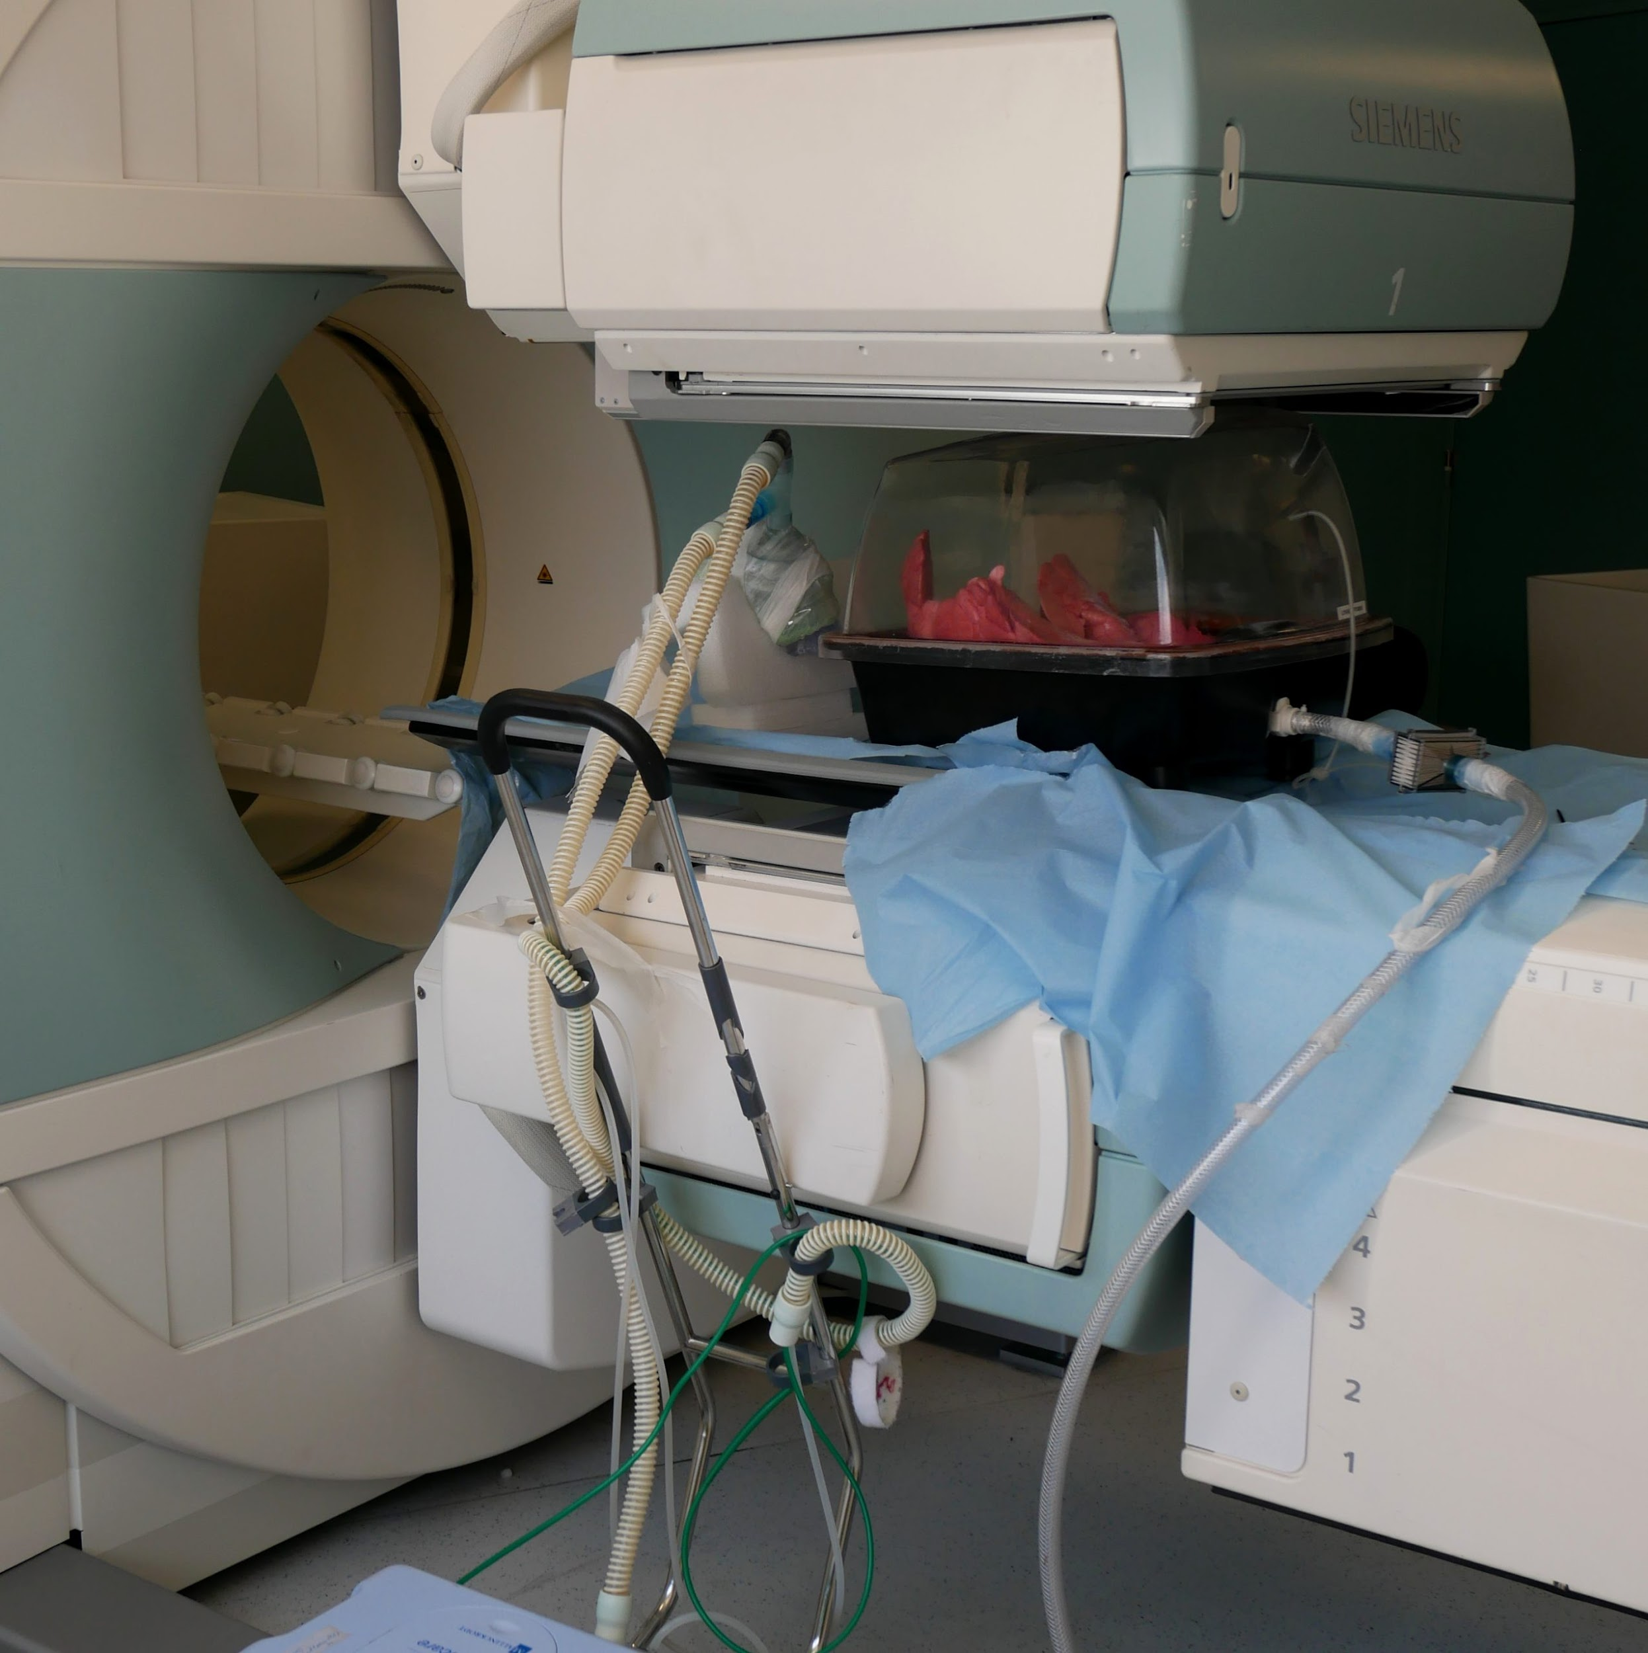
Radiopharmaceuticals
  Perfusion
    ^{99m}Tc-MAA (macroaggregated albumin)
  Ventilation
    ^{99m}Tc-DTPA
    Sulfur colloid aerosols

Slide 39
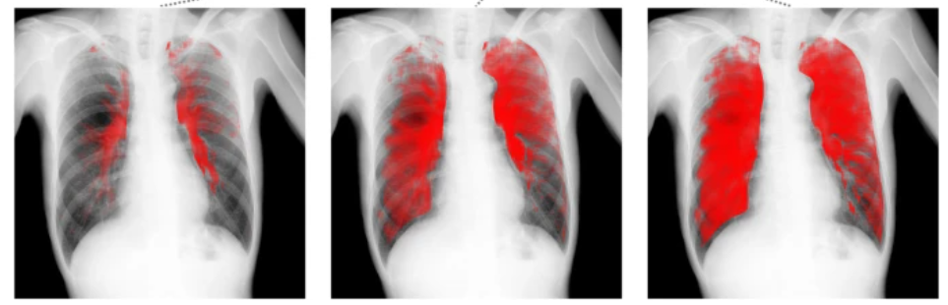
Indications
Pulmonary embolism
  CTPA is the gold standard for diagnosis
  V/Q scans are typically used when a patient has contrast allergy, chronic kidney disease, or pregnant
Chronic thrombo-embolic pulmonary hypertension (CTEPH)
  V/Q has similar or higher sensitivity in the diagnosis of CTEPH than CTPA
Quantitative function
(for pre-surgical purpose)

Slide 40
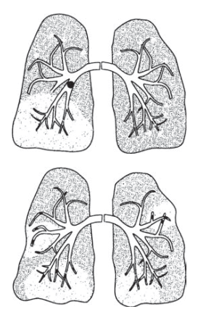

Notes:
size of defect depends of the size of emboli

Slide 41


Ventilation-perfusion mismatch (wedge-defect)

Slide 42


Slide 43


Slide 44


Strip sign

Slide 45

Fissure sign
Notes:
Pleural effusion or thickening, chronic lung disease, micro-emboli

Slide 46

Bone Scintigraphy
^{99m}Tc-MDP

Slide 47

Basics and Radiopharmaceutical
Bone scan used for cancer with osteosclerotic metastases.
  ^{99m}Tc Methylene Diphosphonate (MDP)
Which tumors do we get bone scans for?
  Mostly Breast and prostate cancer, while most other cancers use PET scan
Notes:
IV route of administration of activity

Slide 48

71-year-old male recently diagnosed with prostate cancer was referred to nuclear medicine to rule out bony metastases
Notes:
NORMAL due to symmetrical increased radiotracer activity in both AC, sternoclavicular, sacroiliac joints and the iliac crests.
Search Pattern Tips: Look for focal uptake outside the joints, especially in the axial and proximal appendicular skeleton

Slide 49

68-year-old male recently diagnosed with prostate cancer was referred to nuclear medicine to rule out bony metastases
Notes:
bone metastasis.

Slide 50

¹⁸F-FDG PET/CT
Bone Scan
Notes:
66-year-old man with metastatic renal cell carcinoma. (A) FDG-PET/CT shows numerous foci of intense FDG uptake in the bones. While some lesions have corresponding lytic lesions (bilateral iliac bones and see Fig. 4), the extent of FDG uptake is greater than the lucencies and others have no CT correlate (e.g., sternum, T7). (B) Bone scan significantly underestimates the amount of metabolically active bone metastases.

Slide 51

41-year-old female was referred to nuclear medicine to evaluate bilateral joint pain and morning stiffness
Notes:
Inflammatory joints disease

Slide 52

79-year-old female with back pain and vertebral loss of height on CT
Notes:
Osteoporotic fracture loss of height on CT

Slide 53

26-year-old female who recently started having to walk 15 km twice a day to get to and from work is now complaining from shin pain not responding to analgesia.
Notes:
The answer is Stress fracture, and we can differentiate from shin split (diffuse posterior-medially uptake)

Slide 54

Renal Scans

Slide 55

Diuretic Renography
Radiopharmaceuticals (dynamic)
  ^{99m}Tc MAG3
  ^{99m}Tc DTPA
Pharmacologic protocols: diuretics (e.g. furosemide)
Indications
Obstructive vs nonobstructive hydronephrosis
Stent function
Renal artery stenosis/thrombosis
Notes:
By

Slide 56


Normal
Notes:
NL

Slide 57

Notes:
Left obstruction

Slide 58

DMSA
Radiopharmaceutical
  ^{99m}Tc dimercaptosuccinic acid (DMSA) (Static)
Indications
  Relative function
  Pyelonephritis vs Scarring
  Pre-nephrectomy assessment

Slide 59

Notes:
NORMAL

Slide 60

Notes:
There is heterogeneous uptake of tracer in both kidneys, more marked on the left. In the left kidney, the outline is irregular with multiple wedge shaped areas of photopaenia in keeping with multiple renal cortical scars. In the right kidney, there is a focal defect in the interpolar region as well as irregularity at the inferior pole also in keeping with further scarring.
Renal function is asymmetric, with the left kidney contributing 35.7% to overall function and the right contributing 64.3%.

Slide 61

PET Imaging

Slide 62


Positron Emitting Tomography
Radiopharmaceutical
Radioactive fluorine is the most widely used (¹⁸F-FDG)
Also uses ¹¹C, ¹⁵O, ¹³N, ⁶⁸Ga
Notes:
Almost of the radiotracer used in PET are IV route

Slide 63

Indications
  Staging
  Response assessment
  Interim evaluation of treatment (lymphoma)
  Evaluation of suspected disease recurrence, relapse and/or residual disease
  Evaluation of indeterminate lesion
  Myocardial viability
  Localizing seizure foci

Slide 64

Complete Metabolic Response
Baseline
End of Treatment
Notes:
Patient with lymphoma showing generalized lymphadenopathy above and below the diaphragm showing CMR after Chemotherapy

Slide 65

Notes:
Different times for evaluation of response to therapy

Slide 66

Notes:
Types of response to therapy in lymphoma patient

Slide 67

Your education is a dress rehearsal for a life that is yours to lead

