Slide 1
Ophthalmic Examination and Glaucoma

Slide 2
Introduction to Ophthalmic Examination
Purpose: Assess eye health and vision function
Basic steps: History, Visual acuity, Ocular motility, Alignment, Eye structure exam

Slide 3
Equipment for Ophthalmic Examination
Direct ophthalmoscope: Examines fundus
Focused light: Examines pupil reaction & anterior chamber
Aspheric lens: Examines anterior chamber
Eye charts: Visual acuity testing at 5 meters (20 feet)
Binocular loupes: Remove corneal/conjunctival foreign bodies
Eyelid retractors and foreign-body needles for eye surface inspection
Recommended meds: topical anesthetic, sterile buffer, antibiotic drops, compresses, adhesive bandage

Slide 4
History Taking in Eye Examination
Family history: hereditary eye diseases (e.g. glaucoma, cataract)
Medical history: systemic diseases affecting eyes (e.g. diabetes, hypertension)
Ophthalmic history: corrective lenses, strabismus, trauma, surgery
Current symptoms: vision loss, pain, redness, diplopia, timing, trauma

Slide 5
Visual Acuity Testing
Test each eye separately, cover other eye lightly (palm or paper)
Use standardized eye charts (Snellen, Landolt rings, pictographs) at 5 meters
Visual acuity expressed as a fraction (e.g., 5/5 = normal)
If unable to see at 5 m, test at 1 m, then counting fingers, hand motion, light perception

Slide 6
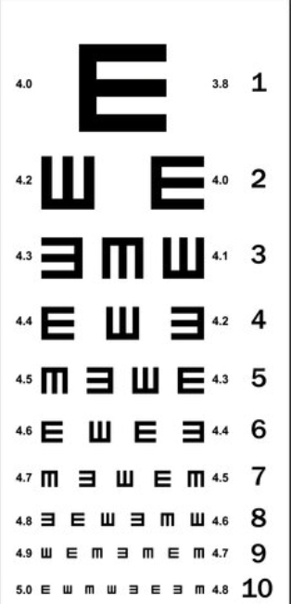

Slide 7
Ocular Motility
Test nine diagnostic gaze positions (straight, right, left, up, down, diagonals)
Detects strabismus, paralysis, gaze paresis
Cardinal directions test extraocular muscles
Figure: Positions of gaze (Fig. 1.5)

Slide 8
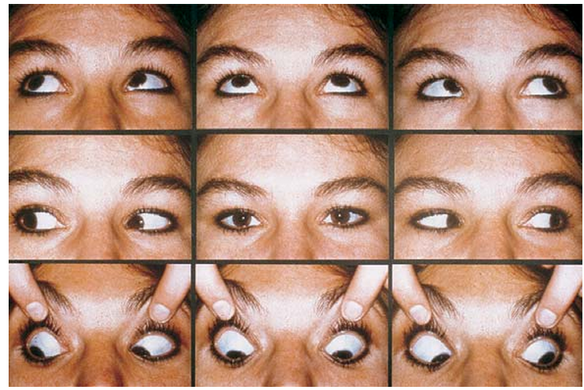

Slide 9
Binocular Alignment (Cover Test)
Shine light at 40 cm and 5 m to observe corneal light reflex
Normal reflex: centered on pupil
Tropia: off-center reflex; uncovered eye shows compensatory movement
Cover one eye, observe movement of uncovered eye, then repeat other eye
Figure: Cover test (Fig. 1.6)

Slide 10
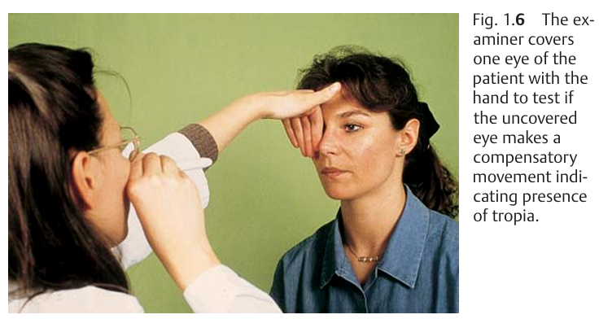

Slide 11
Eyelid and Nasolacrimal Duct Examination
Eyelids cover cornea margins, check for redness, swelling
Nasolacrimal duct stenosis: tear pooling and reflux of mucus/pus
Patency tested with fluorescein dye in conjunctiva
Probing/irrigation by ophthalmologist only

Slide 12
Examination of Conjunctiva
Inspect bulbar conjunctiva directly; evert eyelids for palpebral conjunctiva
Normal: smooth, shiny, moist
Look for redness, secretion, scars, foreign bodies
Lower eyelid eversion: patient looks up, pull eyelid down (Fig. 1.7)
Upper eyelid eversion: patient looks down, use swab or glass rod (Fig. 1.8)
Full eversion with Desmarres retractor by ophthalmologist (Figs. 1.9a,b)

Slide 13
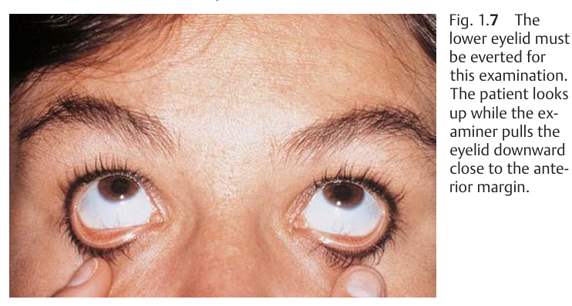

Slide 14
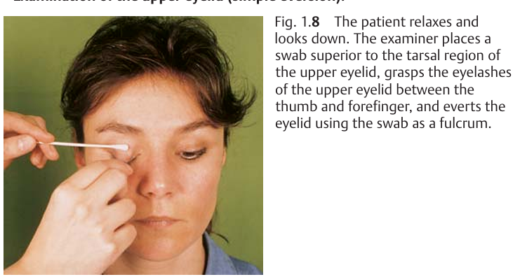

Slide 15
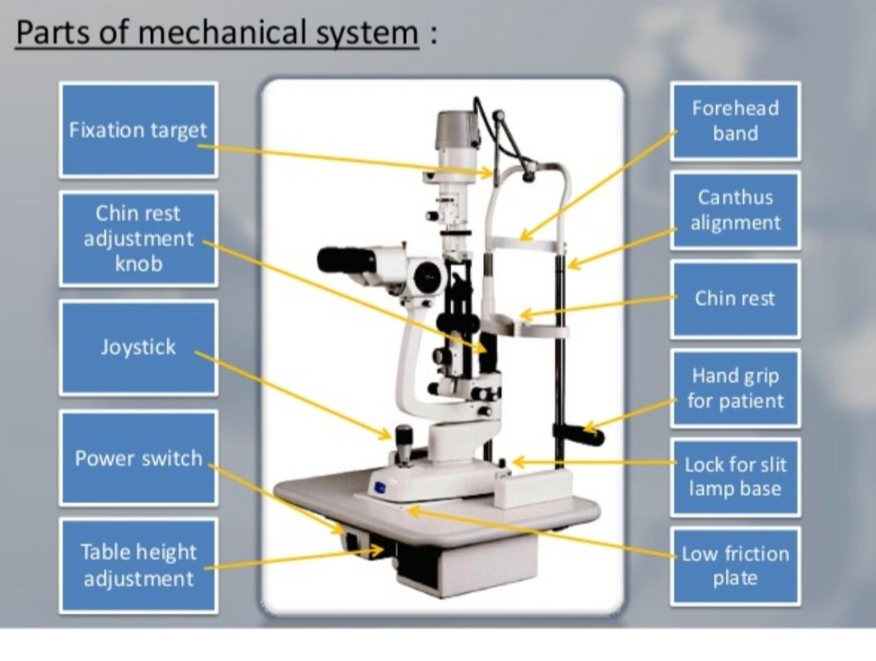

Slide 16
Examination of the Cornea
Use point light and loupe for inspection
Cornea: smooth, clear, reflective
Fluorescein stain: highlights epithelial defects (green), infiltrates (gray-white)
Test corneal sensitivity with cotton swab; compares both eyes (Fig. 1.11)

Slide 17
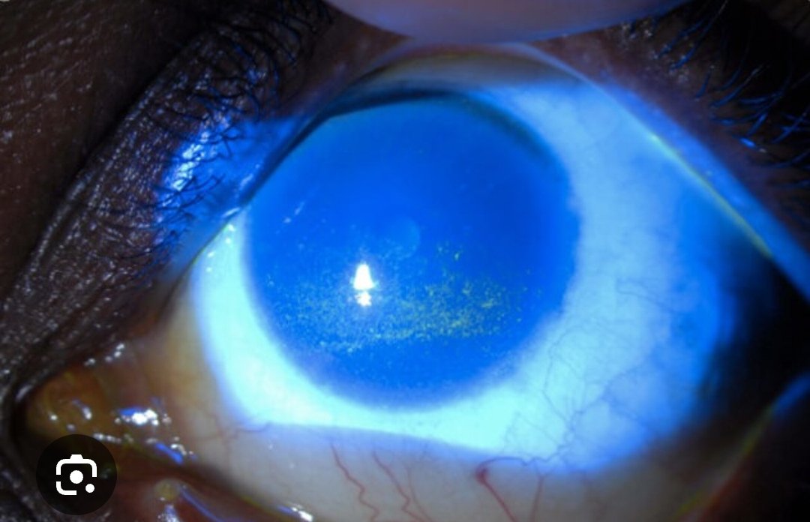

Slide 18
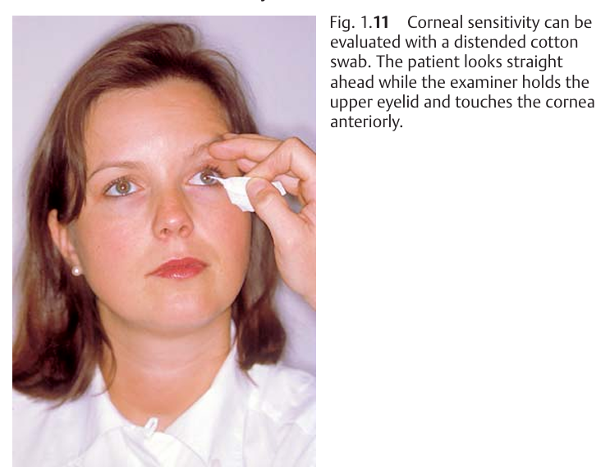

Slide 19
Anterior Chamber Examination
Filled with aqueous humor; look for cells, pus (hypopyon), blood (hyphema)
Assess depth with lateral light source
Normal: iris well illuminated
Shallow chamber: medial shadow on iris (risk for angle-closure glaucoma)
Avoid pupil dilation if shallow anterior chamber

Slide 20
Lens Examination
Use slit lamp or focused light + +14D loupe
Normal lens: clear, red reflex from fundus visible
Opacities = cataract (gray shadows or clouding)

Slide 21
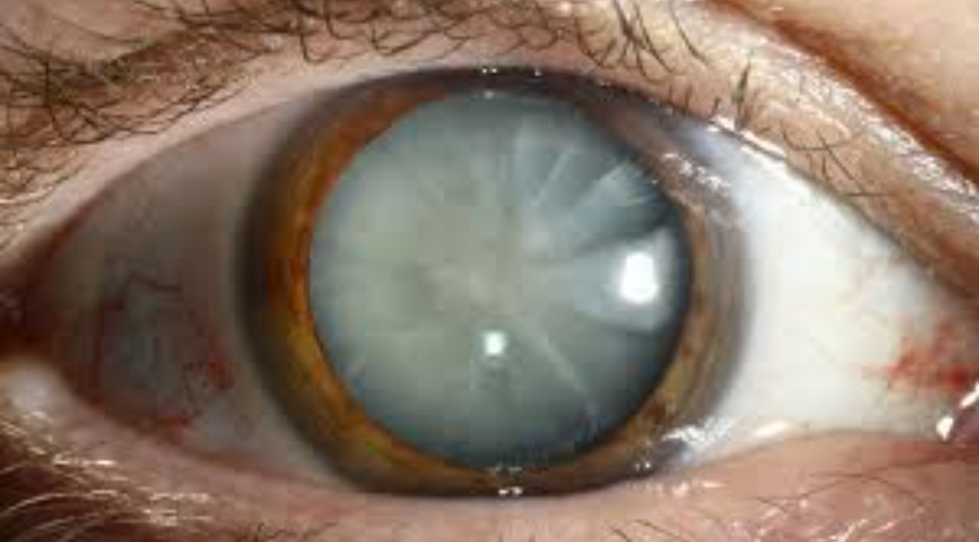

Slide 22
Ophthalmoscopy
Direct ophthalmoscopy: erect, 16x magnified image of retina
Patient's right eye examined with examiner's right eye (nose does not interfere)
Identify optic disc, vessels, macula, fovea
Normal optic disc: yellow-orange, central excavation
Spontaneous venous pulse normal; arterial pulse abnormal

Slide 23
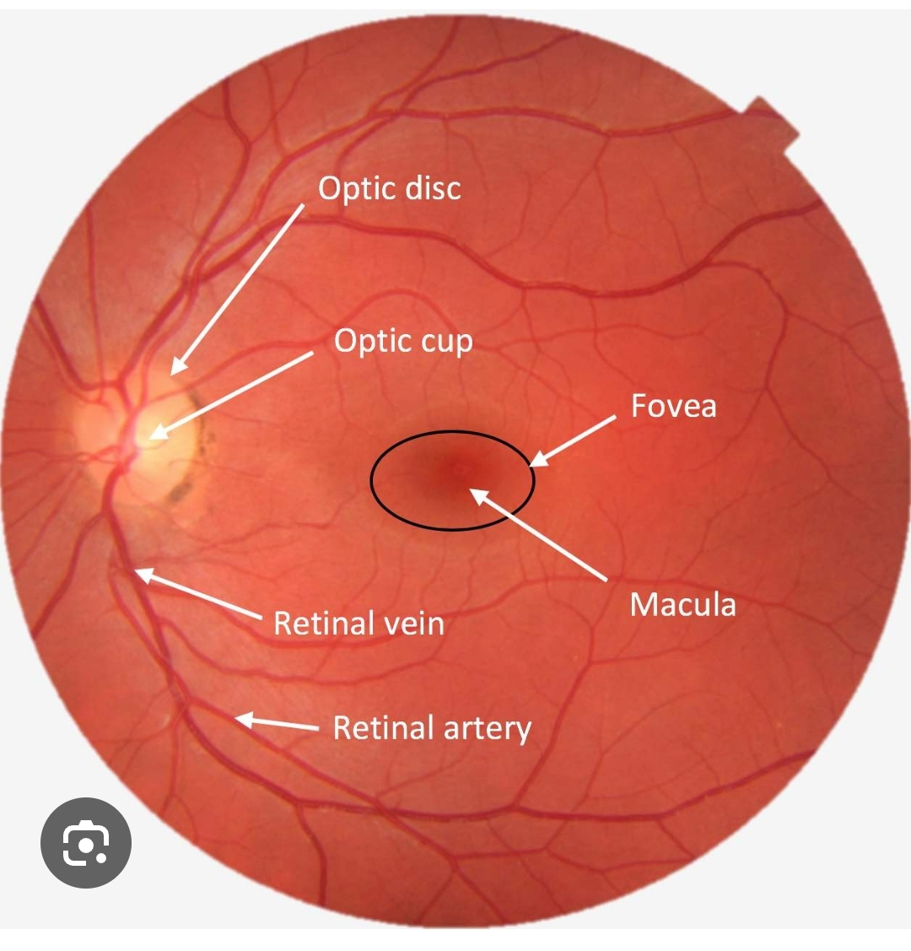

Slide 24
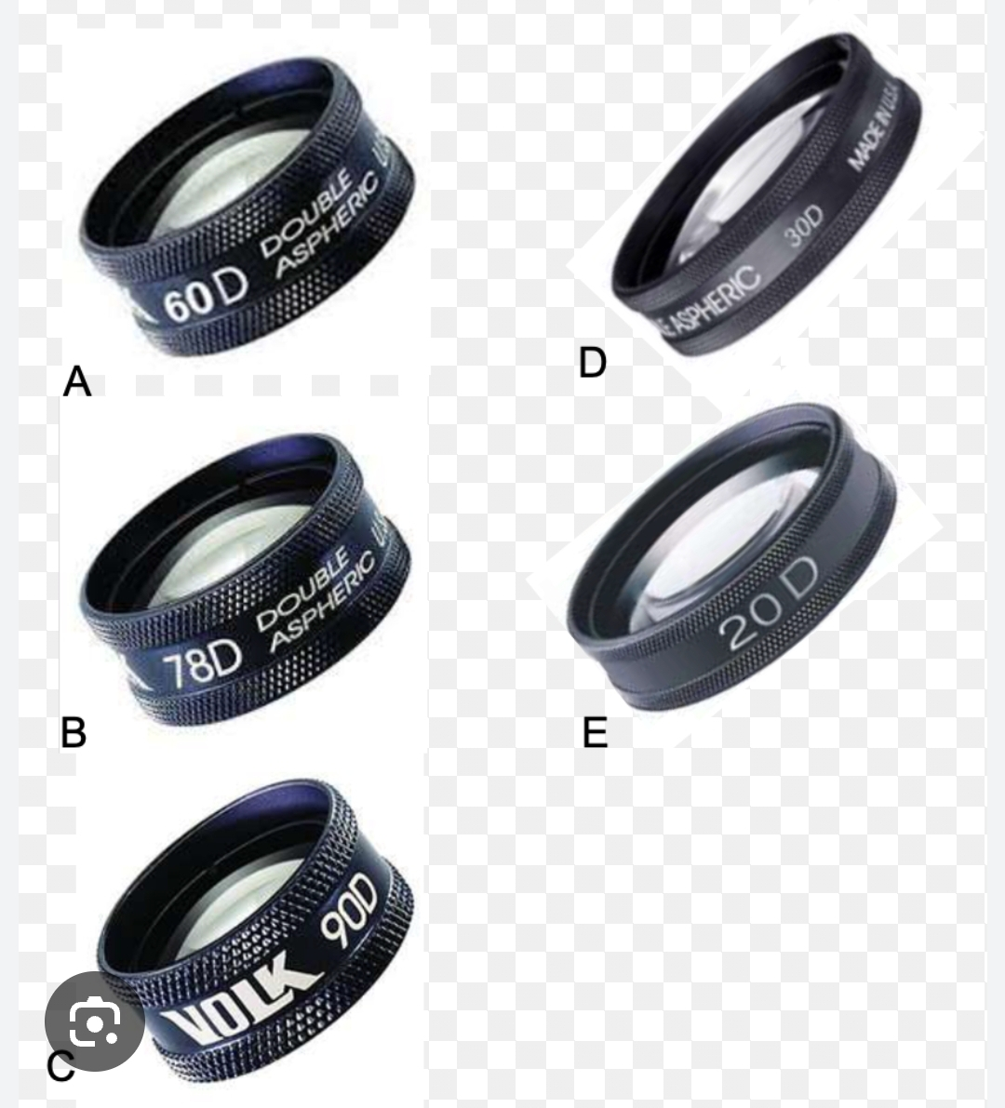

Slide 25
Visual Field Testing (Confrontation)
Gross screening when formal perimetry unavailable
Patient and examiner face each other at 1 m, each covers one eye
Examiner moves object from periphery toward midline in four quadrants
Patient reports when object seen; delay indicates field loss
Detects homonymous hemianopsia, quadrantanopsia
Figure: Confrontation test (Fig. 1.14)

Slide 26
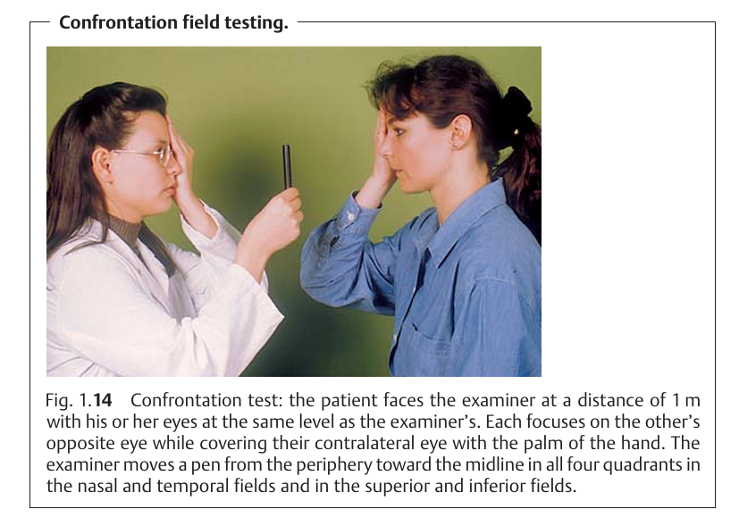

Slide 27
Intraocular Pressure (IOP) Measurement (Palpation)
Palpate closed eyelid with both index fingers to assess globe firmness
"Rock-hard" eye suggests acute angle-closure glaucoma
Mild chronic glaucoma not palpable

Slide 28
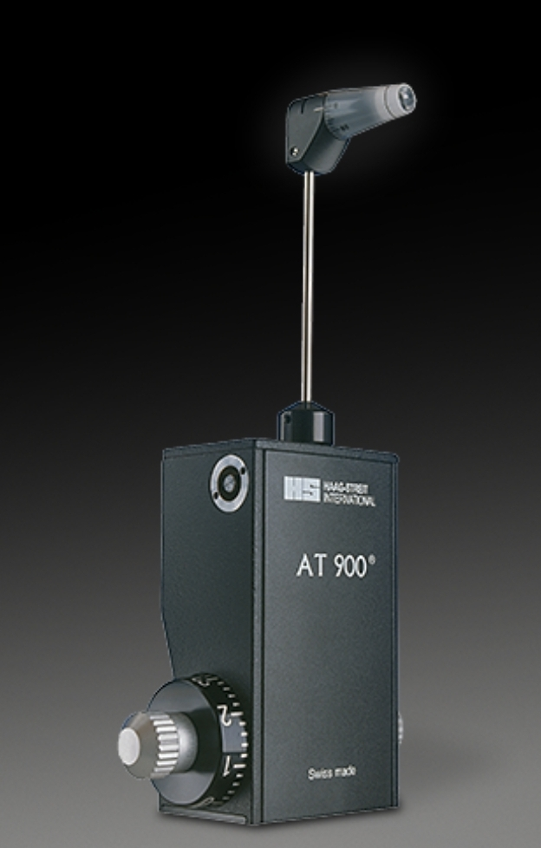
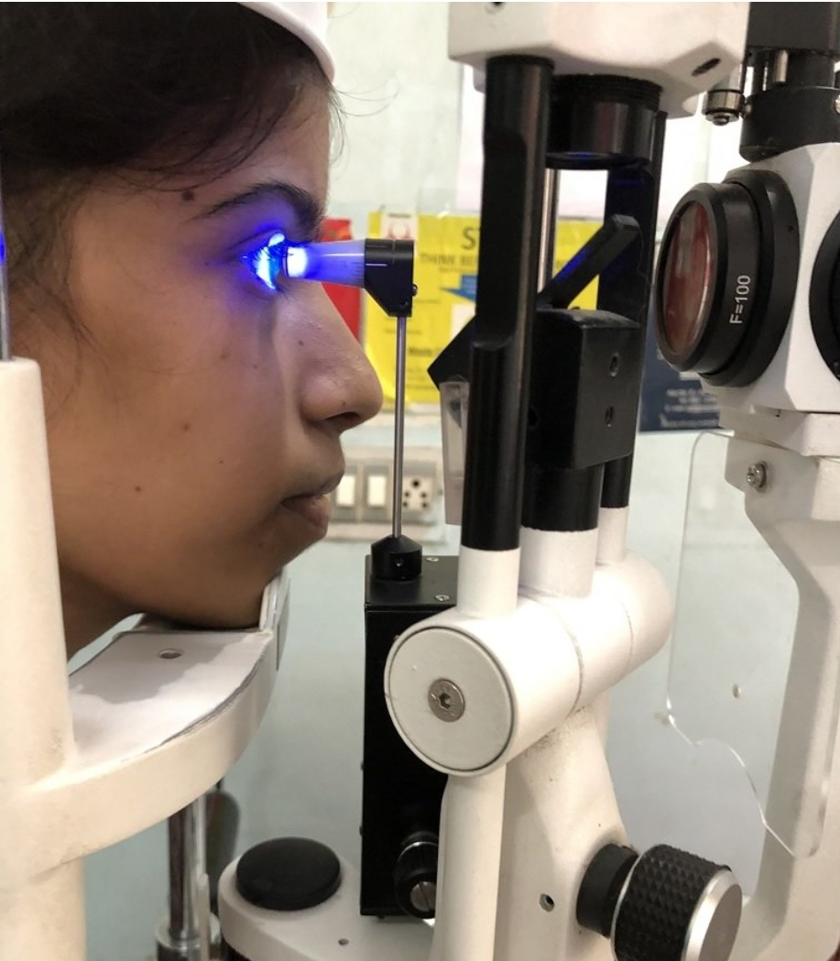

Slide 29
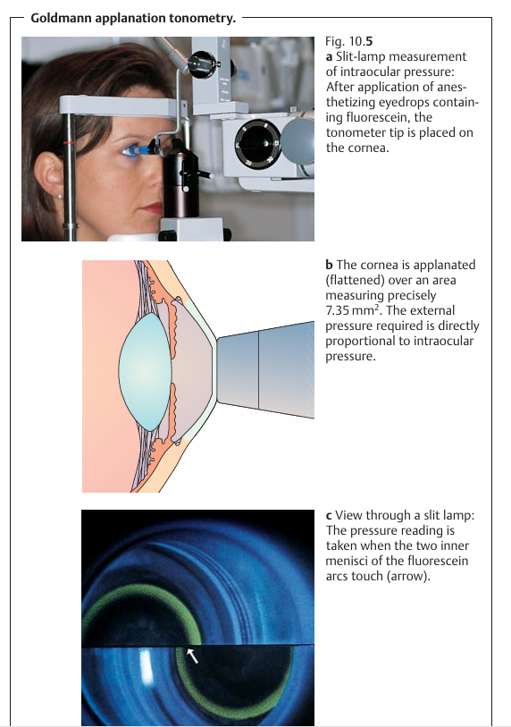

Slide 30
Administration of Eye Drops, Ointments, and Bandages
Drops/ointment given posterior to everted lower eyelid in conjunctival sac
One drop or 1 cm ointment strip
Patient supine or seated with head tilted back
Avoid contact of bottle tip with eyelashes
Ointment contraindicated after ocular trauma
Eye bandage applied with sterile material fixed with tape
Figure: Eye drops administration (Fig. 1.16)

Slide 31
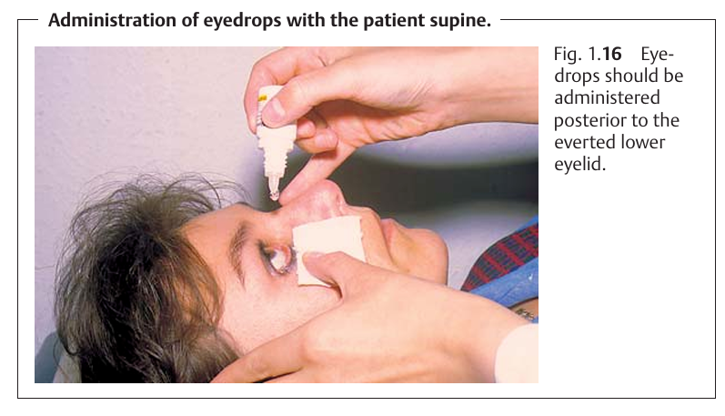

Slide 32
Glaucoma

Slide 33
Define glaucoma!

Slide 34
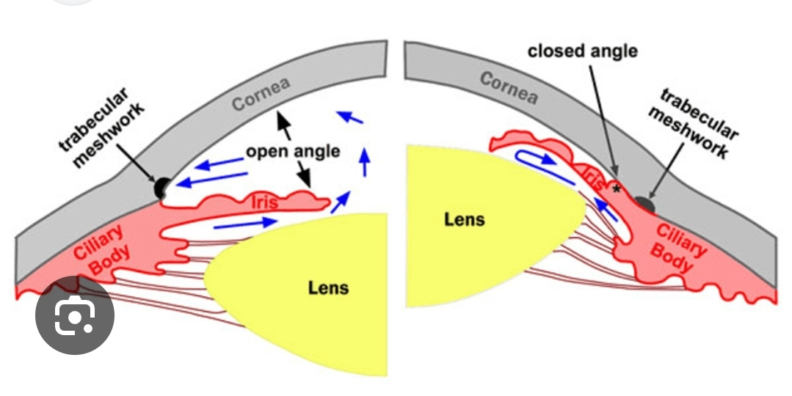

Slide 35
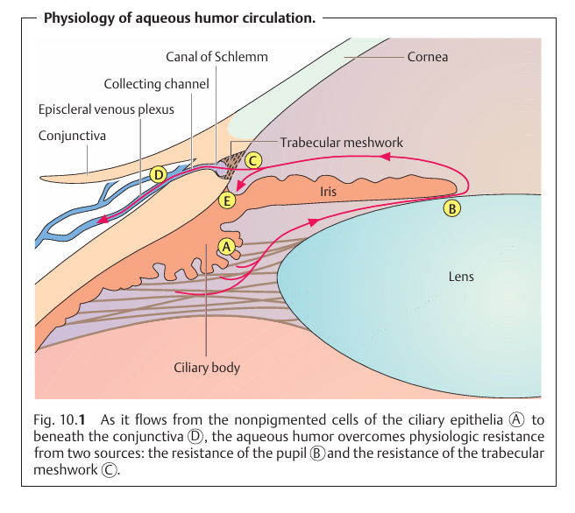

Slide 36
Glaucoma
Primary
Secondary
Open -angle
Closed -Angle

Slide 37
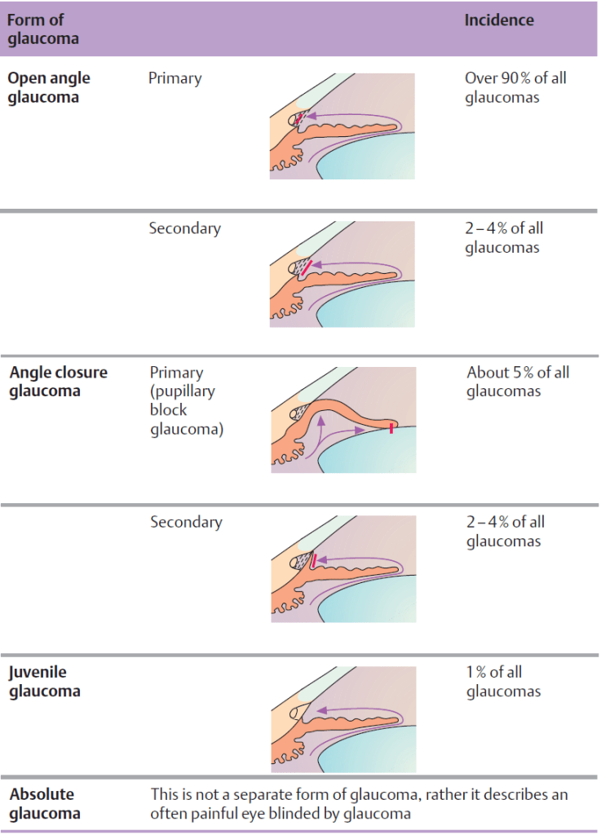

Slide 38
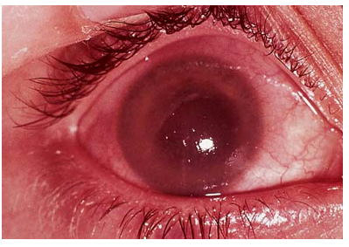

Slide 39
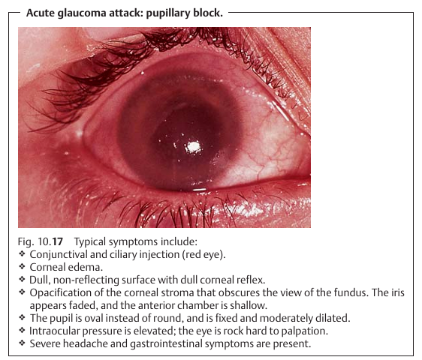

Slide 40
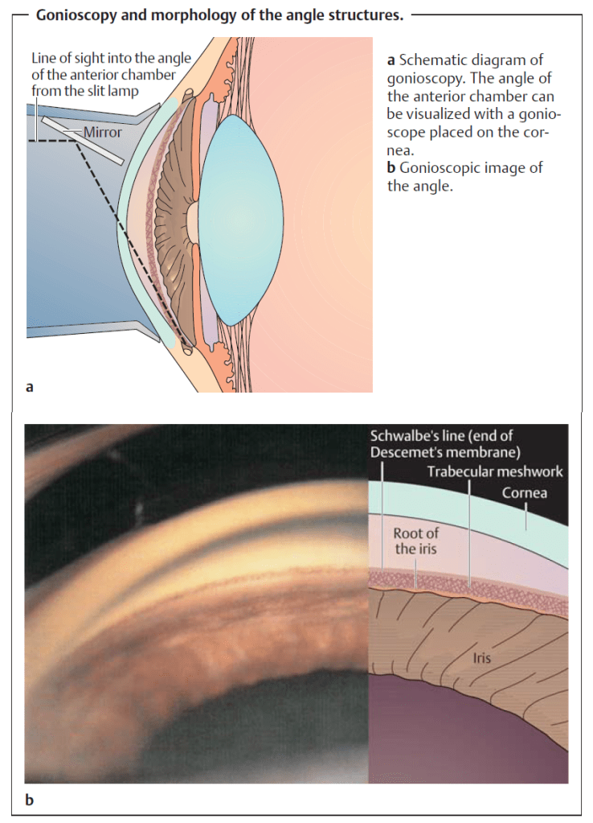

Slide 41
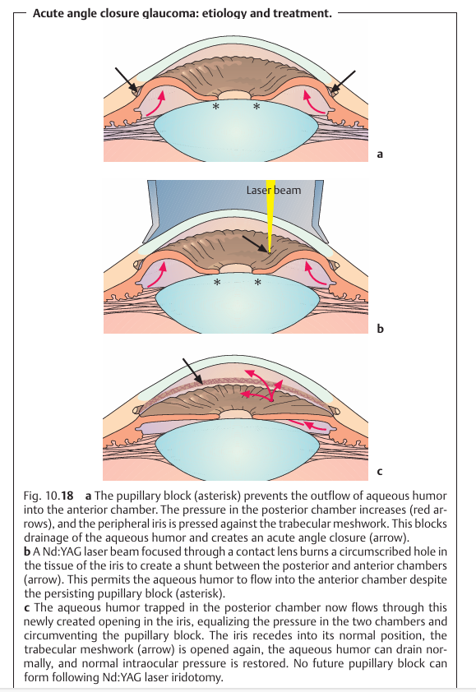

Slide 42
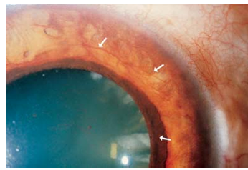

Slide 43
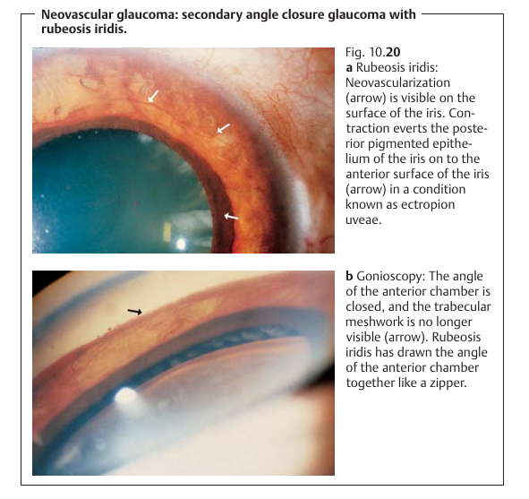

Slide 44
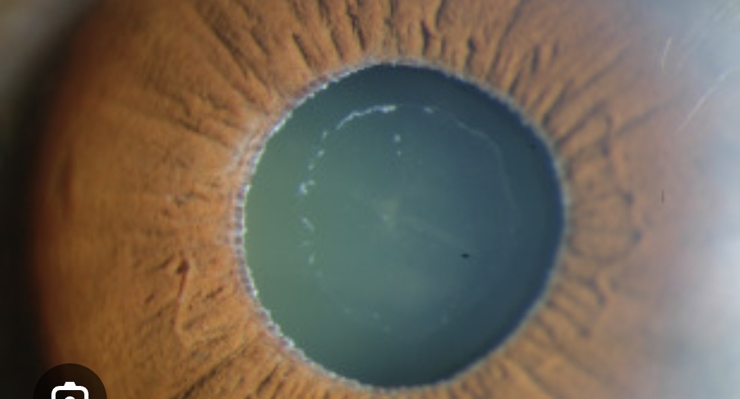
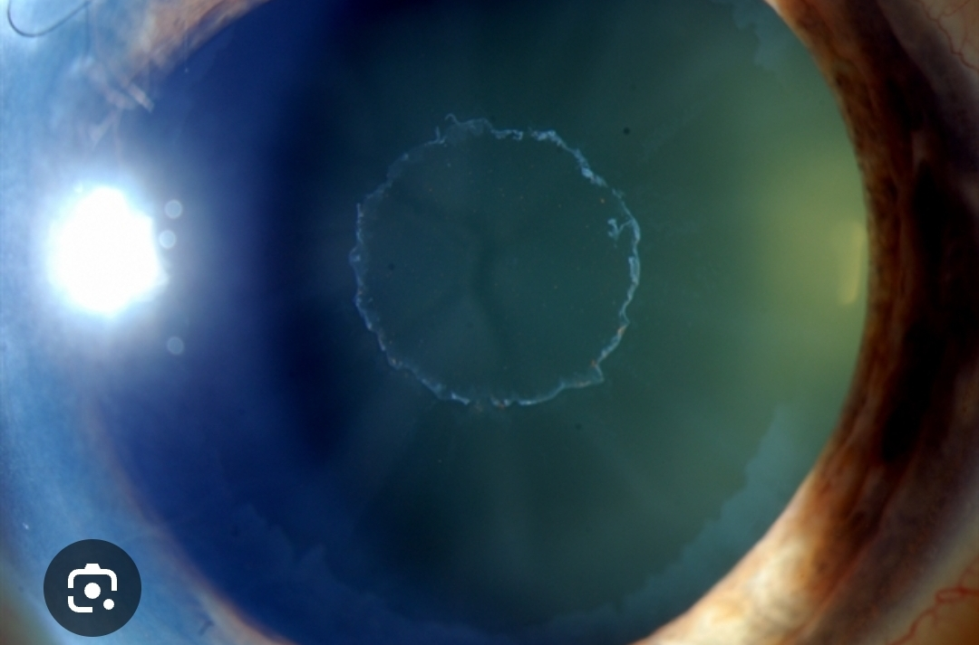
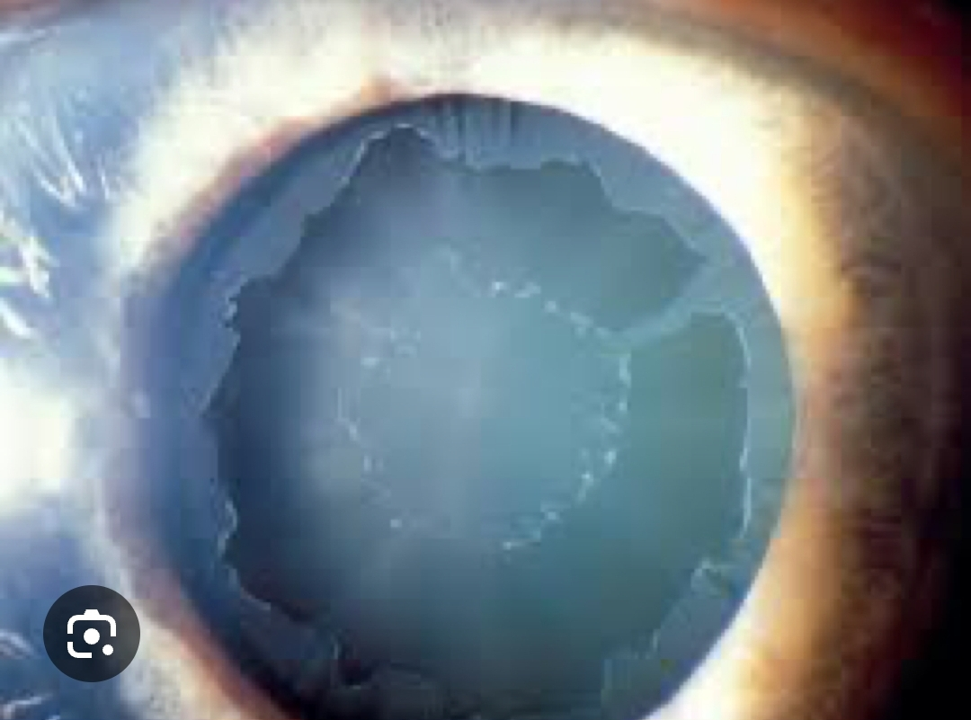

Slide 45
NTG
Congenita Glaucoma

Slide 46
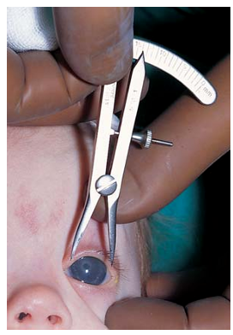
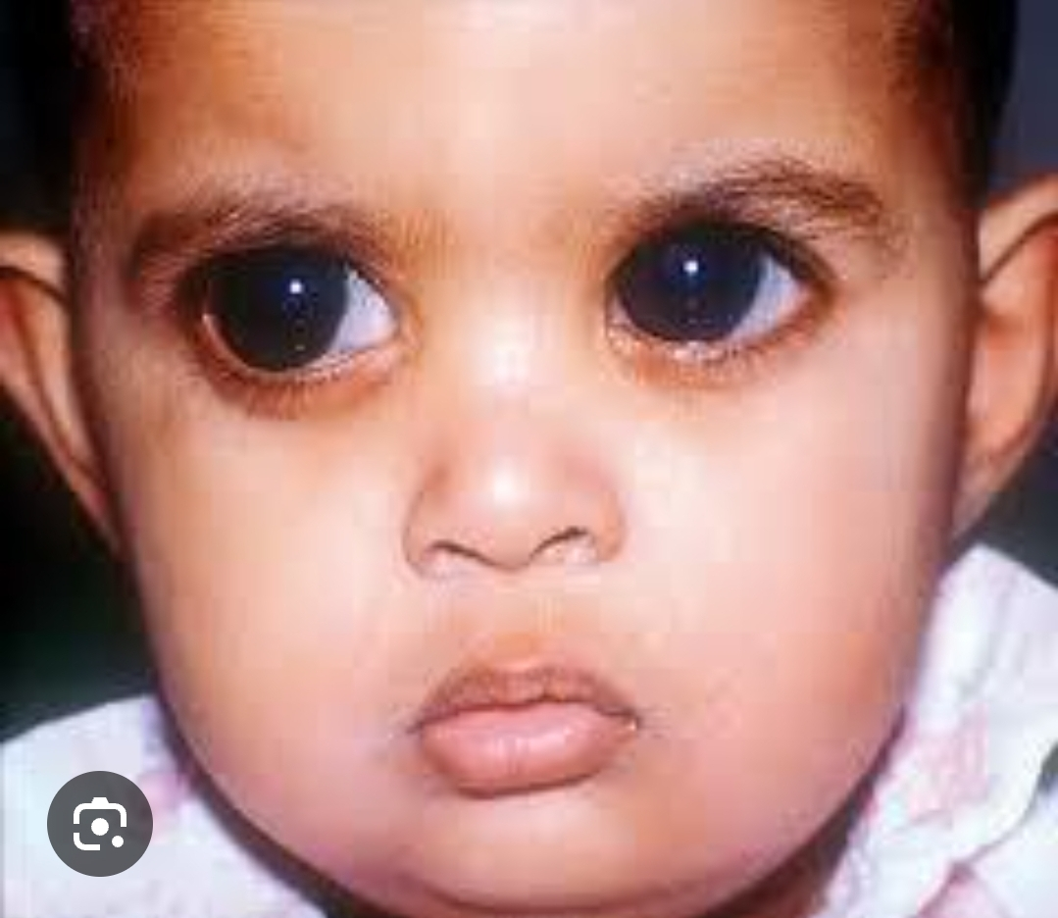

Slide 47
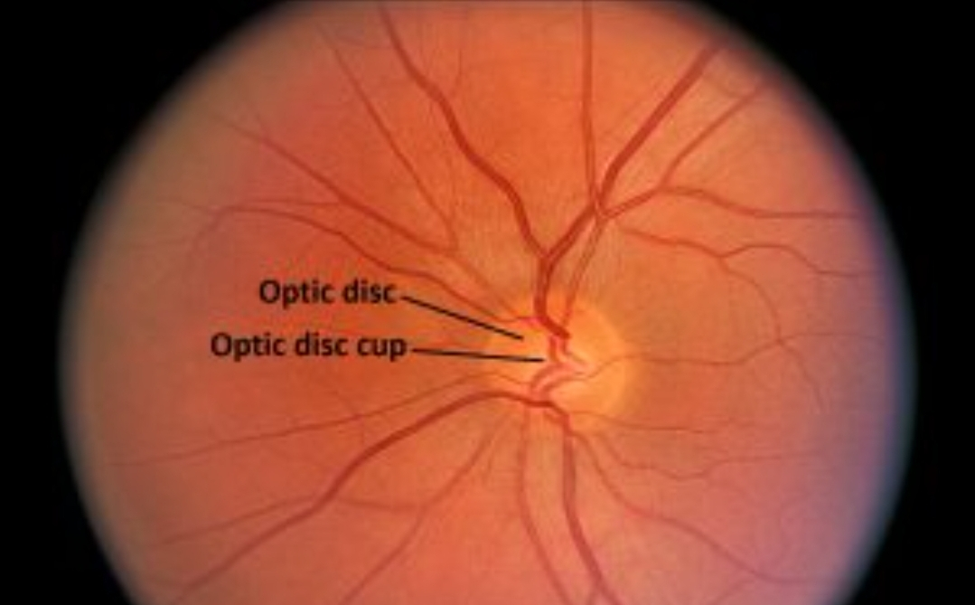

Slide 48
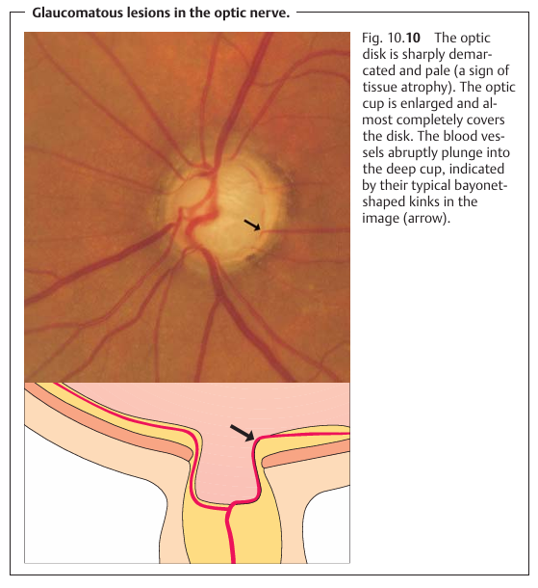

Slide 49
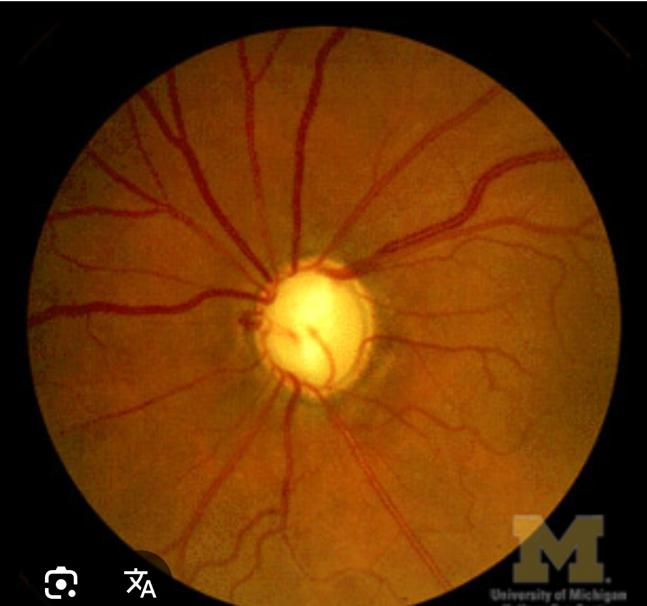

Slide 50
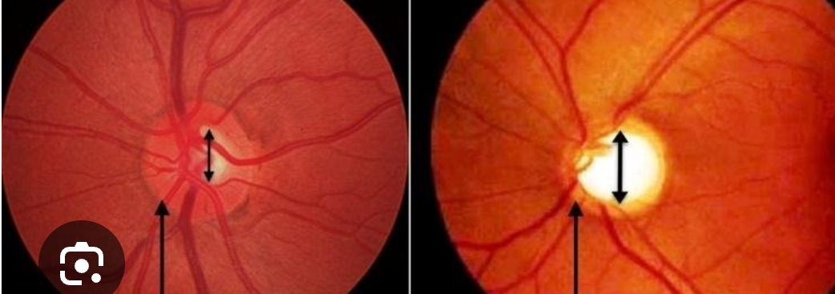

Slide 51
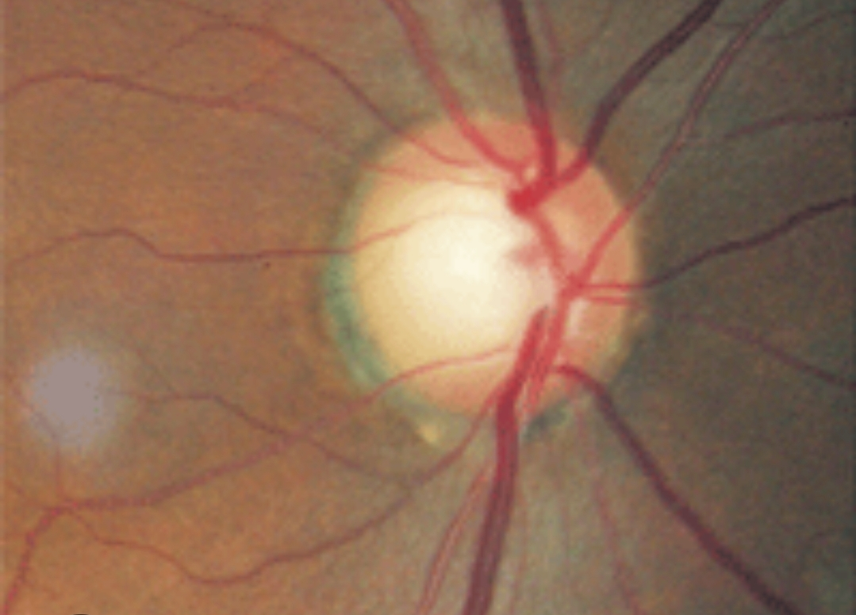

Slide 52
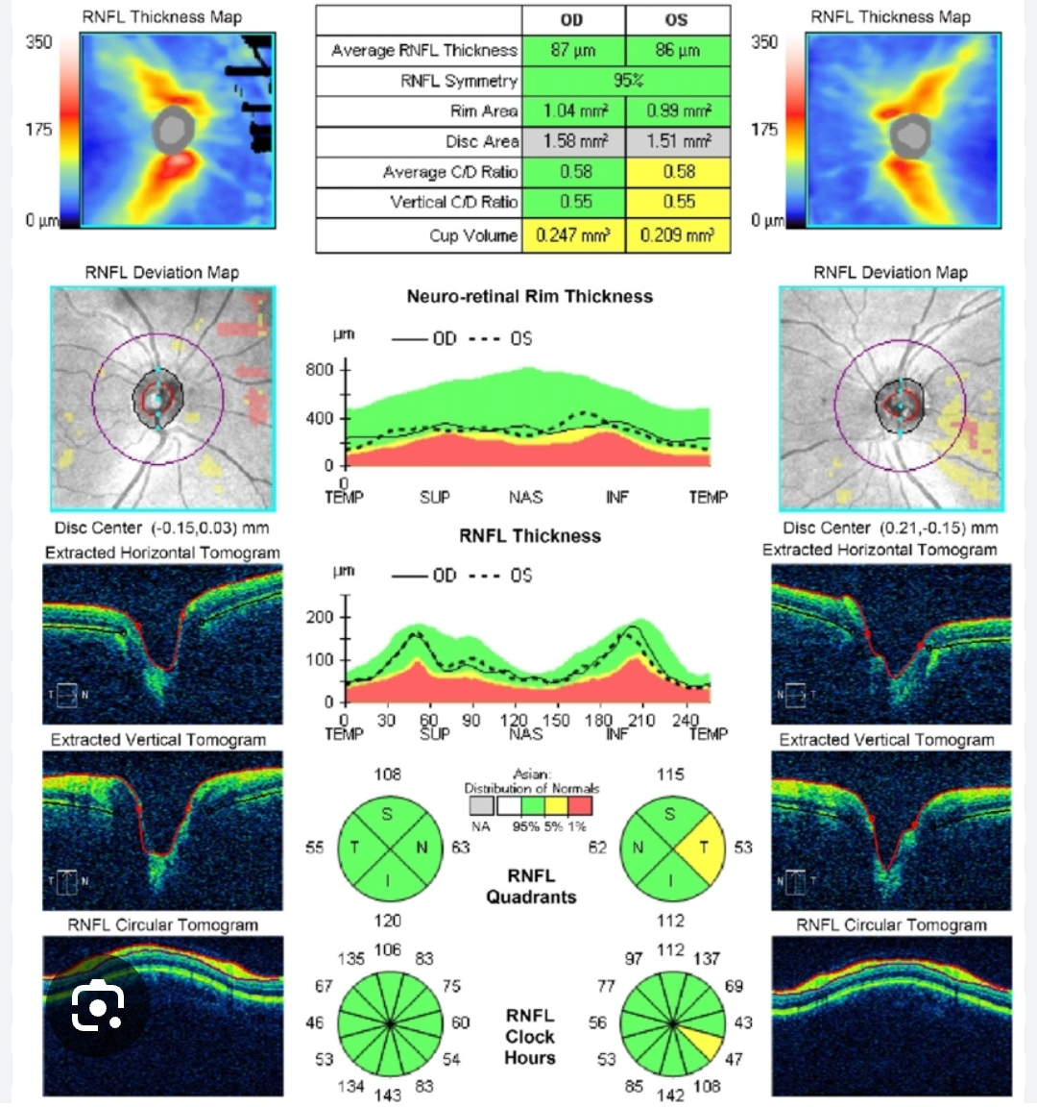

Slide 53
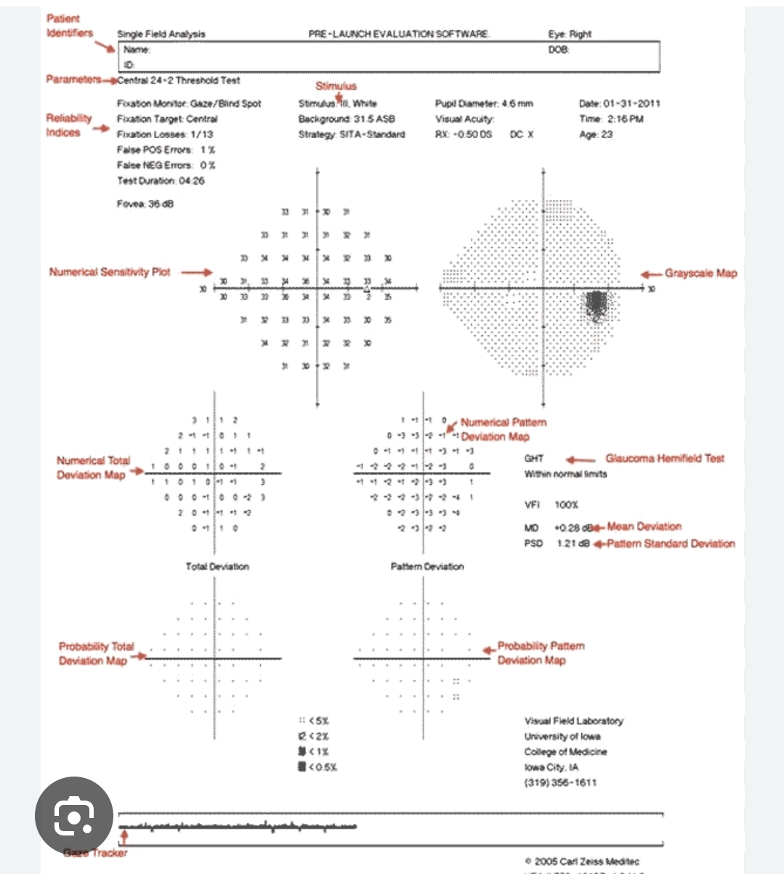

Slide 54
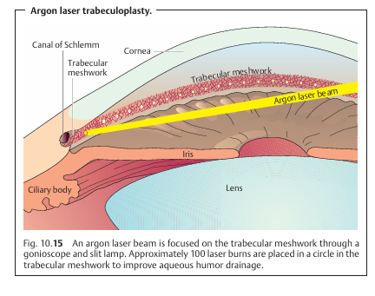

Slide 55
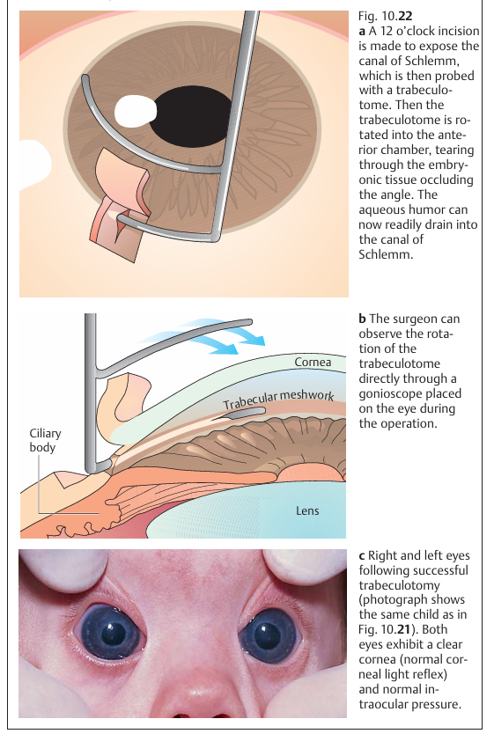

Slide 56
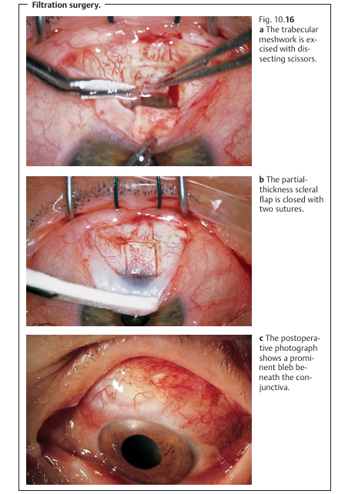

Slide 57
